Slide 1


Best Marketing Ideas for Association Education & CPE
CPA Educators Conference
San Antonio - February 25, 2016
With William A. Draves, CAE, President of LERN
© Learning Resources Network (LERN) Do not reprint without express written consent from LERN info@lern.org
1

Slide 2
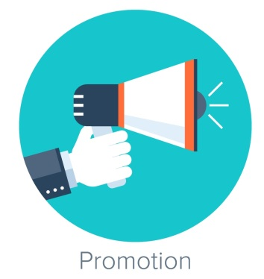
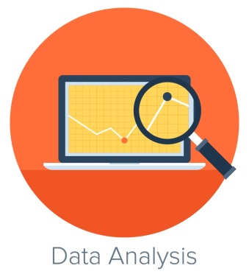

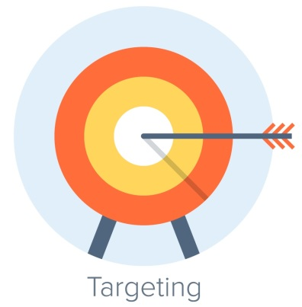
Agenda
Part I. Best Marketing Practice for 2016
Part II. Analyzing Your Data
Part III. The Coming Change in Learning
Part IV. Your Questions

Slide 3



Part I. Best Marketing
Keep Print for High Dollar Events
Emotional attachment, even for Gen Y

Slide 4

Print Brochure
YES – Print Brochure
State
Conference
Preliminary Conf
Catalog of
Courses*
Any event
priced over $295
(maybe $195)*
* Includes online
courses and events
NO – Probably No Print
Webinars
under $295
Self Study online
priced under $195
Half day seminars
Any event priced
under $195
(maybe $295)

Slide 5
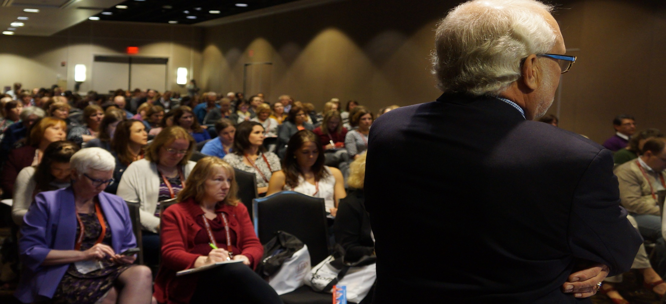
New this year
1.Your refund policy is all wrong.
Guarantee your programs
2.Keep your registration form in the brochure

Slide 6
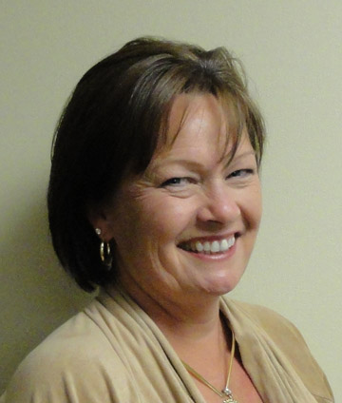
Two Best Customers Lists?
If you have a big seasonal event, such as your annual conference, you may have two
Best Customer Lists.
MORE
-Page Analysis
-Integrated Marketing
Lisa Beytein-Carlson

Slide 7
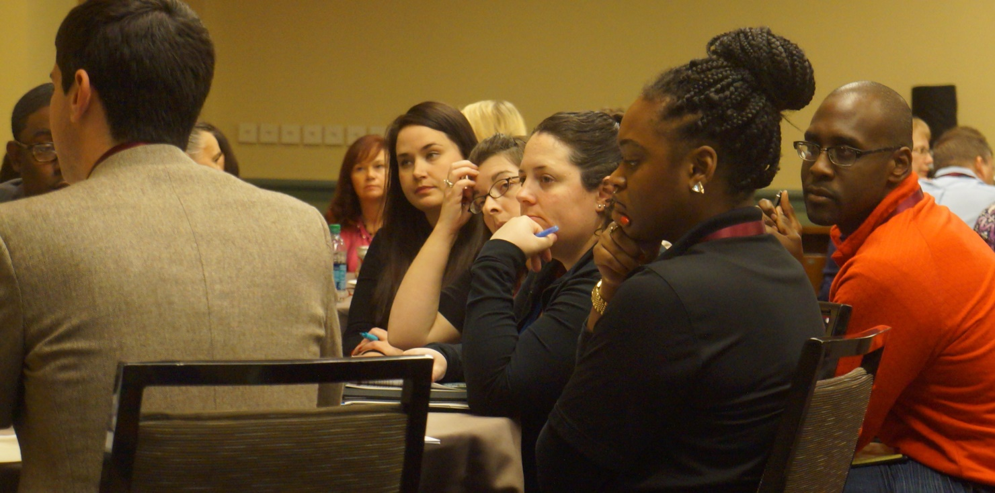

If you don’t have a Gen Y advisory board, get one quick!
Analyze everything
By Generation
Gen Y generation gap getting bigger, not small, culture more different

Slide 8
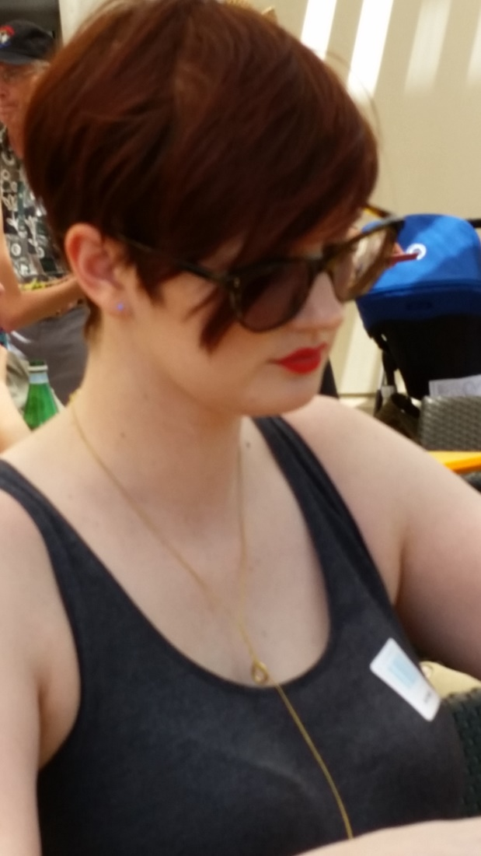
Social Events
Formats – Roundtable
New one?
Presenters
Questions and Issues
Leadership
New Skills for the 21st Century
Crisis in conference meals?

Slide 9
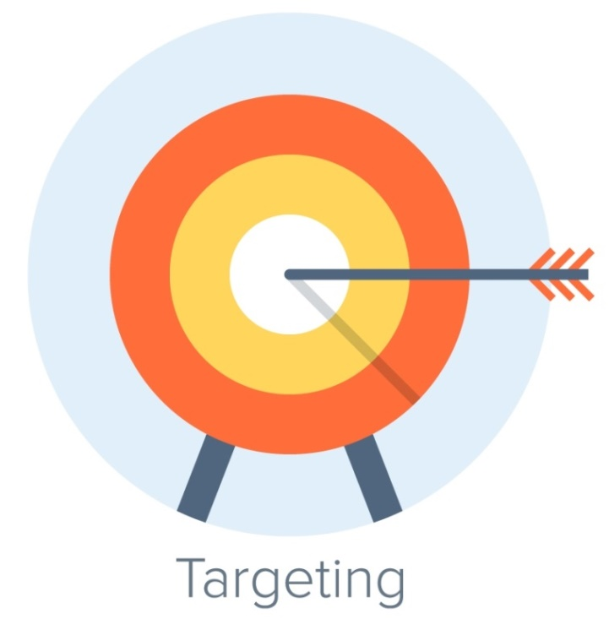
What Data To Collect
Address
Birth Year
Occupational Subspecialty
Each best customer, and those best potential customers, will fall in 1 of 7 market segments
based on the segment demographics.

Slide 10
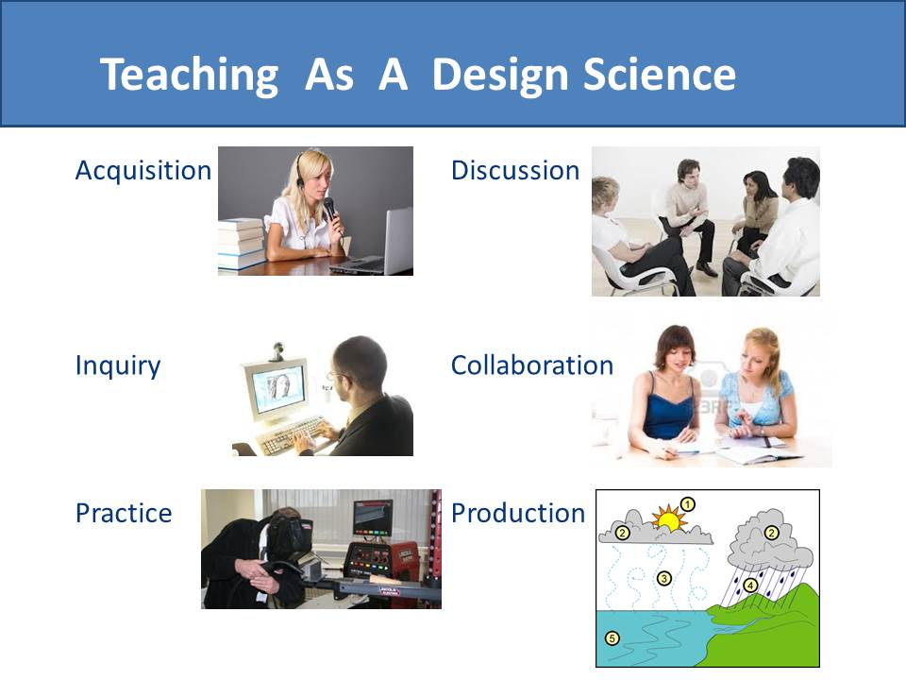
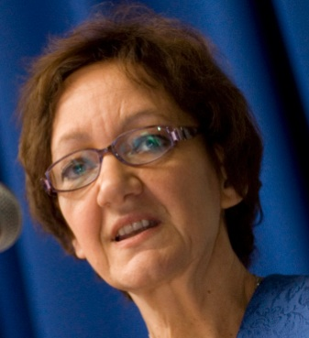
Diana Laurillard

Slide 11
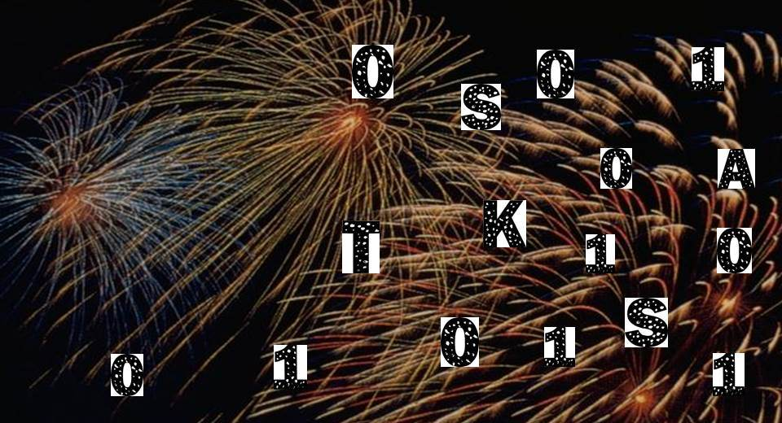

More
Data
Analysis
Professionals in our field,
Particularly women,
Need more math skills

Slide 12

Mail 2 Weeks Earlier

Slide 13
3 times
2nd or 3rd time
Best
Customers
2 Times
Customers +
Same Demographics
1 time
Non-Customers
13
Notes:
Mail 3 times to your best prospects and past participants.
Mail the same package twice.
Mail a different package the second or third time.

Slide 14

Email should be
Around 15% of Promotion

Slide 15
Email
Promotion
Every member and customer should get at least one email a month. But not the same one.
Stop doing email ‘blasts’ - - one email to everyone.
Start customizing emails to your 7 primary member segments and targeting more
Figure out the saturation/spam point.
It probably is somewhere between 1 and 4 emails a week when members holler.

Slide 16
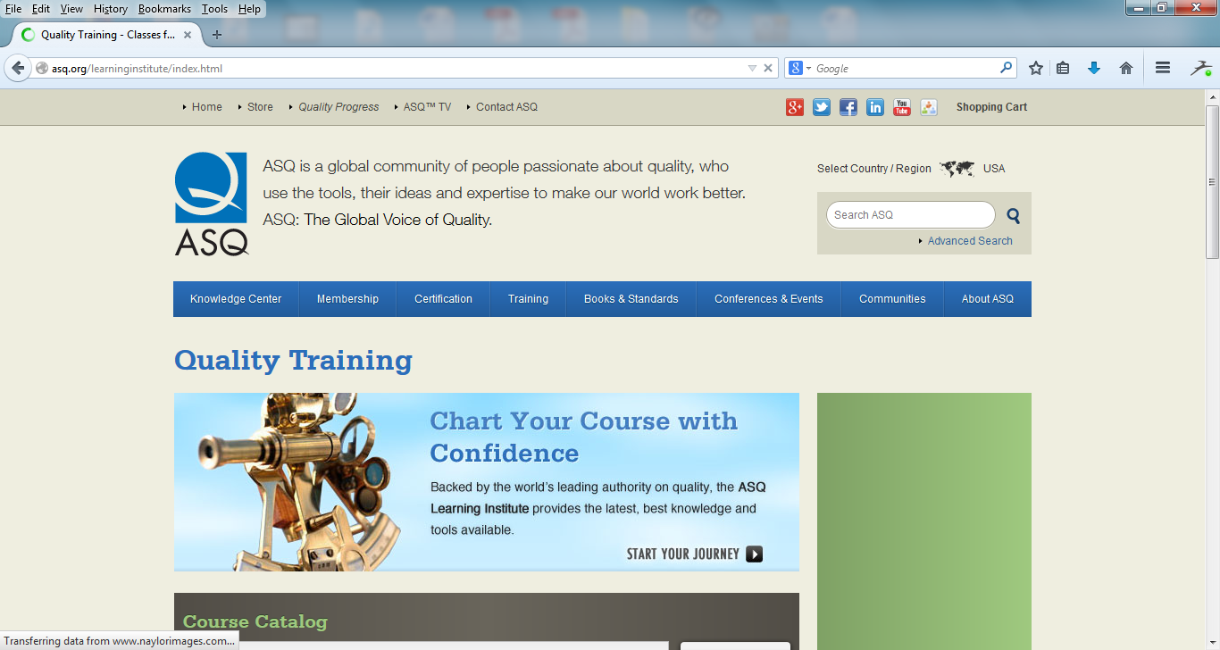

Slide 17
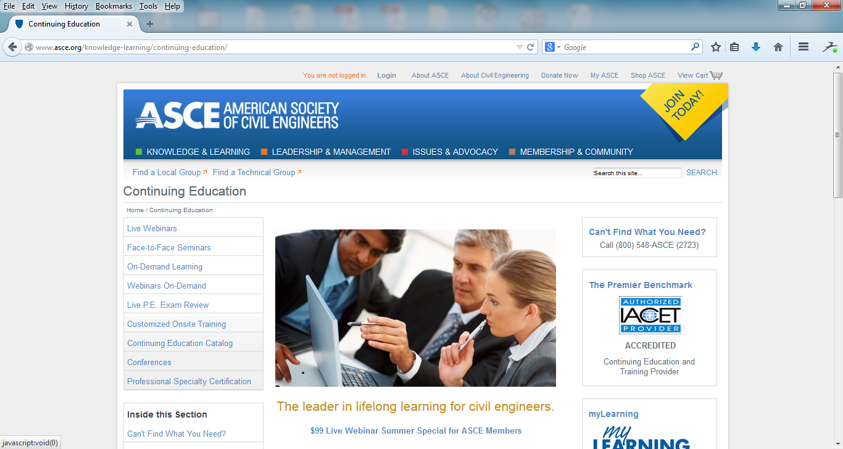

Slide 18
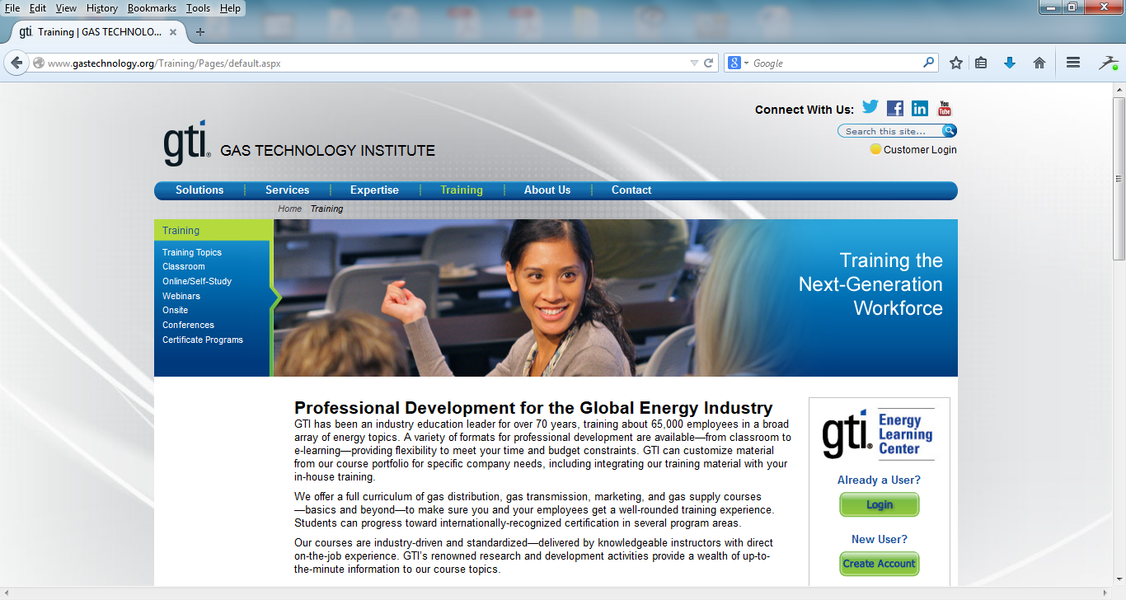

Slide 19
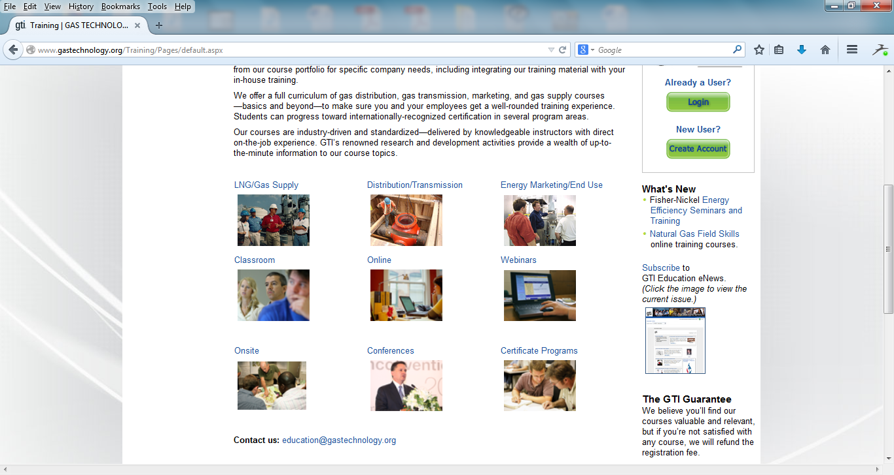

Slide 20
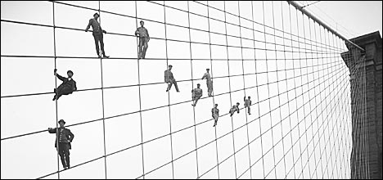
Focus on Customer Retention

Slide 21
Follow Up on Inquiries
Send 1 item out within 24 hours of inquiry
Send 2nd item out within 3 days of inquiry
Follow up the next week after an inquiry
Put the person’s name and data in your database!

Slide 22
Part II:
Analyze Your Customer Data

Slide 23
Chart 2:
Association CPE Participants

Slide 24
Chart 3: Operating Margin

Slide 25
Chart 6:
Efficiency Strategy

Slide 26
Chart 1: Your Customers

Slide 27
Best Marketing Ideas for Association Education & CPE
Thanks for being here!
With William A. Draves, CAE, President of LERN
© Learning Resources Network (LERN) Do not reprint without express written consent from LERN info@lern.org
27

