Slide 1
Creating Department Recreation and Parks Program Plans
LERN WEBINAR 2016
Laura T. Wetherald, CPRP
Bureau Chief of Recreation, Howard County, MD
lwetherald@howardcountymd.gov

Slide 2
Overview of the Session
Introduction
10 Basic Programming Areas
CAPRA Standard 6.1 Recreation Program Plan
Foundations of Recreation and Leisure
Meeting Constituents Needs
Agency Role in Philosophy and Goals
Programming Breakdown within an Agency
Program Function Areas
Programming in Facilities
Questions and Answers

Slide 3
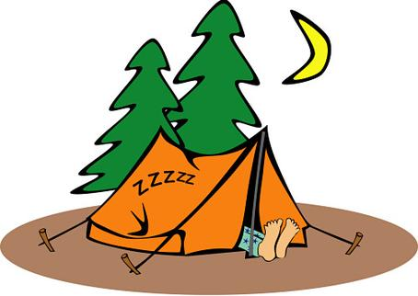
10 Basic Program Areas
Volunteerism/Service Opportunities
Special Events/Social Recreation
Music and Dance
Sports, Fitness and Games, Health and Wellness
Visual Arts/Arts and Crafts

Slide 4
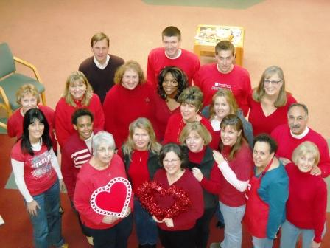
10 Basic Program Areas
Outdoor Recreation/Adventure/Nature /Environmental Activities
Drama
Self Improvement/ Hobbies, Leisure Ed
Cognitive and Literary, STEM and Computer Learning and Gaming
Trips and Tours/ Local Tourism and Sport, Eco and Heritage Tourism

Slide 5
Macmillan Matrix
Fit-the degree to which a program belongs or fits within the agency
Financial Capability- the degree to which a program is attractive to the organization from a financial perspective
Alternative Coverage-are similar services provided, are there few or now comparable programs being provided in the county/city/agency?
Competitive Position-is the degree to which the organization has a stronger capability and potential to deliver the program than other agencies
                Shared from Sasaki and Heller and Heller Consultants

Slide 7
Program Lifecycle
Look at your program areas and determine the program lifecycle.
  Introduction-New program within the last year, program growth is modest but could take off
  Growth-consistent participation growth
  Mature-continued but slow participation growth
  Decline- declining participation
                Sasaki and Heller and Heller Consultants

Slide 8
CAPRA 6.1 Recreation Program Plan
Standard :
The agency shall have a recreation programming plan covering 3-5 years that is updated periodically and a current year implementation plan. The plan shall address all programs and services of the agency’s programming functions, including activity selection, type and scope of programs and outreach initiatives.

Slide 9
6.1 Evidence of Compliance
Provide the current recreation programming plan and describe the update process. The Plan shall address how the agency delivers services to persons of all ages and abilities, how it develops program offerings and it shall include the following elements:
  Program Objectives
  Program and Service Statistics
  Program and Service Determinants
  Recreation and Leisure Trends Analysis and
  Community Inventory

Slide 10
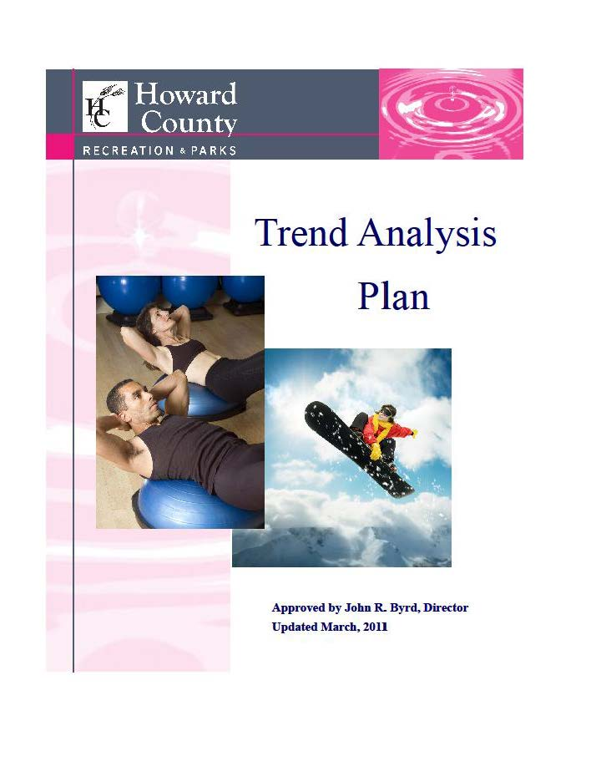
6.1 Evidence of Compliance
Trends Analysis Plan
8 point process to identify, evaluate and address new trends…..
Surveys,
Comp Plan
Staff Meetings
Management Team
Advisory Board
Director or County Adm
Budget/Staffing/Contract
Staff/Facility assigned

Slide 11
6.1 Evidence of Compliance
Trends Analysis Plan – cont’d
Census
Parks and Recreation Magazine
LERN
State Weekly Newsletter
Activity Guides from around the area to USA
Strategic Plans
Community Meetings
Agency and Organizational Networking
Supplier Catalogues
Professional Association Meetings
Social Media
PR Materials
Community Programming
Inventory

Slide 12
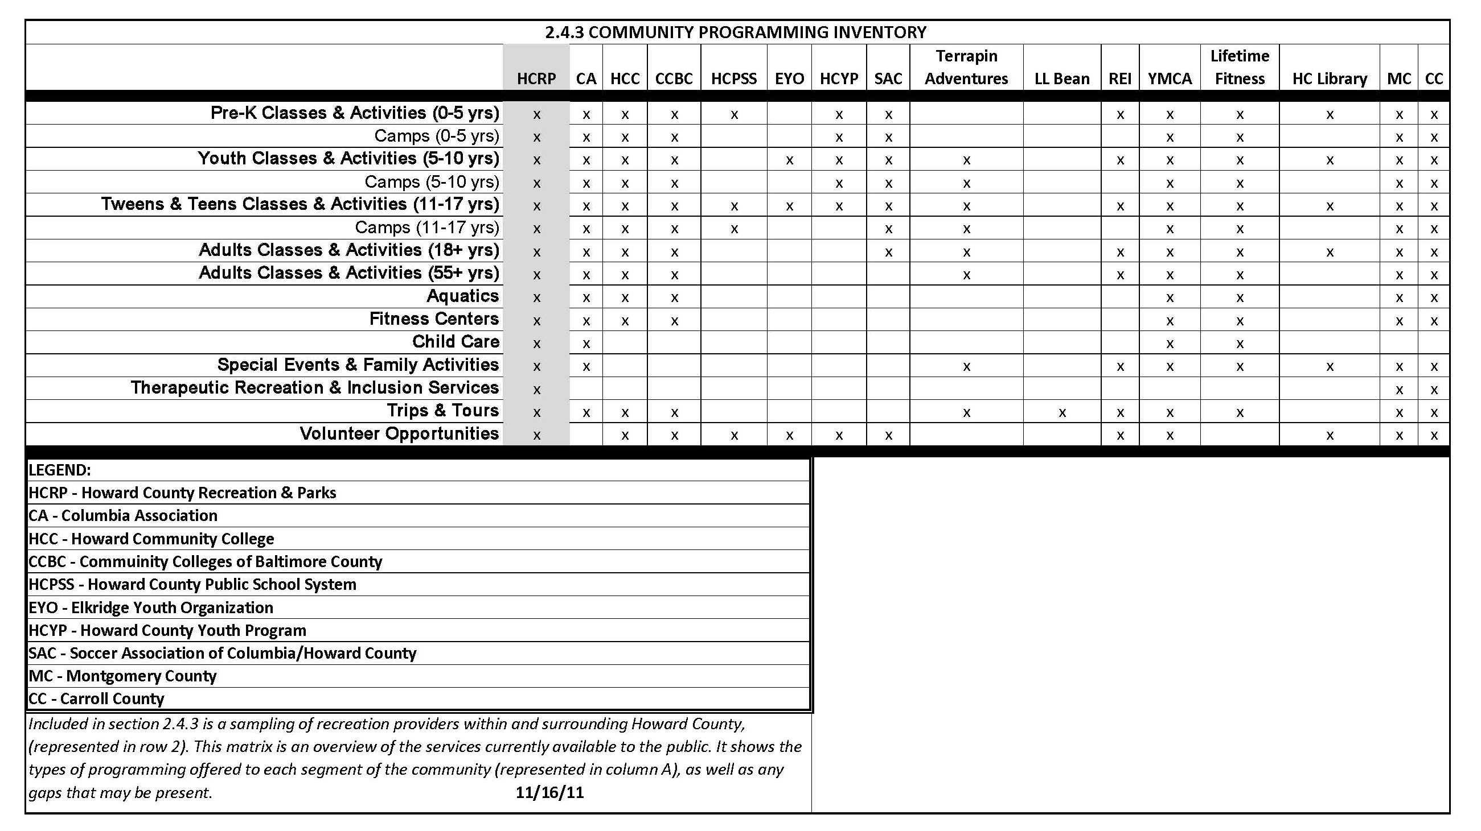
6.1 Evidence of Compliance
Community Programming Inventory

Slide 13
What is CAPRA Standards looking for in Programming Standards?
How you determine programs
Participant Involvement
Self-Directed Programs and Services
Leader Directed
Facilitated Programs and Services
Cooperative Programming
Program Objectives
Scope of Program Activities
Outreach to Diverse Populations
Community Education for Leisure
Community Health and Wellness
Code of Conduct

Slide 14
Conceptional Foundations of Play
Expressing creativity, developing self worth and making choices that enhance overall well being
Recreation is an activity in which a person engages for a positive purposeful end
Programs should be developed to promote a degree of freedom, choice and voluntary engagement
A quality program will provide opportunities for the pursuit of job and pleasure, excitement and challenge
There is also a role in therapy which happens in a TR program through Leisure Ed, Functional Intervention and Recreation Participation

Slide 15
Conceptual Foundations of Play
Most quality programs have a secondary purpose which is building of family, community and special interests.
Helping participates connect with other people who share similar interests can be a catalyst for life long friendships.
The Benefits of Recreation are a endless

Slide 16
Conceptional Foundations of Environmental Education, Historical Education and Interpretive Programs
Environmental Education teaches children and adults how to learn about and investigate their environment.
Historical Education is an umbrella term what covers various methods for youth and adults to engage in their local history and goes beyond a traditional setting.
Interpretation is a communication based program that forges emotional and intellectual connections between an audience and meaning of nature or cultural resource

Slide 17
Programs that Meet Constituent Needs
Meeting the needs and demands of the community
Volunteers
Facilities
Heritage
Special Projects
Special Sports Events
Recreation Inclusion and TR Programs
Not a part of your agency options: Local resources such as the YMCA, private health clubs, martial arts, dance studios, golf courses, neighborhood pools….

Slide 18
Agency Role in Philosophy and Goals
Share first all Organizational Charts for a good overview of the structure for programming and service
Department Vision in place
Department Mission in place
Department Core Values in place

Slide 19

Mission, Vision & Core Values

Slide 20
Experience Desirable for Clientele
Being Trend Setting, attracts Clients as does….
  Licensed Childcare
  Early Learning Centers and Preschool Programs
  TRIO (a program for teens with disabilities that have aged out of traditional childcare)
  Teen Programs, Middle School Grant Programs and Homework Clubs that meet educational goals and interest this specialized group
  Afterschool, night and weekend programs for all ages
  Day programs and evening programs for adults and age 55 plus and Trips and Tours

Slide 21
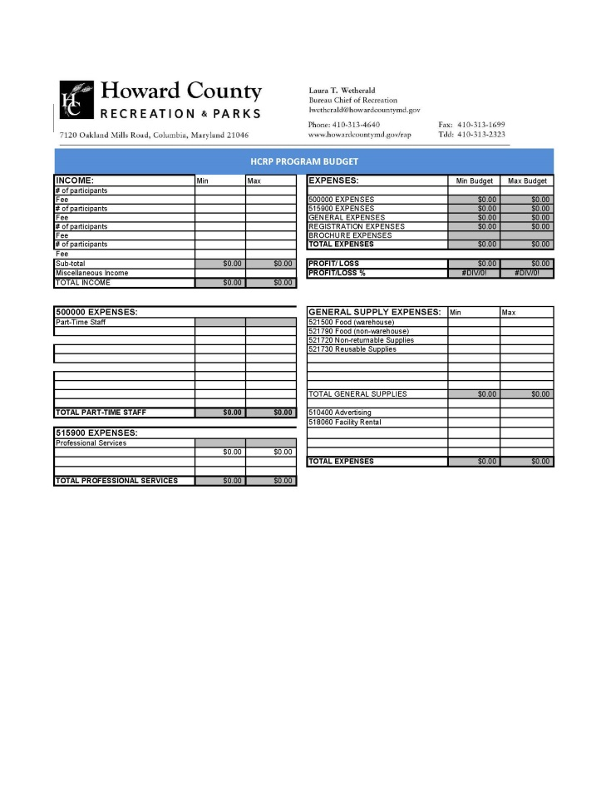
Program Budget Worksheet

Slide 22
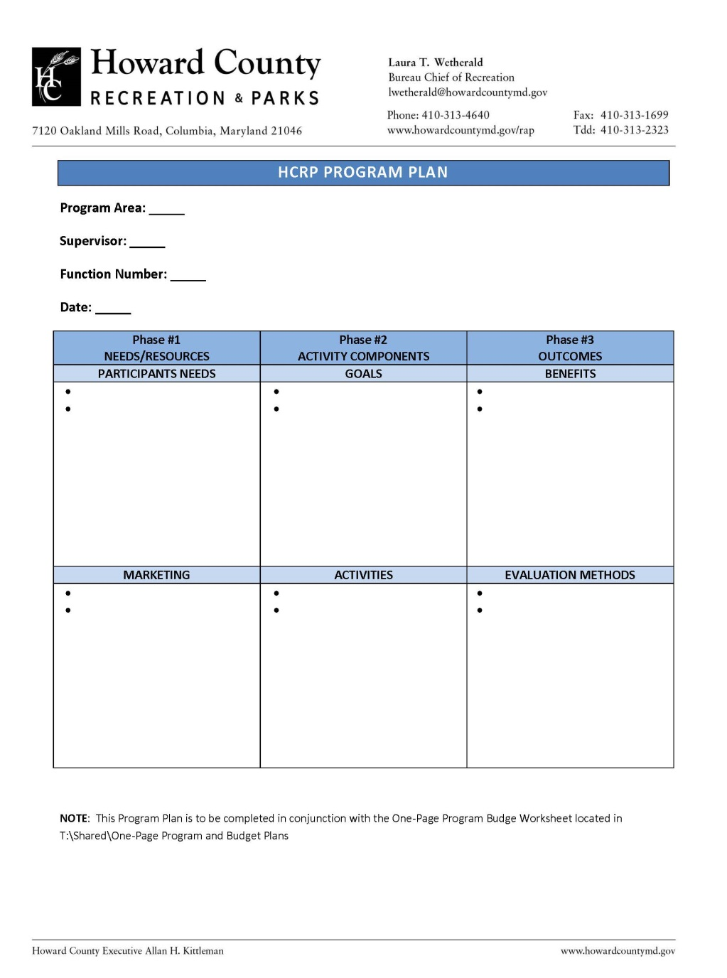
Program Plan with Goals

Slide 23
Program Evaluations
If you are not going to use the data, why do the evaluation?

Slide 24
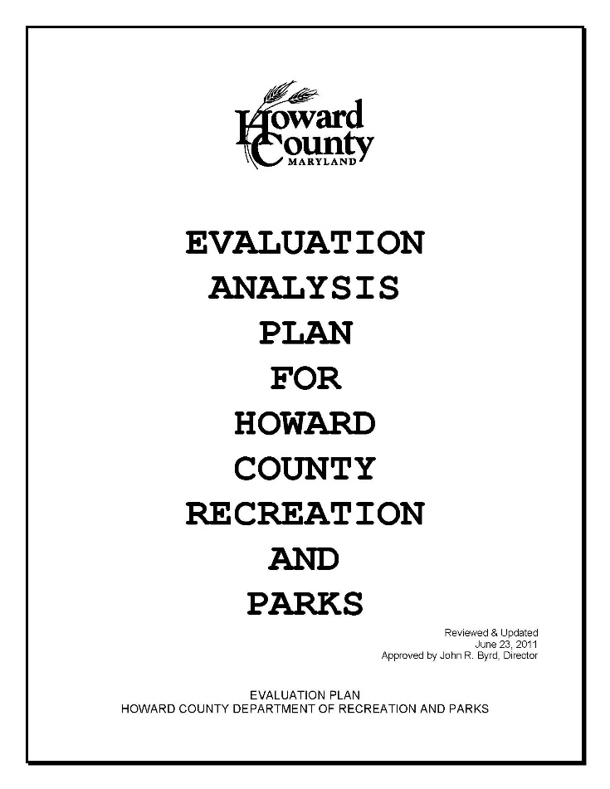
10.1 Systematic Evaluation Plan
Human Resources- Performance Evaluation
Reports-Comp Plan to Annual, Seasonal, fiscal and program evaluations
Customer Feedback- all levels
Staff Feedback- site visitations, meetings to facility evaluations

Slide 25
Further Evaluative Questions of your Programs
What are the programs and services that are the most greatly challenged?
What does your department need to do to accommodate growing demands?
What is the quality of your customer experience?
What internal support functions to you get to support your programming functions?
How well does your program fit your mission?
Is your agency the best agency to provide a particular service?

Slide 26

More Evaluative Comments on Programs
Should your agency be working with other organizations to provide services?
Do you have programs you offer that is eliminated, would cause customers irreplaceable loss?
What is the competitive strength of each of your programs?
          Sasaki and Heller and Heller Consultants

Slide 27
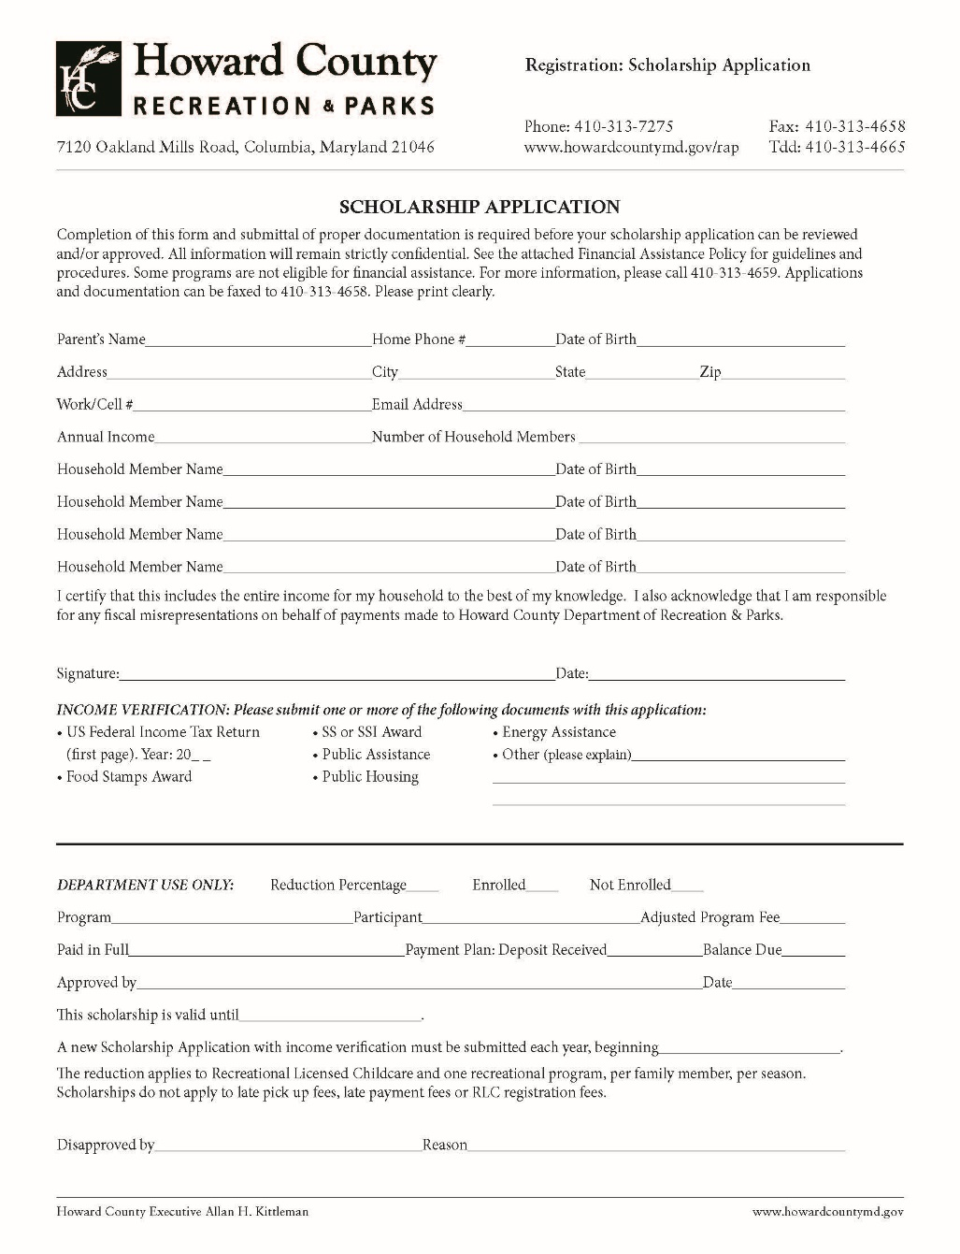
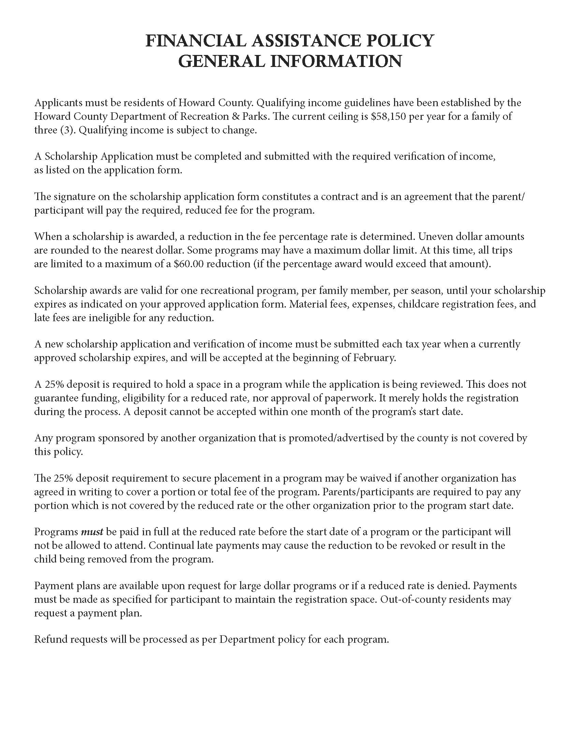
Financial Assistance

Slide 28

Expanding our Program Vision with Environmental Sustainability
Benchmarking
Purchasing
Water Conservation/Quality Protection
Energy Conservation and
Buildings and Facilities

Slide 29
Recreation Programming Model
Breakdown of Divisions
  3 Program Divisions in Recreation
  1 Program Division in Parks
Programs implemented by Programmers, not Facility Staff, in Community and Athletic Facilities
  Marketing, Registration, IT, Warehouse and Purchasing, OHR and Accounts Payable provided by Administrative Bureau so Programmers have more time to manage programs
  Programs in Parks Bureau focus on Natural Resources, Heritage, Rangers, Forestry, Deer Management and Nature Center and Environmental Areas

Slide 30

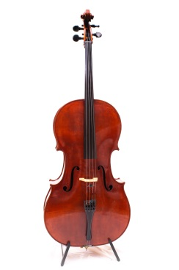





Program Function Areas
How are programs handled in your agency?

Slide 31
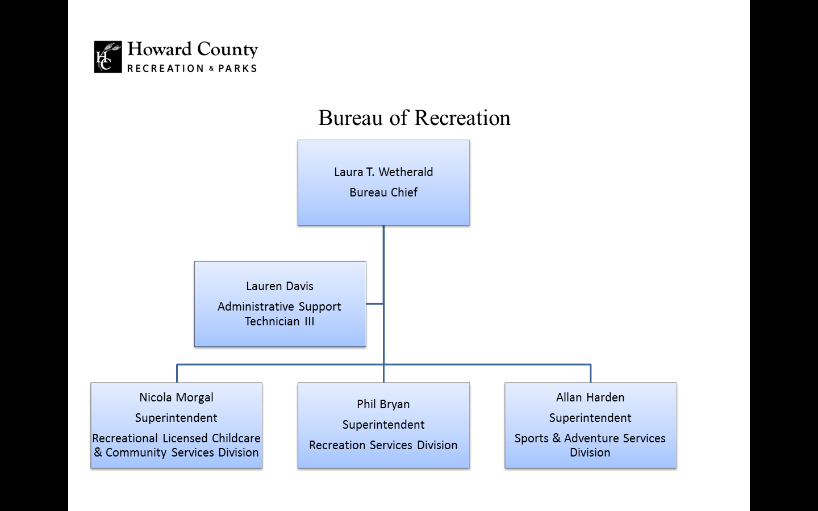

Slide 32
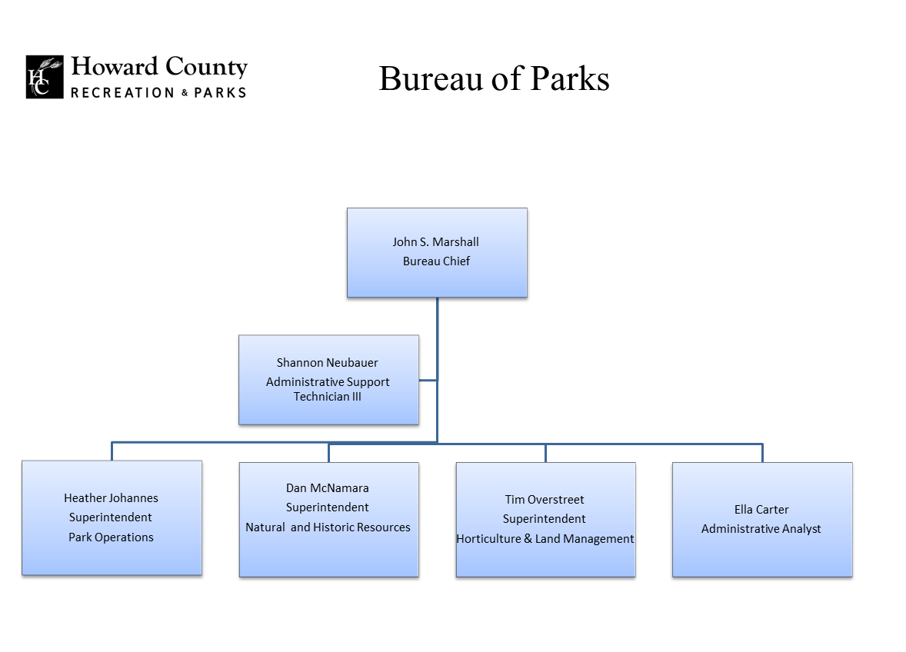

Slide 33
Program Coordination between Bureaus
If there is a duplication of effort or a conflict between programmers….
  Determine the topic area and consider if it is outside of assigned function area
  If unsure of conflict speak directly with the affected programmer
  If the conflict is resolved, staff will move forward with taking on the program in question
  If there is a conflict a chain of command will be followed until resolution.
  Examples of Conflicts that arise…..

Slide 34
Guidelines for Facilities
Program Management and Operations
Facility Guidelines
Rentals and Permit Guidelines for Indoor
Field Permits for Outside
Handling Joint Use Agreements with HCPSS
Pavilion and Parks Permits
  Discounts
  Refunds
  Cancellations
  Moon bounces

Slide 35
Program Matrix
Program Name
Programs with general or little supervision
Programs with structured leadership
Program Fees
Scope or Level of Program
Types of Participation; Physical, Intellectual, Social, Creative
Types of Participation; Individual , Small Group or Large Group

Slide 36
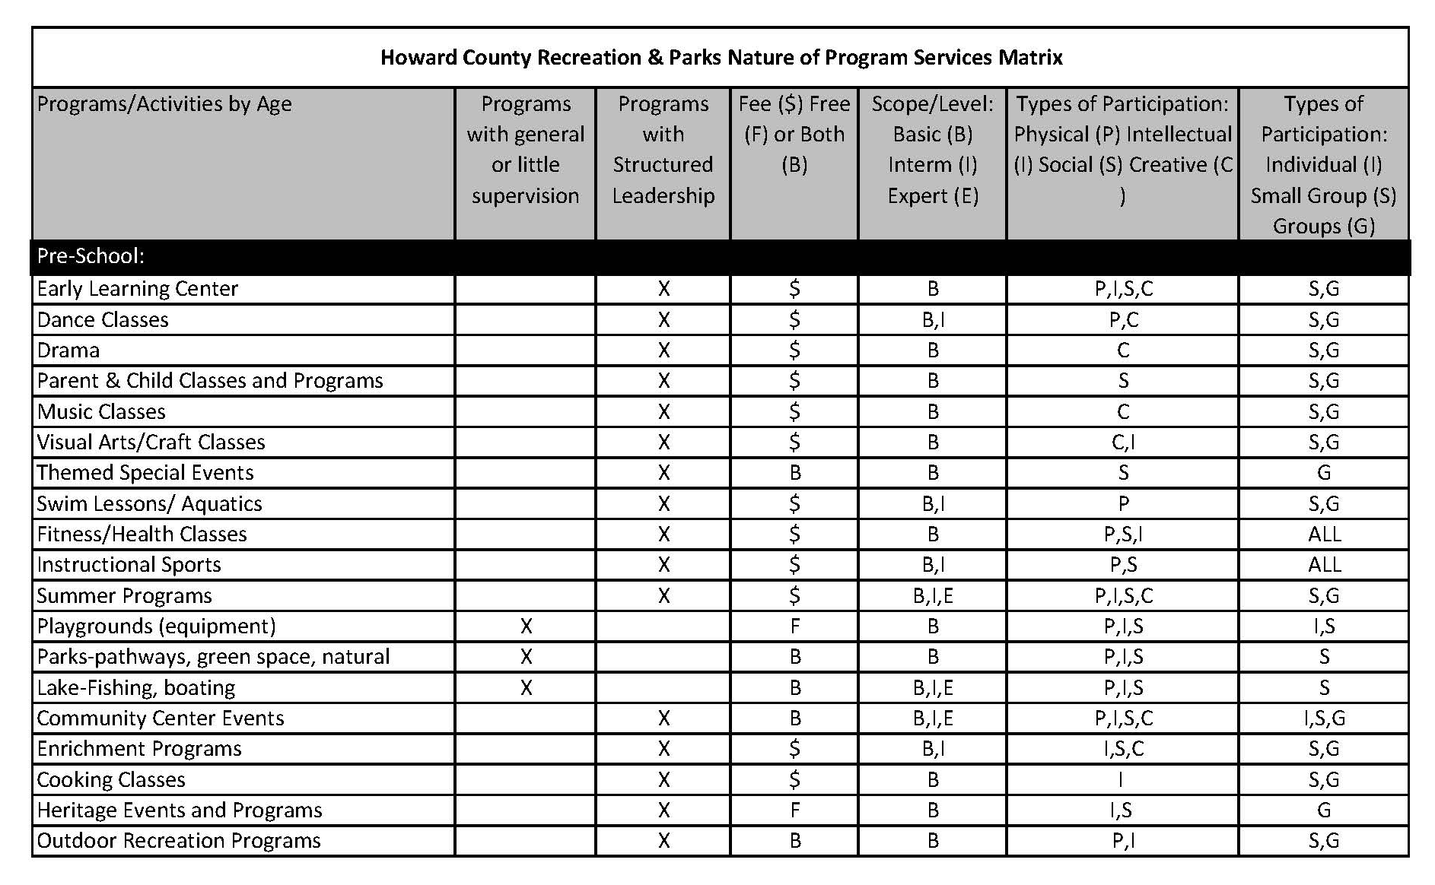
Program Matrix

Slide 37
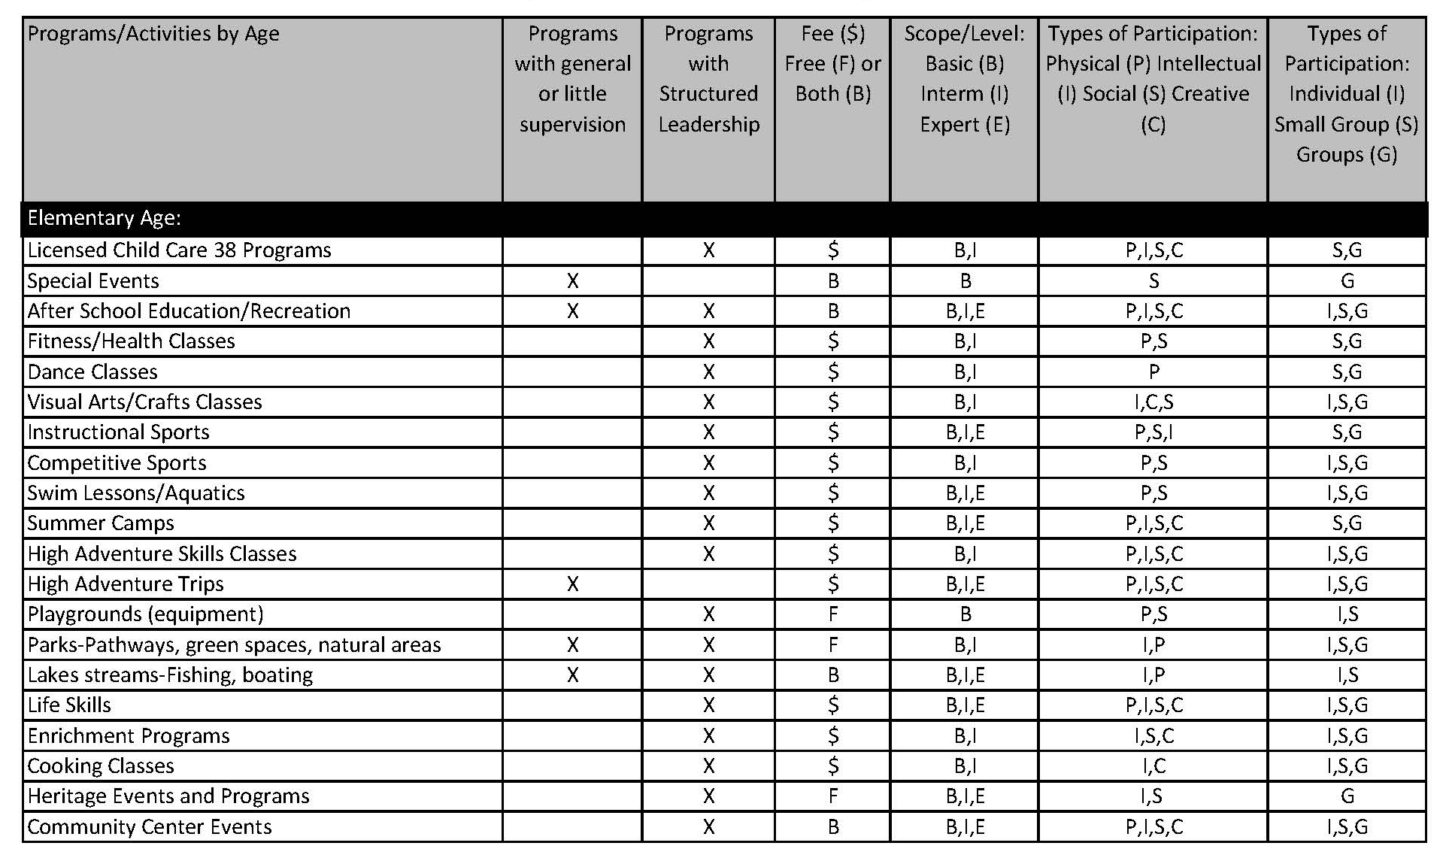
Program Matrix

Slide 38
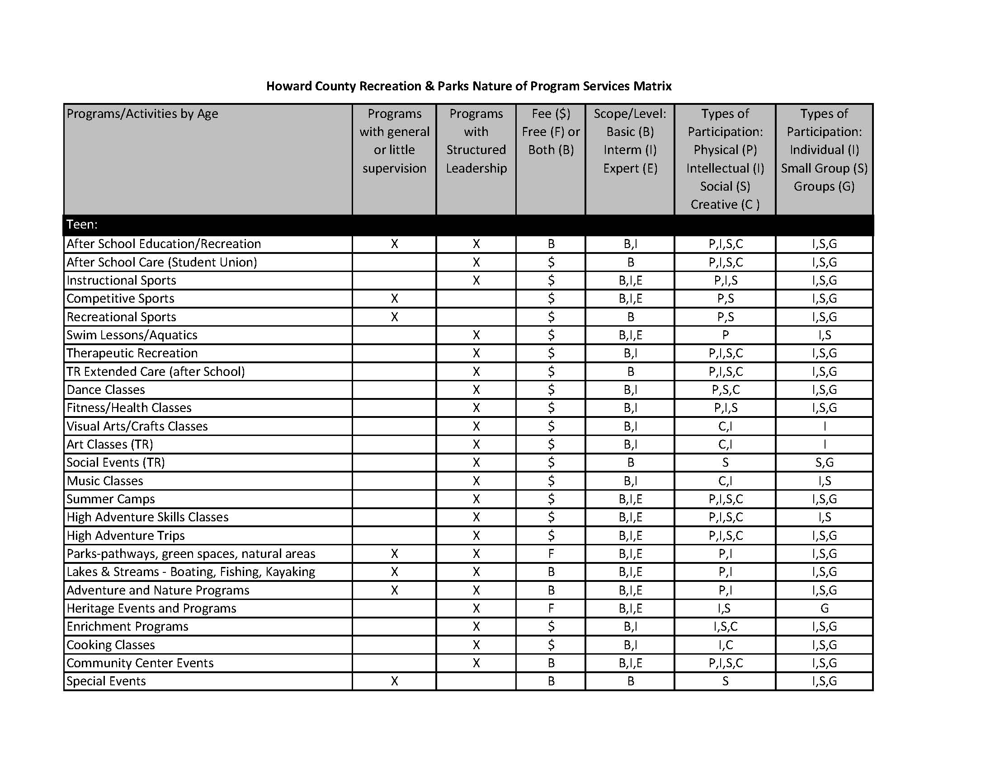
Program Matrix

Slide 39
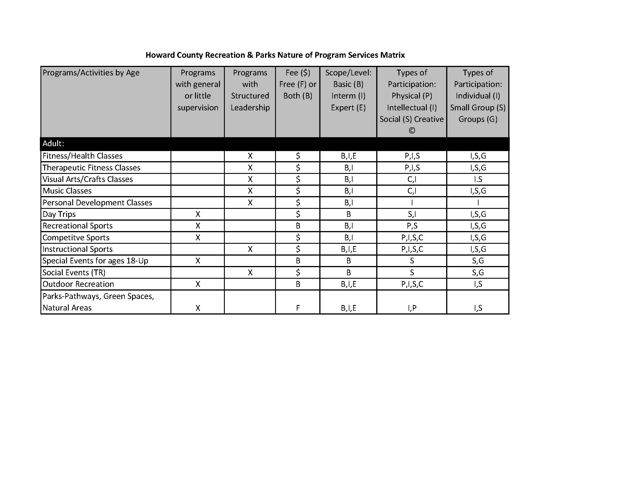
Program Matrix

Slide 40
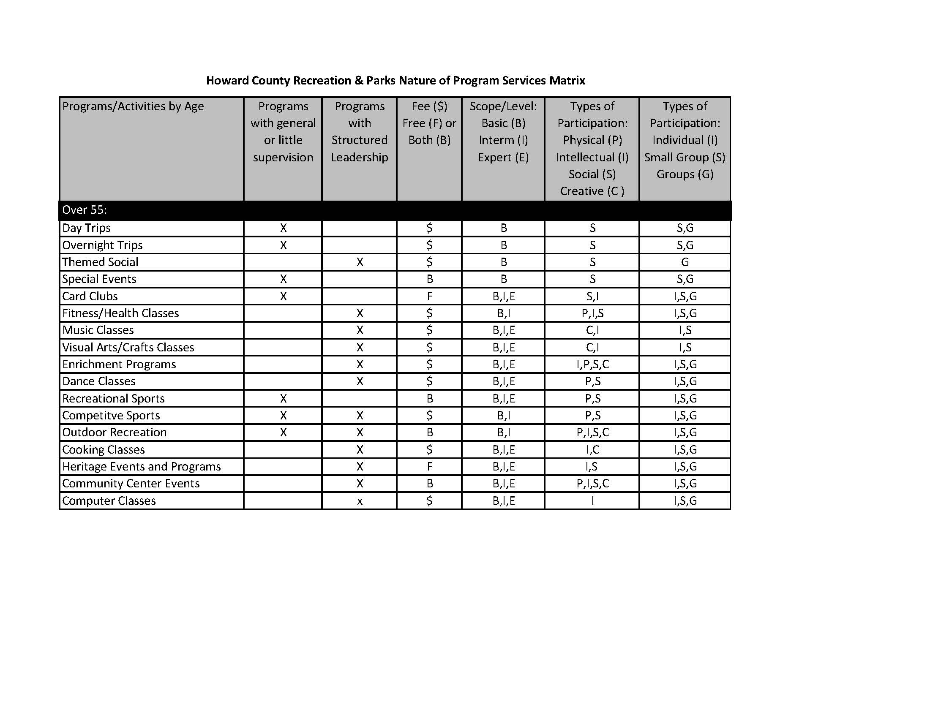
Program Matrix

Slide 41
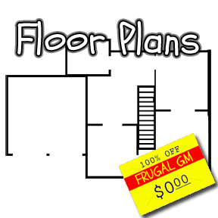
Plans: Comp, Strategic, General and Annual
General Plan
Comprehensive Master Plan
Strategic Plan
Annual Goals and Objectives

Slide 42
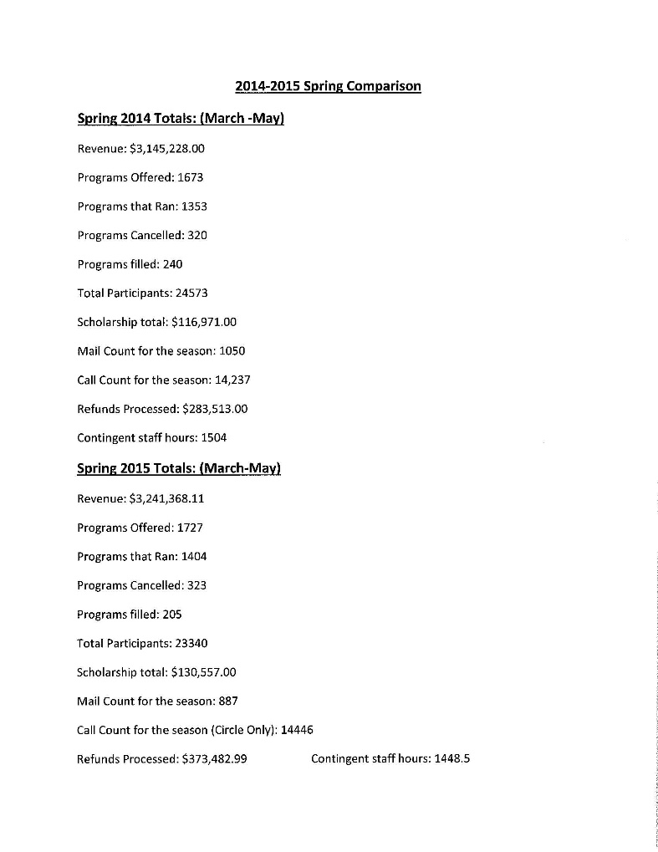

Program Statistics
Registration Statistics : Spring 2014 v. Spring 2015

Slide 43
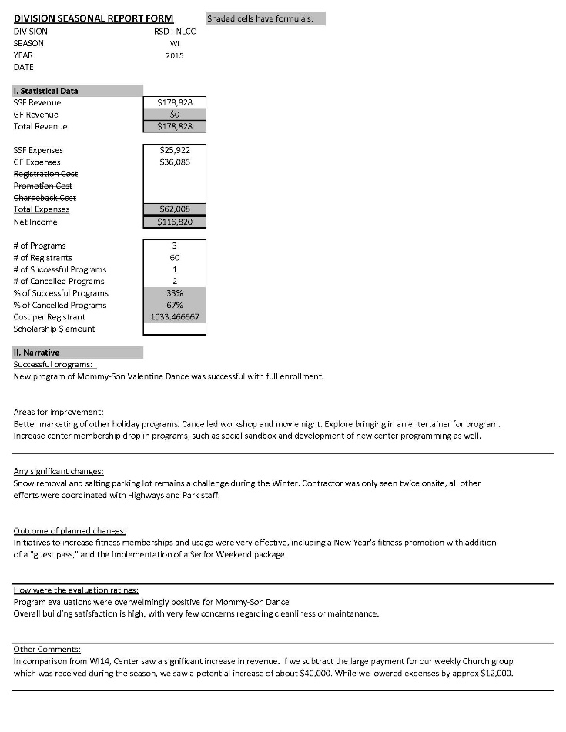
Program Statistics
Facility: North Laurel Community Center

Slide 44
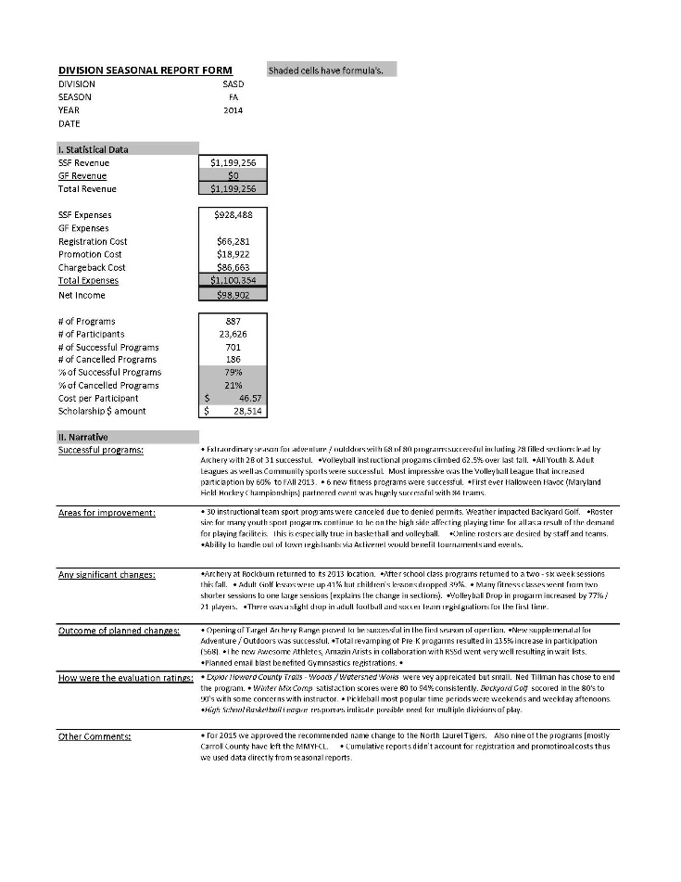
Program Statistics
Sports & Adventure Services Division

Slide 45
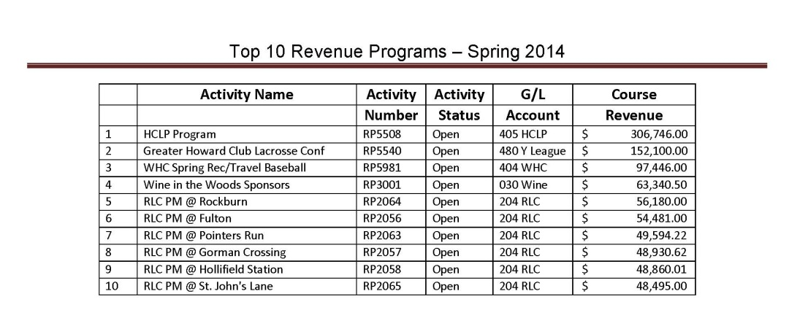
Program Statistics

Slide 46

Closing Remarks and Questions
Program Plan
Questions
All the Components of a Recreation and Parks Plan
What CAPRA is looking for?
Develop Program Offerings from evaluative data and planning

