Slide 1
Pricing for Profit:
Strategies to Add to Your Bottom Line
Fred Bayley, LERN Sr. Consultant
Bayley@lern.org

Slide 2
Pricing for Profit:
Strategies to Add to Your Bottom Line
1. Basics
2. Market Price
3. Changing Prices
4. Advanced Techniques

Slide 3
1. Basics

Slide 4
Pricing Myths
Raise or Lower all prices by same $ or %
Increasing prices reduces registrations
Lowering prices increase registrations
People evaluate course experience based on price
Pricing for Profit

Slide 5
A. Pricing & Attendance
1
2
3
4
Attendance
$\Attendees
Income
Price Increase

Slide 6
Stage | Price | Attendance | Income
1 | Up | Up | Up
2 | Up | Same | Up
3 | Up | Down | Up
4 | Up | Down | Down

Slide 7
B. Your Price is Your Image
Pricing for Profit: Basics

Slide 8
C. Underpricing
Maximum & Minimum Price Customers have minimum & maximum price they will pay
Pricing for Profit: Basics

Slide 9
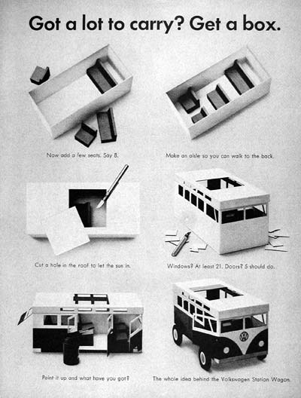
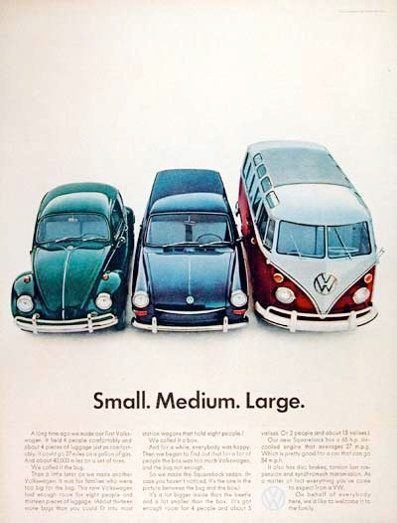
Pricing for Profit: Basics

Slide 10
D. Diversified Pricing
Clustered Pricing
Diversified Pricing
Diversified pricing helps you
• Reach other markets
• Provide alternatives for your current customers
Pricing for Profit: Basics

Slide 11
E. Price Breaks
$49 $50
Significant numbers will not register
Pricing for Profit: Basics

Slide 12
Price Breaks:
Community Programs
$10 | $20 | $25 | $30
$40 | $50 | $60 | $75
$80 | $100 | $150 | $200
$300 | $400 | $500 | $1,000
Pricing for Profit: Basics

Slide 13
Price Breaks:
CPE, Seminars, etc.
$50 | $100 | $150 | $200
$250 | $300 | $400 | $500
$600 | $700 | $800 | $900
$1,000 | $1,250* | $1,500 | $1,800*
$2,000 | Up by $1,000
Pricing for Profit: Basics

Slide 14
37
38
39
40
41
42
43
44
45
46
47
48
49
50
51
52
Pricing for Profit: Basics

Slide 15
2. Market Price

Slide 16
A. Market Price Advantages
Always use market price
Courses individually priced
Consider course costs
What the audience is used to paying
Examine competition
Know your brand
Pricing for Profit: Market Price

Slide 17
B. Pricing Rules
$97 $95 or $99
Close to price break
$95.00 $95
Don’t hide or highlight
Pricing for Profit: Market Price

Slide 18
C. Steps to Set Market Price
Determine income needed
Formula price
Nearest price breaks
Competition charging
People willing to pay
Pricing for Profit: Market Price

Slide 19
LERN Financial Format
Income | $____ | ___%
Promotion Costs | $____ | ___%
Production Costs | $____ | ___%
Direct Costs | $____ | ___%
Operating Margin | $____ | ___%
Administration Costs | $____ | ___%
Net | $____ | ___%

Slide 20
LERN Financial Format
Income | $____ | ___%
Promotion Costs | $____ | ___%
Production Costs | $____ | ___%
Direct Costs | $____ | ___%
Operating Margin | $____ | ___%
Administration Costs | $____ | ___%
Net | $____ | ___%

Slide 21
LERN Financial Format
Income | $____ | ___%
Promotion Costs | $____ | ___%
Production Costs | $____ | ___%
Direct Costs | $____ | ___%
Operating Margin | $____ | ___%
Administration Costs | $____ | ___%
Net | $____ | ___%

Slide 22
LERN Financial Format
Income | $____ | ___%
Promotion Costs | $____ | ___%
Production Costs | $____ | ___%
Direct Costs | $____ | ___%
Operating Margin | $____ | ___%
Administration Costs | $____ | ___%
Net | $____ | ___%

Slide 23
D. LERN Financial Format
Income | $____ | 100%
Promotion Costs | $____ | 10-15%
Production Costs | $____ | 45-50%
Direct Costs | $____ | 60%
Operating Margin | $____ | 40%
Administration Costs | $____ | 35%
Net | $____ | 5%

Slide 24
Production Cost = $400
Production Percentage = 50%
Projected Registrations = 40
1. Income Needed = Prod. Cost ÷ Prod. %
2. Formula Price = Income Needed ÷ Proj. Reg.
3. Nearest Price Breaks
4. Select Pricing Options

Slide 25
Production Cost = $400
Production Percentage = 50%
Projected Registrations = 40
1. Income Needed = Prod. Cost ÷ Prod. %
2. Formula Price = Income Needed ÷ Proj. Reg.
3. Nearest Price Breaks
4. Select Pricing Options

Slide 26
Production Cost = $400
Production Percentage = 50%
Projected Registrations = 40
1. Income Needed = Prod. Cost ÷ Prod. %
2. Formula Price = Income Needed ÷ Proj. Reg.
3. Nearest Price Breaks
4. Select Pricing Options
$400 ÷ .50 = $800 Income Needed

Slide 27
Production Cost = $400
Production Percentage = 50%
Projected Registrations = 40
1. Income Needed = Prod. Cost ÷ Prod. %
2. Formula Price = Income Needed ÷ Proj. Reg.
3. Nearest Price Breaks
4. Select Pricing Options
$400 ÷ .50 = $800 Income Needed
$800 ÷ 40 = $20

Slide 28
Production Cost = $400
Production Percentage = 50%
Projected Registrations = 40
1. Income Needed = Prod. Cost ÷ Prod. %
2. Formula Price = Income Needed ÷ Proj. Reg.
3. Nearest Price Breaks
4. Select Pricing Options
$400 ÷ .50 = $800 Income Needed
$800 ÷ 40 = $20
$20 $25

Slide 29
Production Cost = $400
Production Percentage = 50%
Projected Registrations = 40
1. Income Needed = Prod. Cost ÷ Prod. %
2. Formula Price = Income Needed ÷ Proj. Reg.
3. Nearest Price Breaks
4. Select Pricing Options
$400 ÷ .50 = $800 Income Needed
$800 ÷ 40 = $20
$20 $25
$19 $25

Slide 30
Production Cost = $400
Production Percentage = 50%
Projected Registrations = 40
1. Income Needed = Prod. Cost ÷ Prod. %
2. Formula Price = Income Needed ÷ Proj. Reg.
3. Nearest Price Breaks
4. Select Pricing Options
$400 ÷ .50 = $800 Income Needed
$800 ÷ 40 = $20
$20 $25
$19 $25

Slide 31
D. Price vs. Competition
Competition
Pricing for Profit: Market Price

Slide 32
D. Price vs. Competition
Quality
Competition
Pricing for Profit: Market Price

Slide 33
D. Price vs. Competition
Quality
Competition
Cheaper
Pricing for Profit: Market Price

Slide 34
D. Price vs. Competition
Quality
Location, Instructor, Time, Day, Content
Competition
Cheaper
Pricing for Profit: Market Price

Slide 35
3. Changing Prices

Slide 36
A. Increasing Prices
Price Increase | What To Do
0 - 14% | Do It - Price Break
15 - 24% | Test
25 - 49% | New Features
50%+ | New Event
Pricing for Profit: Changing Prices

Slide 37
B. When To Increase Prices
Down economy
Full classes
Low registrations
High priced selling more than low price
Reach another market segment.
Pricing for Profit: Changing Prices

Slide 38
C. Selling Price Increases
Raise one digit
One major price increase
Better brochure
Add refreshments or other touches
Outside speaker
Booklets or handouts
Make course longer
Add activities create high perceived value
Pricing for Profit: Changing Prices

Slide 39
D. Lowering Prices
Rarely
Get off price break
Reach another market segment
Pricing for Profit: Changing Prices

Slide 40
4. Advanced Techniques

Slide 41
A. Price Discounts
Group discount – saving promotion expense
Certificate discount – saving promotion expense
Early bird discount – the regular price is the early bird discount
Pricing for Profit: Advanced Techniques

Slide 42
B. Premiere Courses
Triple average price
Create new program based on price
50% operating margin
Build in perceived value
Low registrations high operating margin
Pricing for Profit: Advanced Techniques

Slide 43
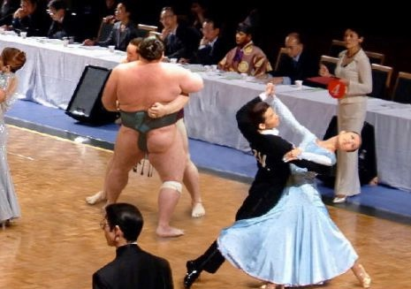
C. Split One Into Many
Dancing - $100
Square Dancing - $30
Circle Dancing - $30
Pole Dancing - $30
Norwegian Dancing - $30
Pricing for Profit: Advanced Techniques

Slide 44
D. Full Courses
Raise prices by 20-25%
Pricing for Profit: Advanced Techniques

Slide 45
E. Low Registrations
Test raising prices – you have nothing to lose
Pricing for Profit: Advanced Techniques

Slide 46
Pricing for Profit:
Strategies to Add to Your Bottom Line
1. Basics
2. Market Price
3. Changing Prices
4. Advanced Techniques

Slide 47
Need help with pricing?
Fred Bayley
Bayley@LERN.org
info@LERN.org
www.LERN.org

Slide 48
Pricing for Profit:
Strategies to Add to Your Bottom Line
Fred Bayley, LERN Sr. Consultant
Bayley@lern.org

