Slide 1
Six Strategic Best Practices for 2015
Learning Resources Network
Greg Marsello
March 2, 2015

Slide 2
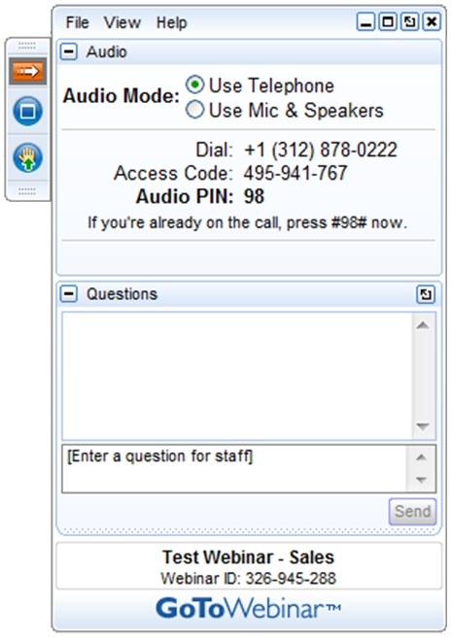
GoToWebinar
Today’s webinar will be recorded. A link to the webinar will be sent to participants within the next 24 hours.
Please do not place the conference call on hold. If you need to take another call, please leave the conference call and rejoin later.
Please use the Questions function in your GTW menu to ask any questions. Questions are answered at the conclusion of the presentation.

Slide 3
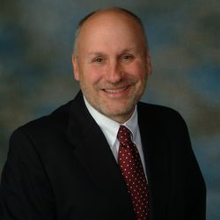
Presenter
Greg Marsello
-LERN Co-founder
-Road warrior
-Program Reviews, technical assistance consulting & data analysis

Slide 4
Agenda
- Overview
- Six Strategic Best Practices for 2015
- New! LERN Consulting & Training via Webcast
- Questions & Answers

Slide 5
Overview – State of Lifelong Learning
- Overall the field of lifelong learning is healthy and programs are intact after big recession
- 65% of programs still flat or down
- Generational transition seems to be taking place – course programming, delivery, marketing, customer service, and staffing
- Sporadic lack of institutional support
- Consolidation increasing, as well as decentralization and elimination

Slide 6
Overview – Why Winners Win
#1. Financially self-sufficient
#2. Data-driven decisions
#3. “Right” structure and operating system
#4. Best practices
#5. Short and long-term planning
#6. “Right” software
#7. Connected and visionary leadership

Slide 7
Overview – Hot Trends/Issues
- Integrated marketing taking hold
- Questions about Baby Boomer and Generation Y participation
- Online certificate programs the future of continuing professional education
- The future of adult community education is unclear
- The 30% Rule more important
- Selecting and implementing new initiatives a must
- Where possible operating margin moving from 40% to 50%, thus good pricing is critical

Slide 8
Six Strategic Best Practices for 2015

Slide 9
#1. Building a One-Year Business Plan
- Good planning gets best results
- Need OYBP before Strategic Plan
- Shift to accountability and setting organization, division and individual goals
- Tool for leader to manage organization
- Demonstrates proactive attitude
- Central administration likes numbers
- Engages staff in the process, thus better buy-in and understanding
One-Year Business Plan Model
1. Organization Goals
2. Organization Budget/Benchmarks
3. Division OM Budget, Courses/Contracts, Benchmarks, Market Segments, Selling Strategies
4. Quarter/Term
5. Promotions
6. Promotion Timeline
7. Staffing Responsibilities

Slide 10
#2. Creating a Marketing Plan
- Marketing getting more complex, integrated
- Having someone coordinating marketing
- Think in terms of 3 portals
- You must spend money … 10-15% of budget … to make money
- Organizations still spending 75% of budget on print promotions
- Marketing getting much more targeted
- Course programmers and contract sales staff play a critical role
Marketing Plan
1. Marketing Goals
2. Marketing Budget
3. Marketing Benchmarks
4. Marketing Promotions
5. Marketing Promotion Plan
6. Staff Responsibilities

Slide 11
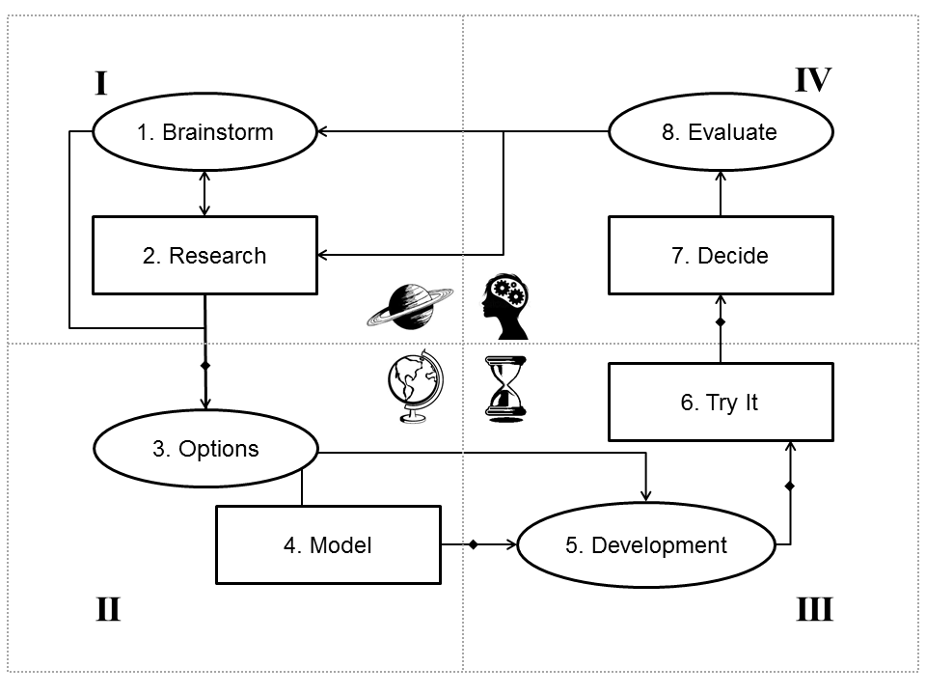
#3. Developing & Pricing Successful New Courses
- You can’t be everything to everybody
- 20%+ must be new, but it is not more
- Operating margin and price listing is key
- Think in terms of products, market segments, and delivery methods and 30% Rule
- Manage don’t develop
- Hybrid best way of learning
- 3rd party vendors important but operating margin must be right
- Have a new initiative selection process

Slide 12
#4. Assessing Your Lifelong Learning Organization
- 80/20 Principle and running a lifelong learning organization
- Knowing the industry benchmarks and best practices
- Key areas…course programming, instruction, marketing, contract sales, operations, management, planning, etc.
- Comparing your program with similar organizations…LERN Dashboard
- Setting a plan for improvement, normally tied into OYBP

Slide 13
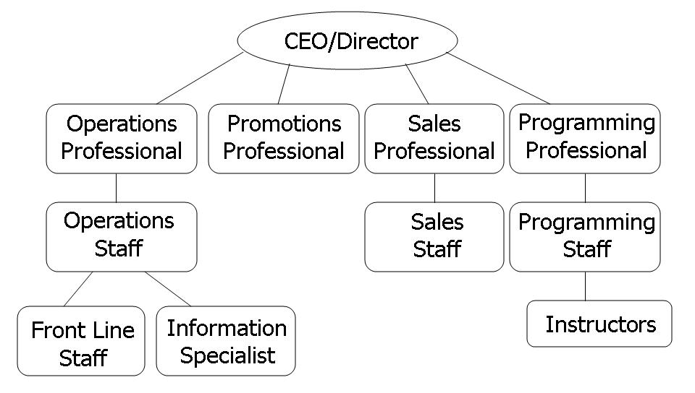
#5. Staffing Structure & Increasing Productivity
- Staff Productivity number of $125,000+
- Centralize operations, let revenue generators generate revenue, have at least one person dedicated to marketing, and split OE and CS
- Clear vision, RPRS, scorecards, document and follow processes, handle issues, set quarterly goals, run effective meetings…Traction
- Management Team
- Quarterly and annual reviews
- Software that works for you

Slide 14
#6. Performing a Community Needs Assessment
- You can’t be everything to everybody
- Customer management, not product management
- Yearly SWOT analysis helpful
- Identify the issue first…do your homework
- Work with people who participate in and support the work you do
- From focus groups to surveys
- Act on what you learn

Slide 15
New Service from LERN

Slide 16
Q&A

Slide 17
For more information
www.lern.org
info@lern.org
marsello@lern.org
Continue to lean on LERN for “Information That Works!”

