Slide 1
Instructor Handbooks for
Youth & Adult Programs
Holly Klotz, Operations Manager
Continuing Ed & Professional Development
Schoolcraft College (Livonia, MI)

Slide 2

Purpose
Instructors
Students
Operations
Programming
Marketing

Slide 3

Procedure
Budget (printing costs)
Brainstorm
Draft
Review
Seek input from instructors
Seek input from other departments
  Media, IT
  Campus Police
  Counseling/Advising
  Bookstore
  Risk Management
  Payroll
  Human Resources

Slide 4

Content
NOTE: LERN has copies of handbooks from other locations as well

Slide 5



Content
Welcome
Table of Contents
Intro
Checklist
General Campus Info
  Parking
  ID Badge

Slide 6
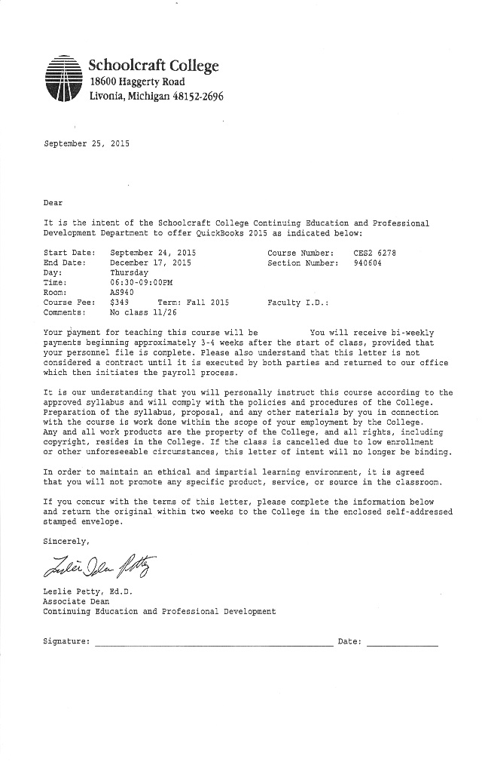
Content
Contracts
Compensation
Benefits
  Discounts
  Staff Development

Slide 7
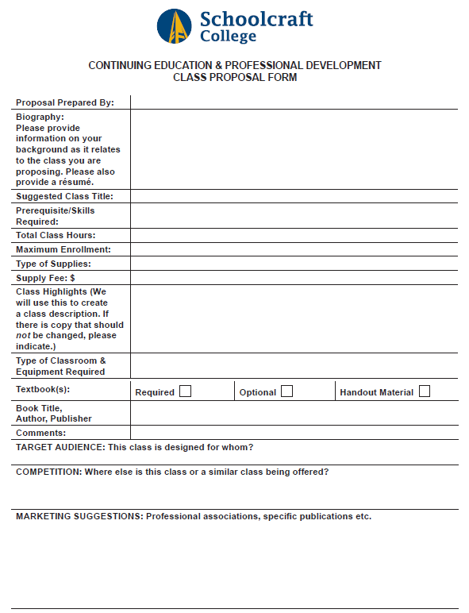
Content
Marketing Plan
New Class Ideas
  How to submit
  Timing

Slide 8
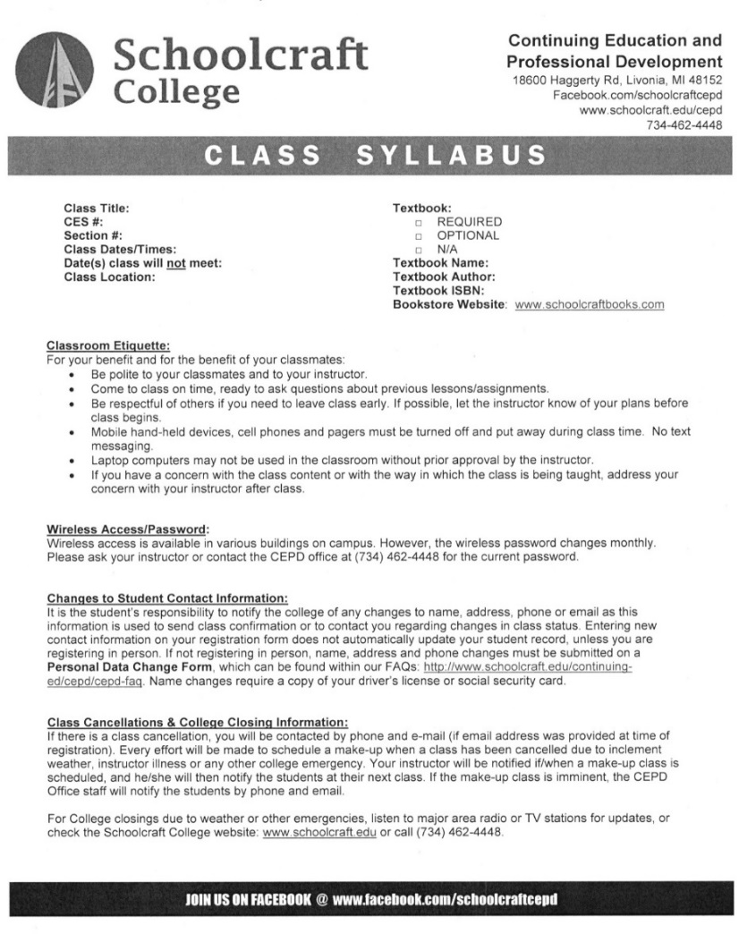
Content
Class Syllabus
Student FAQs
Textbooks
Supplies

Slide 9

Content
Registration
Student Inquiries
Class Rosters
Attendance/Grading
Student Services

Slide 10
Content
Student Evaluations
Class Cancellations
Late Arrival
Taking Breaks
Subs & Make-Ups

Slide 11
Content
Campus Closings
Emergencies
Disruptive Students

Slide 12

Content
Classroom Location
Classroom Equipment
Wireless Access
Other Resources
  Copying Services
  Faculty Data Drive

Slide 13

Content
Special Program Info
  Physical Fitness
  Facility Rules
  Certifications
  Working w/Children
Off-Campus Trips
Insurance
FERPA
Code of Conduct

Slide 14

Day Camp Staff
www.schoolcraft.edu/koc

Slide 15

Day Camp Staff
Different Website, Checklists, FAQs, Forms
Different Payment Methods/Timing
How to Order/Purchase Supplies
Staff Badges/Apparel

Slide 16


Day Camp Staff
Child Drop Off/Pick Up
Parent Interaction/Tips
Parent Perspectives
Social Media Policy
Specific Activity Info
Field Trip Procedures
Emergency Scenarios
Behavior Scenarios

Slide 17

Day Camp Staff
Cheat sheet for “down time” games/activities
Cheat sheet for songs and skits (campfire)
Provide sample syllabus/schedule
Provide due dates for new class/camp ideas

Slide 18

Distribution
When Hired
Orientation Tool
During Training (KOC)
Email and/or Online
Regular Mail

Slide 19
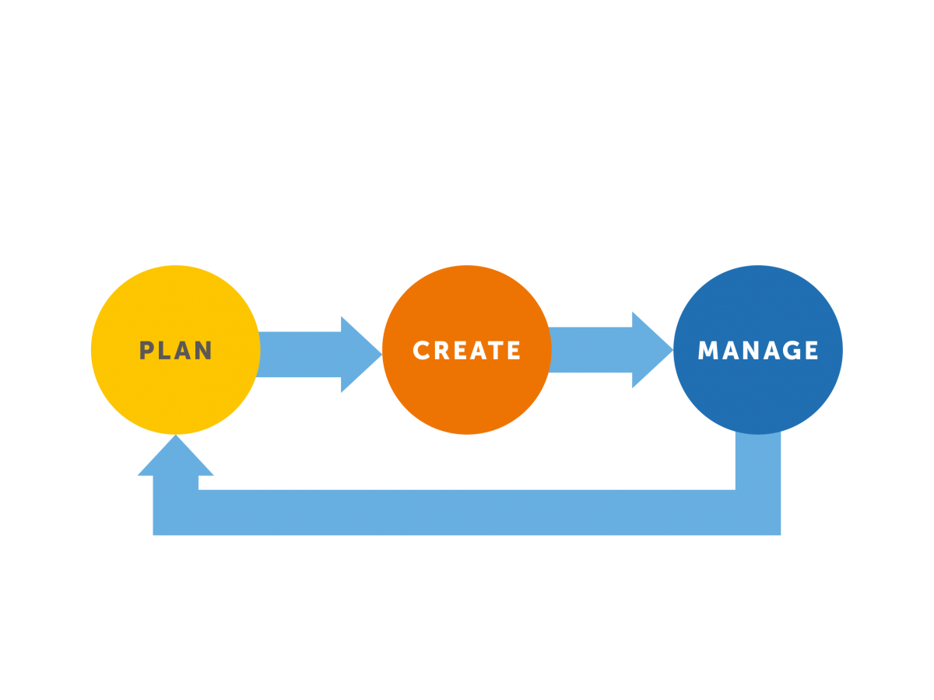
Review & Update
On set schedule
As needed
Coordinated effort

Slide 20
Thank You!
Holly Klotz
Operations Manager
(734) 462-4514
hklotz@schoolcraft.edu

