Slide 1
LERN’s Exclusive Integrated Marketing Study for Lifelong Learning Programs
January 23, 2019

Slide 2
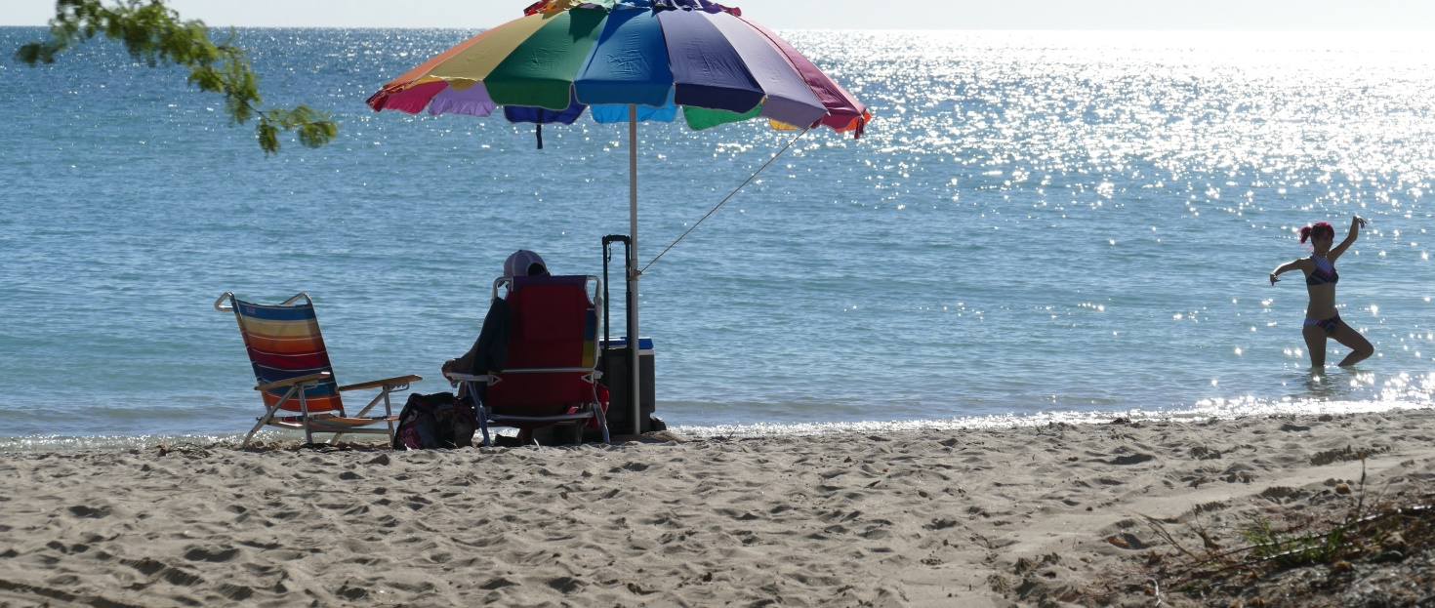
Agenda
Review of Integrated Marketing and the Study Results
New and Additional Study Results
Your Q&A

Slide 4
Integrated Marketing
Integrated Marketing definition for the purposes of this study is using a mix of promotion strategies, including digital and traditional print marketing, to generate more registrations than any one medium could achieve. Ideally Integrated Marketing creates a unified experience for the potential participant.

Slide 5
The LERN Study
We know that one aspect of Integrated Marketing for the field of lifelong learning programming is moving potential learners from one medium to another to improve registrations.
A Study of 26 Successful Programs from our four major institutional settings:
-Recreation Departments
-Community Education in Public Schools
-Continuing Education in Community Colleges
-Continuing Education in Universities

Slide 6
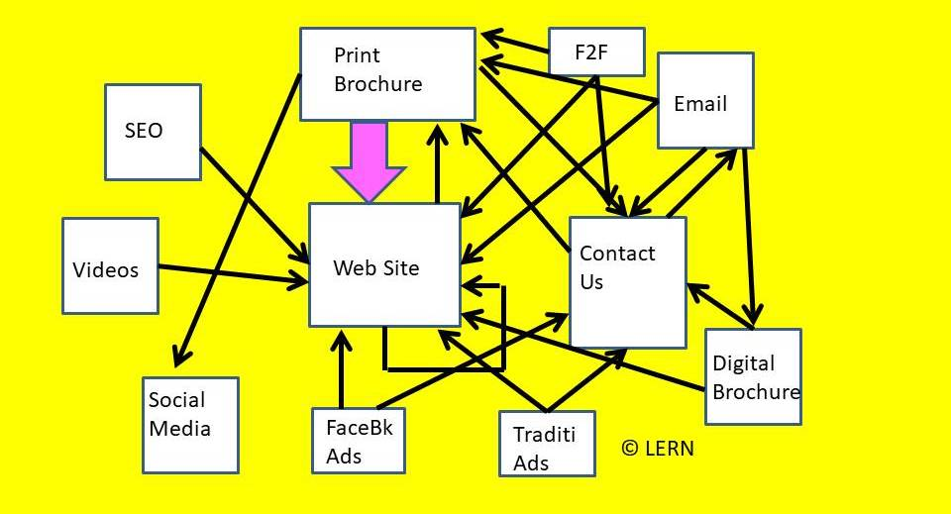
Integrated Marketing Mediums in Lifelong Learning Programming
We know that at least one or more programs use over 25 different marketing approaches (mediums). Which ones work best?

Slide 7
We know that the best promotion is to move people from your Print Brochure to your Web Site
Your Print Brochure continues generates 70% of your registrations and income.

Slide 8
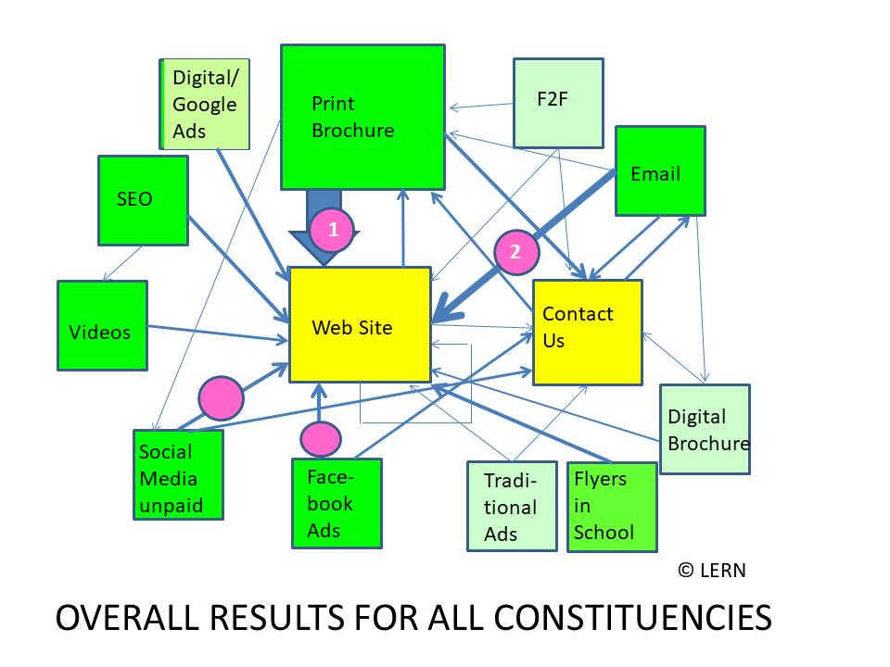
Overall Results

Slide 9
Key Overall Results
1.Email-to-Web Site Clearly the second most successful strategy.
2.Web Site Primary Destination Your Web Site for info and registration the primary destination.
3.Contact Us Contact Us, a surprise second destination, to convert inquiries into registrations.
4.Social Media used by successful programs in all constituencies/institutional settings
5.The results vary significantly by constituency.

Slide 10
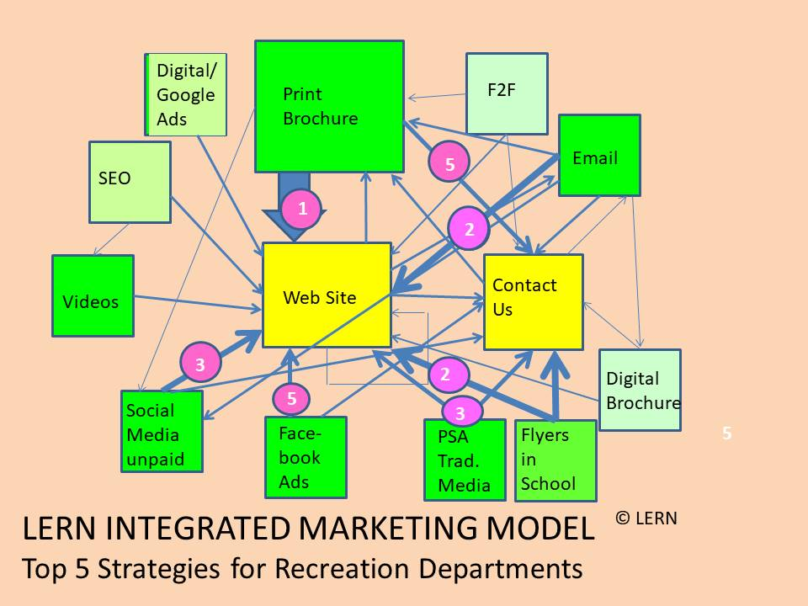
Recreation Departments

Slide 11
Results for Recreation Departments
1.Social media, combining unpaid Social Media and Facebook Ads, rivals Email for success.
2.Recreation departments are leading the field in using Instagram
** LERN predicts more lifelong learning programs in other settings will begin promoting with Instagram.
Nicole Siscaretti-Doyle will do a conference session just on Instagram Thursday 11:20 a.m. **
3.Flyers in schools, as well as Public Service Announcements (PSAs) in traditional media (newspapers, radio, etc.) also one of the most successful strategies
4. Seventeen strategies are used by one or more successful recreation departments; the most of any constituency.

Slide 12
Community Education in Public Schools

Slide 13
Results for Community Education in Public Schools
1.Moving people from the Print Brochure to Contact Us is one of the top 3 strategies.
** LERN predicts programs will want to make Contact Us a)More visible; b) More ways to contact you; and c) Encourage people more to contact you **
2.Flyers in schools one of the top strategies
3.Social media, both unpaid and paid, also a top strategy.

Slide 14
Continuing Education in Universities

Slide 15
Results for Continuing Education in Universities
1.Paid online ads, both Facebook and also banner and other digital ads, are more prominent.
2.Search engine optimization (SEO) is much more prominent.
3.Web sign up for the Print Brochure is also one of the top strategies.

Slide 16
Continuing Education in Community Colleges

Slide 17
Results for Continuing Education in Colleges
1.Video makes the top 5 strategies
** LERN predicts and recommends more video in digital marketing **
2.Moving people from the Print Brochure to Contact Us very prominent strategy.
3.SEO and Facebook Ads also top strategies.

Slide 18
Next 12 Months - More

Slide 19
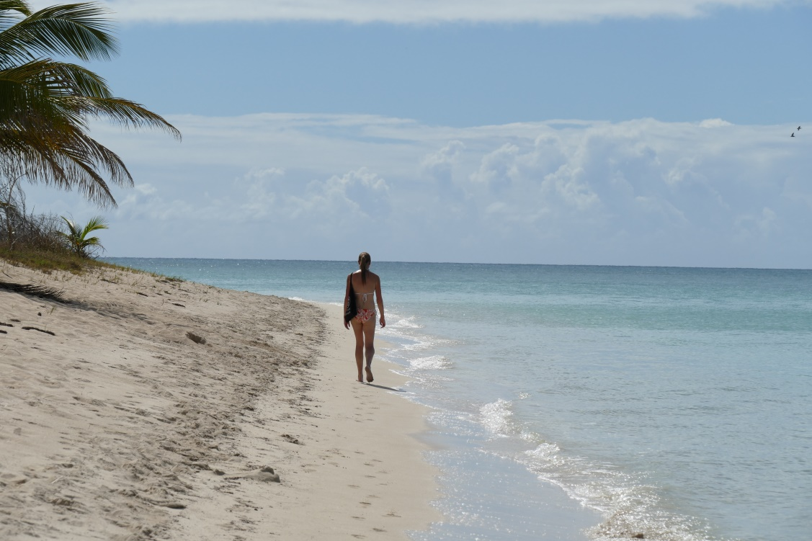
Integrated Marketing for Small Teams
1.Keep your brochure quality high.
2.Keep sending out emails.
3.Periodically improve your web site. -New image every session -Upgrade Contact Us
4.Get a volunteer who likes social media to do Facebook page and posts for your program.

Slide 20
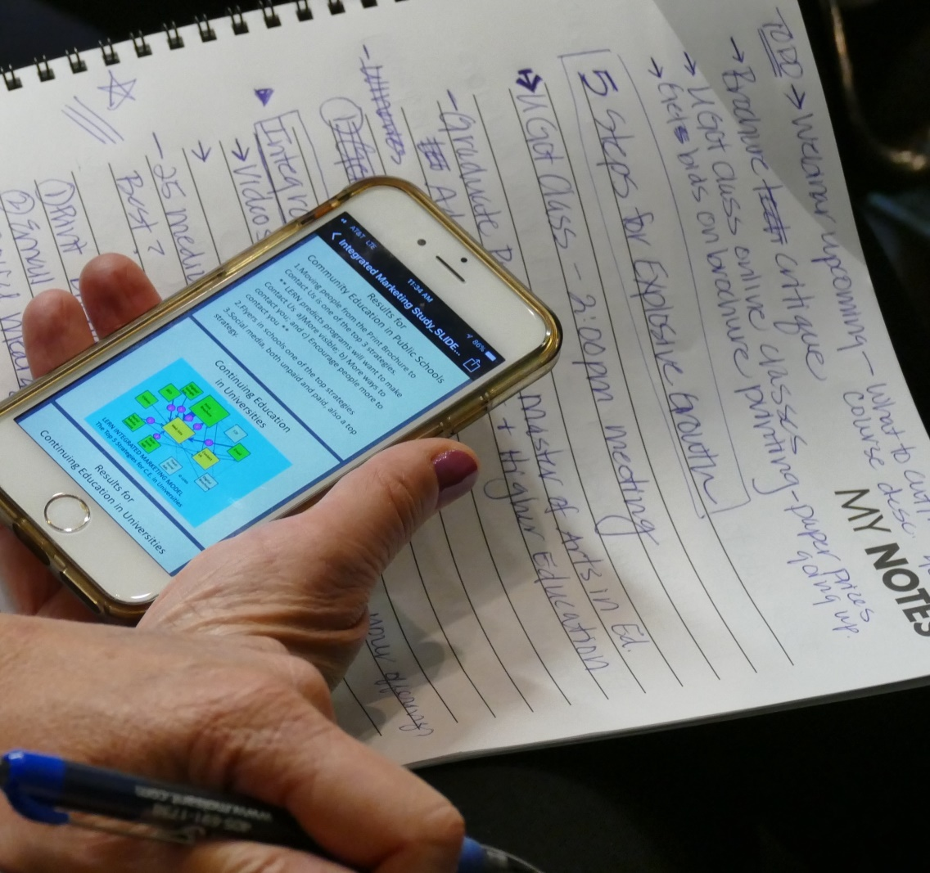
Email Survey
Send your 1-3 Best Emails to research@lern.org
Include: -Open Rate -Click through Rate -Subject line

Slide 21
5 Things About Email Copy
#1 The first sentence is critical. Get into it.
#2 Use a good action verb in the first sentence
#3 Use ‘you’ language
#4 Stress outcomes and results
#5 Write, then Rewrite Your Email Copy (any copy actually)

Slide 22
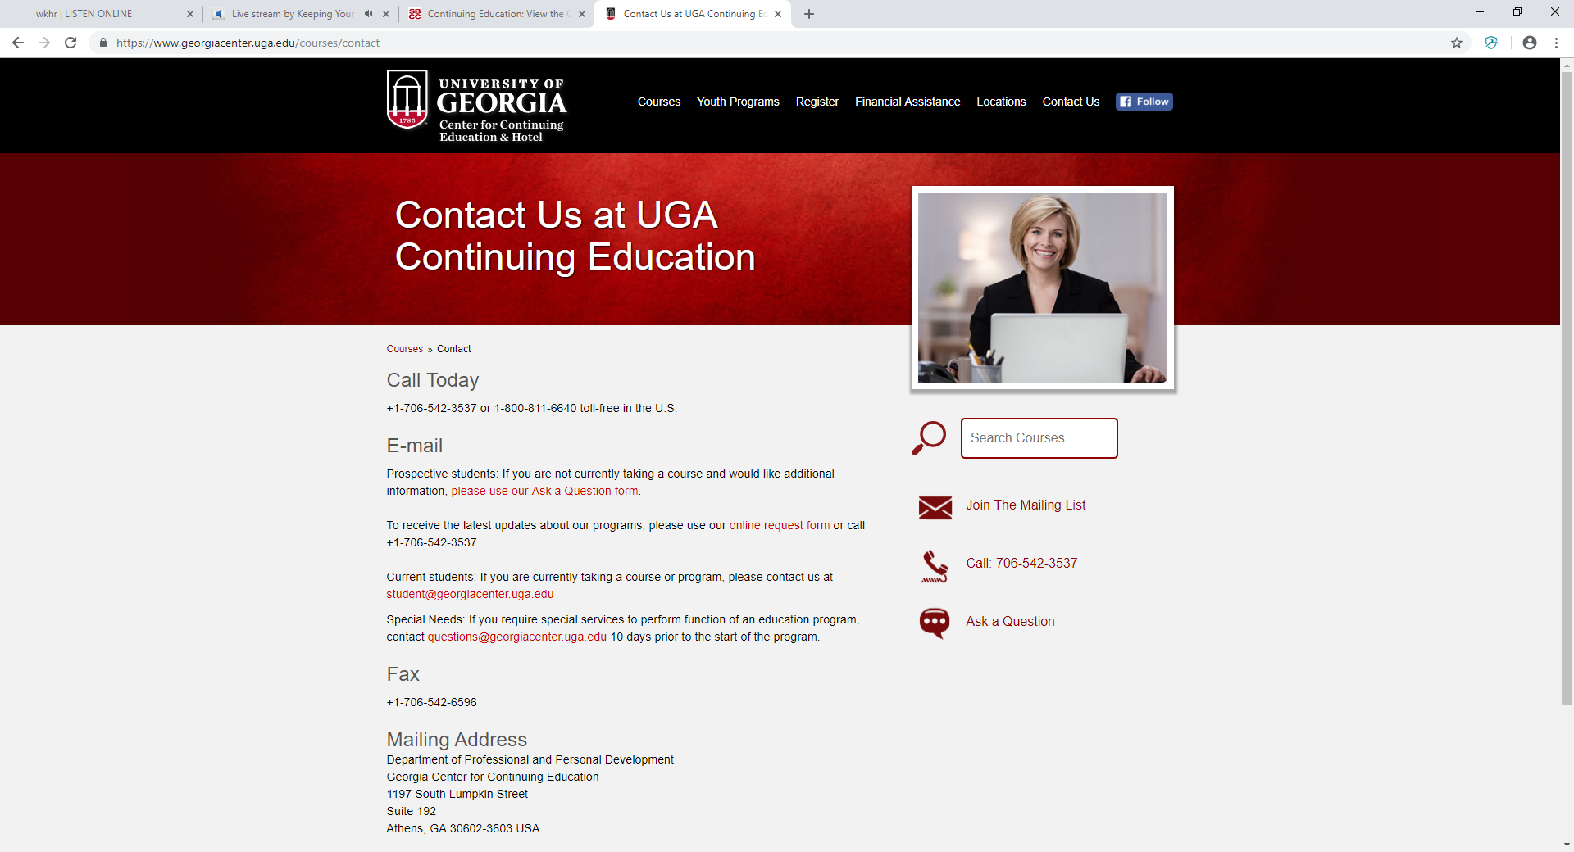

Slide 23
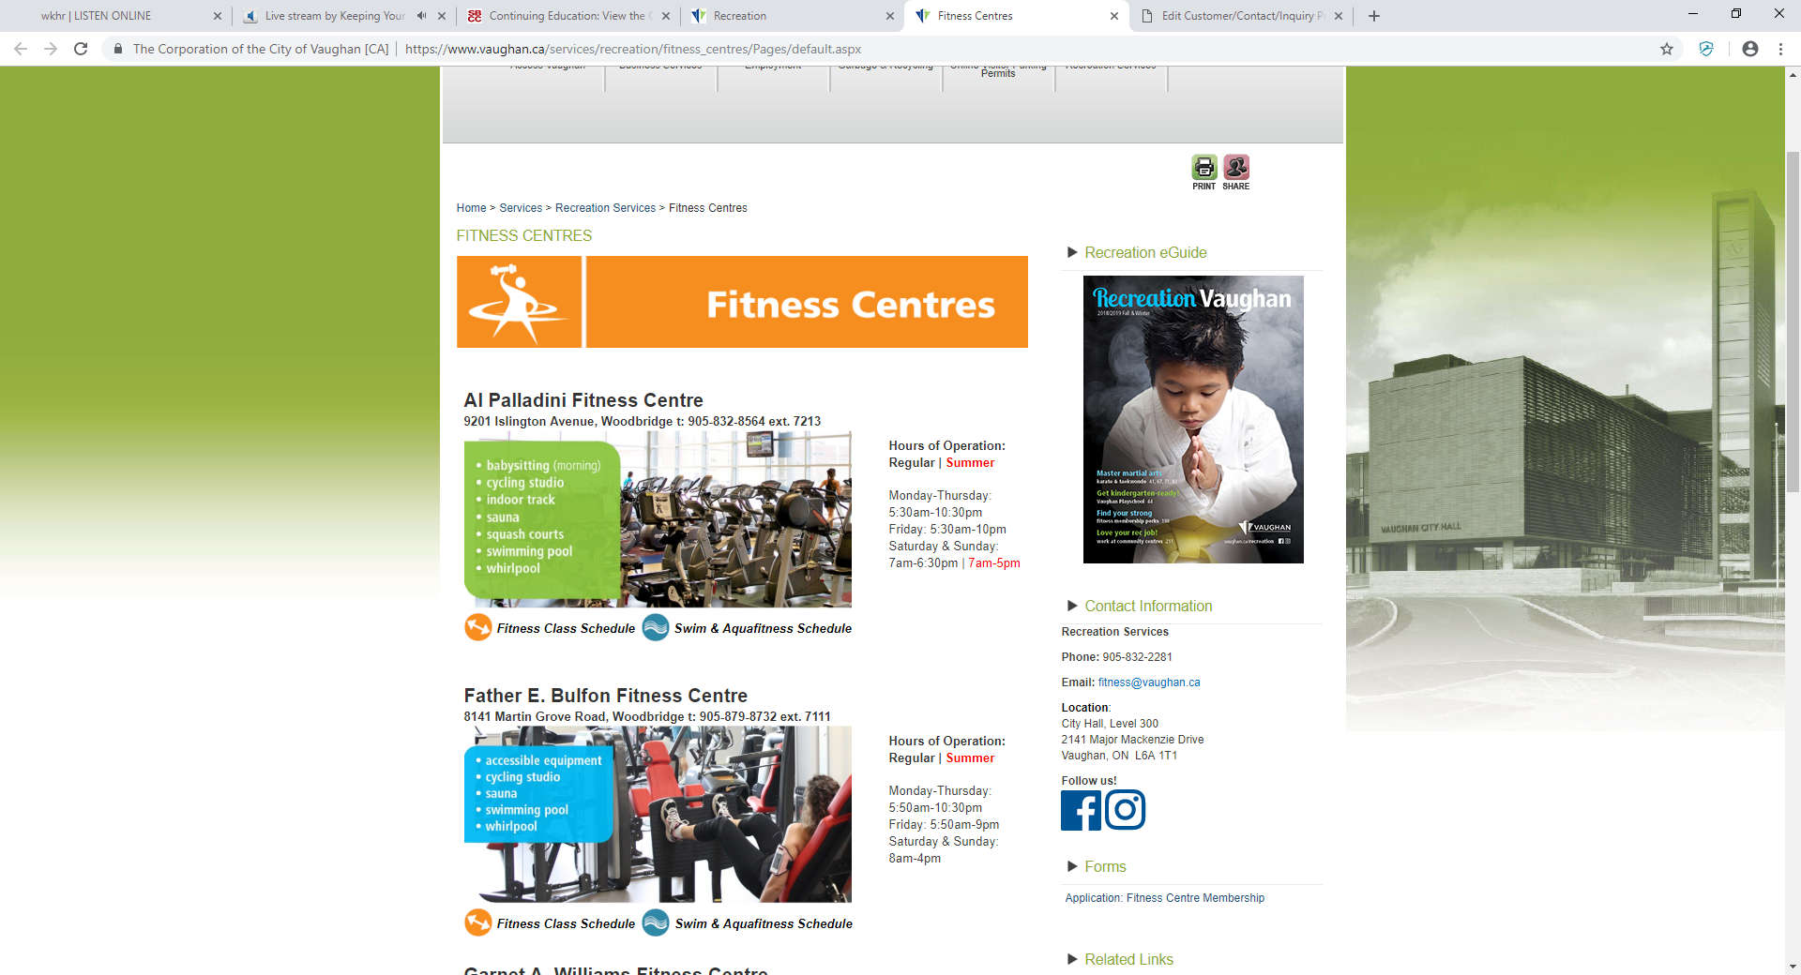

Slide 24
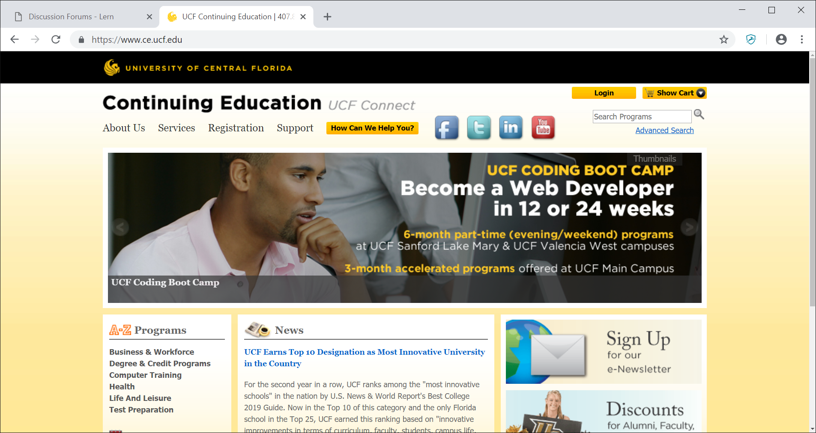

Slide 25
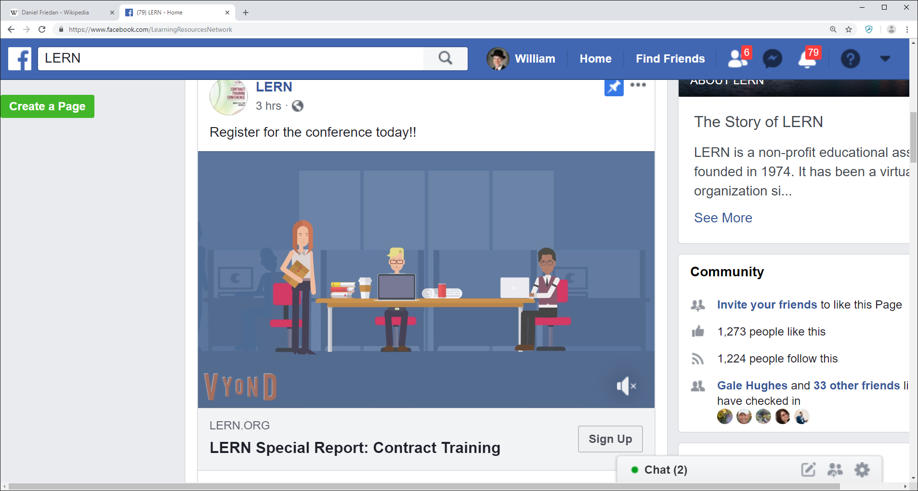
Social Media Tips 1.Put Video in Facebook 2. 80 or fewer characters for posts

Slide 26
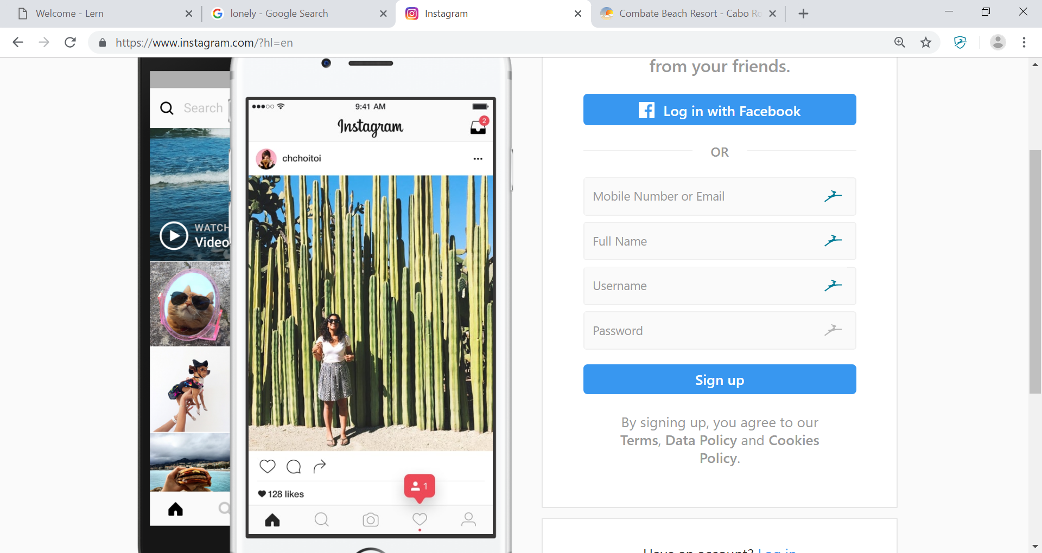
Instagram
#5
Hashtags
Ideal for
Instagram
Posts for
Engagement

