Slide 1
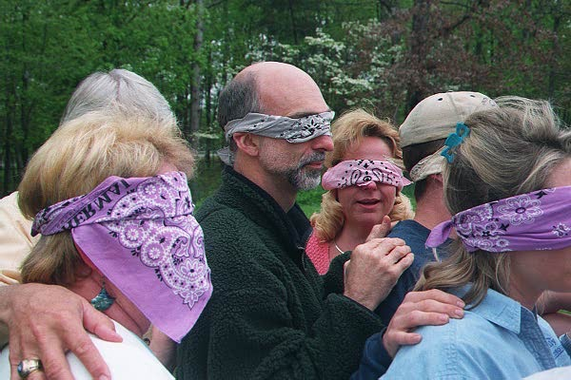
Winning Techniques for Increasing Intellectual Capital
Fred Bayley • LERN Senior Consultant • Bayley@LERN.org

Slide 2
Increasing Intellectual Capital
What is it
Gaps
Training
How LERN can help

Slide 3
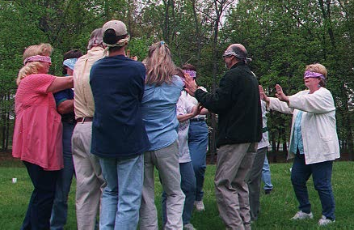
A. People - Biggest Asset
1. What is it

Slide 4
B. Challenges
Changing Times
Only 1 person knows
Retirement
Leave
Start their own business
Don’t do it often.
1. What is it

Slide 5
C. Filling the Gaps
5% of budget - staff development
Options
Staff - skills
Long term agreement - contracts
Train staff.
1. What is it

Slide 6
Increasing Intellectual Capital
What is it
Gaps
Training
How LERN can help

Slide 7
A. Skill Matrix
 | Bob | Jim Bob | Billy Bob | Bobby Ann
Recruit Instructors | X | X
Orient Instructors |  |  | X
Train Instructors |  |  | X
Evaluate Instructors |  |  | X

Slide 8
B. Processes
Document
Review - 2 years
What is best for the customer?
Does this make sense?
2. Gaps

Slide 10
Increasing Intellectual Capital
What is it
Gaps
Training
How LERN can help

Slide 11
A. Orientation
Manual
Process
Mentor
3 points - 3 people
3. Training

Slide 12
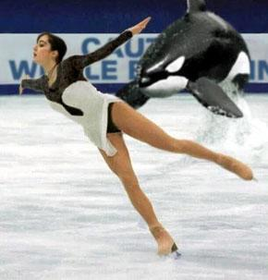
B. Cross Training
3. Training

Slide 13
C. Local Experts
3. Training

Slide 14
D. Personal Plan
1 new skill every 3-6 months
Plan contents
What skill
How
When
3. Training

Slide 15
E. Training
Go back to school
Read
Webinars
Conferences
Visit other programs
3. Training

Slide 16
Increasing Intellectual Capital
What is it
Gaps
Training
How LERN can help

Slide 17
LERN’s On-Site Institutes
Contract Training
Marketing
Operations
Program Management
4. LERN

Slide 18
How Institutes
One fee
LERN - faculty, manuals, readings
Host - room & audio visual
Your folks - you can invite others
Set your own fee
4. LERN

Slide 19
Setting Up Institute
Info@LERN.org or Bayley@LERN.org
4. LERN

Slide 20
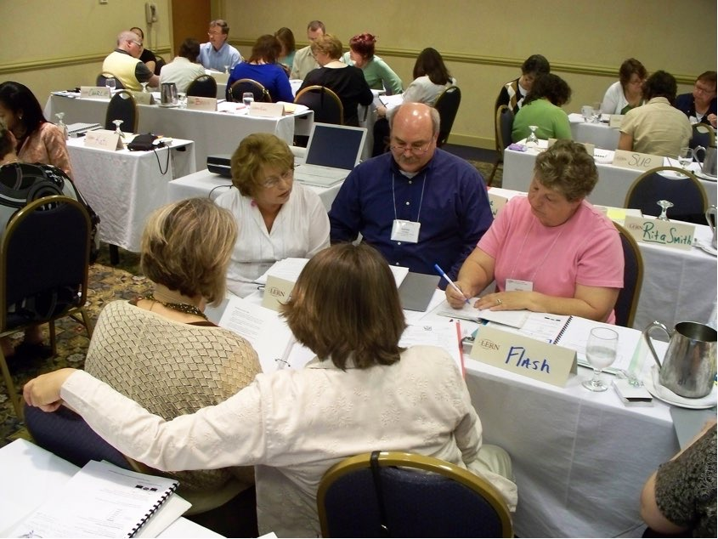
Other On-Site Training
LERN Boot Camp - you pick the modules
Instructor training
Specialized presentations
4. LERN

Slide 21
Key Checklist
5% budget spent in intellectual capital growth
Skill matrix
Document & review processes
Orientation process
Everyone learns new skill 3-6 months
Personal plan

Slide 22
Increasing Intellectual Capital
What is it
Gaps
Training
How LERN can help
Info@LERN.org
Bayley@LERN.org

Slide 23
Winning Techniques for Increasing Intellectual Capital
Fred Bayley • LERN Senior Consultant • Bayley@LERN.org

