Slide 1
Tips for Young Professionals
What I wish I had known

Slide 2
Find a Mentor
Someone senior within the organization or field
Someone who is respected and who has influence
Your mentor can vouch for you, provide you access to others
Your mentor is a wealth of information on career related questions

Slide 3
Make a 5-Year Plan
Roadmap of HOW you are going to get to where you want to be in 5 years
Steps you need to take
Projects you should take on

Slide 4
Build Practical Knowledge: Expert Power
What is the best way to grow?
Expert in what you do
Wide range of knowledge of your field
What will build your reputation?
What will set you apart?
How do you showcase your skills
Expert power comes from experiences, skills or knowledge. As we gain experience in particular areas, and become thought leaders we gain expert power that can be used to get others to help us meet our goals.
http://quickbase.intuit.com/blog/2011/08/26/the-5-types-of-power-in-leadership/#sthash.Y5YKW98s.dpuf

Slide 5
Create a Diverse Set of Relationships: Referent Power
People you admire
People with high standards
People at all levels
Referent power comes from being trusted and respected. We can gain referent power when others trust what we do and respect us for how we handle situations. –
http://quickbase.intuit.com/blog/2011/08/26/the-5-types-of-power-in-leadership/#sthash.Y5YKW98s.dpuf

Slide 6
Communicate
Even “over-communicate”
Get support
Get good ideas
Earn respect and trust

Slide 7
Learn the Art of Small Talk
Develop a list of “go-to” questions to use when interacting with others you may not know well
Create some “talking points” about your own experiences that you can use to respond to common questions others may ask
Being able to put others at ease by being socially comfortable will help you build support

Slide 8
Moving Up! 7 Thoughts for Future Leaders
Rita Martinez-Purson, Ed.D.
Dean Emerita, UNM Continuing Education

Slide 9
1. Get Out of Your Own Way
Don’t believe everything you think
Recognize your higher inner voice
Understand ego and how it can hold you back
Practice Courage and Conviction
Fail well
Develop your muscles
Notes:
1. Get out of your own way
Don’t believe everything you think
Practice mindfulness - Get to know yourself and what your gut tells you. This is a careful balance because you also have to practice enough humility to admit mistakes, and accept criticism. You cannot move to the next level of genuine growth without doing the work of honestly assessing where you are along the journey.
Fail well: Take risks, be innovative, learn from your mistakes. Practice humility
Learn to Sell Yourself
Practice humility with confidence: Doing the work of self improvement should include two dimensions: understanding who you are now – both strengths and weaknesses and having clarity about your purpose and what you want to contribute to the world. This is a lifelong journey and we must be scrupulously committed to doing the work.
Observe and learn from the best: surround yourself with quality role models and people who have values you trust
Be strong: Understand what builds resilience for challenging times (includes stress management, self-care, support networks – buffalo, faith/meditation.
Practice Courage in tough times: Chase out the “little me.” Choose your battles carefully
2. Develop Your Leadership Potential
Become a leader at your level (will help you position for future leadership skills)
Step forward! (volunteer to orchestrate projects, you will learn, and improve your value to the organization)
Deliver on what you promise
3. Hone your Emotional Intelligence
Resonant Leadership (how you connect with people and resonate with needs)
Mindfulness: Be aware of your own inner voice at a higher level. Above ego and fear. This will tell you what your need to do for yourself, for others. What is the right thing to do, what are the important battles to fight. Not every battle is important. Get in touch with your gut and what people around you need most. Everyone wants to be seen and heard. This is a fundamental leadership quality, leading to….
Compassion: Brings purpose and meaning to each day
Hope: Leaders must find ways to stay hopeful and spread positive messages
Understand personality types and the differences between people, starting with yourself
Understand the gifts of introversion and extroversion
4. Learn about the values, culture and politics of your organization. Be savvy in putting this knowledge to work in your interactions.
5. Keep on Learning
Get the education you need for the job you want
Stay on top of skills you need
Marketing
Instructional Design and Technology
Project Management
Leadership Development
Information Technology
Budget and Finance
Fundraising
Managerial Skills such as Human Resource Management, Meeting facilitation skills, organizational development tools
5.Communication is King
Practice public speaking
Continually hone and share your writing
Build higher-level communication skills along the way: negotiation skills, public relations, conflict resolution, mediation, etc.
Connect with smart people who are well connected
Use your social networking sites, meetings, community groups to your advantage
6. Build trust
Trust is the foundation for your future: Recognize that trust is fundamental to relationships, and healthy relationships are fundamental to your success and happiness. Don’t compromise on being trustworthy.
Always have at least one trusted advisor
Build your integrity and trustworthiness (Steer clear of negative messaging in email, gossip – be careful about what you put out to the world. Focus on making a positive difference in the world each day)

Slide 10
2. Be Purposeful
Get in touch with your gut
Recognize your Life Purpose and Passion
Hone Your Leadership Potential to Make a Difference!
Step Forward
Deliver!
Notes:
Get in touch with your gut: This is that higher voice that can guide you to good decisions, help you understand your goals and focus, what battles you need to take on and how to approach issues wisely
Become a leader at your level (will help you position for future leadership skills)
Step forward! (volunteer to orchestrate projects, you will learn, and improve your value to the organization)
Deliver on what you promise

Slide 11
3. Develop Resonance
What it means to be a Resonant Leader
Emotional Intelligence through:
Mindfulness
Compassion
Hope
Understand personality types
Notes:
Hone your Emotional Intelligence
Resonant Leadership (how you connect with people and resonate with needs)
WE have already spoken about Mindfulness, which is not only being aware of your own inner voice at a higher level. (above ego and fear), but extends to the broader world. Mindful people are in touch with their instincts and their inner wisdom. This becomes a lighthouse to guide you to good decisions and will tell you what your need to do for yourself, for others. What is the right thing to do, what are the important battles to fight. Not every battle is important. Get in touch with your gut and what people around you need most. Everyone wants to be seen and heard. This is a fundamental leadership quality, leading to….
Compassion: Brings purpose and meaning to each day
Hope: Leaders must find ways to stay hopeful and spread positive messages
Understand personality types and the differences between people, starting with yourself
Understand the gifts of introversion and extroversion

Slide 12
4. Sharpen your Social and Political Savvy
Learn about the values, culture and politics of your organization
Be savvy in applying this knowledge
Understand and deal with power brokers toward the greater good
Notes:
Learn about the values, culture and politics of your organization. Be savvy in putting this knowledge to work in your interactions.

Slide 13
5. Make Learning Part of the Journey
Get the education you need for the job you want
Stay on top of skills you need, e.g.:
Instructional Design and Technology
Project Management
Managerial: HR, Budgeting, IT
Leadership Development
Marketing and Public Relations
Organizational Development, Strategic Planning
Notes:
Two components:
Get the education you need for the job you want
Then walk the talk as a continuing education professional! Stay on top of skills you need
Marketing
Instructional Design and Technology
Project Management
Leadership Development
Information Technology
Budget and Finance
Fundraising
Managerial Skills such as Human Resource Management, Meeting facilitation skills, organizational development tools

Slide 14
Learning Focus: Communications
Marketing and Public Relations
Meeting Facilitation
Build higher level interaction skills: e.g. negotiations, graphic facilitation, advanced communications
Build higher level writing skills: e.g. contracts, grants
Build your public speaking skills!

Slide 15
6. Communication is King
Stand up and speak!
Listen, listen, listen
Develop clear, concise writing skills
Build connections with connectors
Use meetings well and manage your messages
Build partnerships with purpose
Notes:
Practice public speaking
Continually hone and share your writing
Build higher-level communication skills along the way: negotiation skills, public relations, conflict resolution, mediation, etc.
Connect with smart people who are well connected
Use your social networking sites, meetings, community groups to your advantage

Slide 16
7. Build Trust
Understand that trust is fundamental
Become a trusted advisor
Have at least one trusted advisor or mentor
Build your integrity and trustworthiness
Focus on making a positive difference, and bringing light into your world
Notes:
Trust is the foundation for your future:
Recognize that trust is fundamental to relationships, and healthy relationships are fundamental to your success and happiness. Don’t compromise on being trustworthy.
Always have at least one trusted advisor
Build your integrity and trustworthiness (Steer clear of negative messaging in email, gossip – be careful about what you put out to the world. Focus on making a positive difference in the world each day)

Slide 17
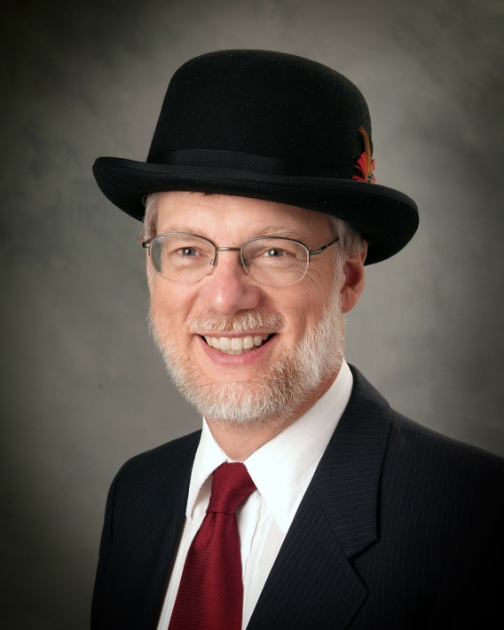
Leadership Insights: What I Wish I Knew As a Young Professional
William A. Draves

Slide 18
1. You are successful

Slide 19
2. It Might Well Be Their Problem

Slide 20
3. Big successes comes once

Slide 21
4. Build Off Your Strengths Don’t Focus on Your Weaknesses

Slide 22
5. Listening is more important a skill than talking

