Slide 1
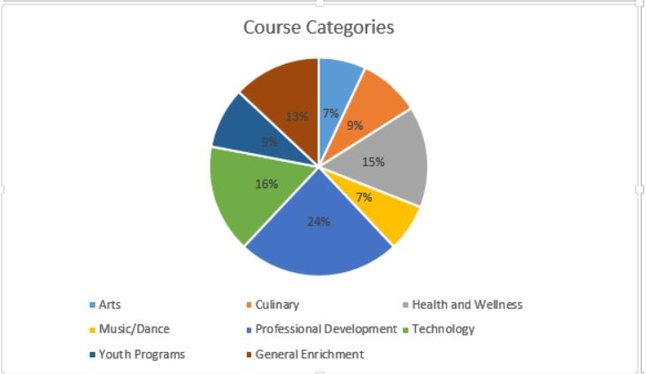

Managing Your Program Mix
Offering the Right Courses to the Right Audience
A Webinar for LERN Members
Presented by Julie Coates
Senior VP for Membership Services
Notes:
NOTE:
To change the image on this slide, select the picture and delete it. Then click the Pictures icon in the placeholder to insert your own image.

Slide 2
What we will cover
What is Program Mix?
What are the best practices for assuring the right combination?
When to drop a course from your program.
How to know what new courses to add.
What is typical for your constituency?

Slide 3

Your Presenter
LERN affiliation since 1976
Director of one of the oldest community programs in the US for 10 years (1976-1986). This program, founded in 1968, is still thriving.
Author of the first publication on LERN Ratios and enrollment analysis as well as multiple articles, reports, and full-length books.
Online teaching in LERN institutes and adjunct faculty member at University of South Dakota
Chair of LERN/University of South Dakota master’s degree program
Research, consulting and membership development
Julie Coates, Sr. VP for Membership Services
Notes:
This data comes from you
All LERN info comes from what our members are doing that works
LERN Collects, analyzes and packages that information for our members
That is why it is critical that you continue to keep us up to date on what is working in your program

Slide 4

What is Program Mix?
Your Program Mix is the percentage of each category of courses, classes, activities, or events you offer to your participants.
Your program mix will vary from others’ based on your target audience.
Having the right proportion of courses in each category is one critical aspect of maximizing your program’s performance.
Notes:
Your program mix is a critical part of your program’s success, and it is essential that you carefully plan and design your course offerings.
The wrong mix can mean you are investing resources into areas where you will not get a good ROI, and that you may be overlooking areas where you could generate more participation and revenue.
Some rules of thumb:
The percentage of income from your courses should be greater than or equal to the percentage of courses in a particular category. In other words, if you generate 20% of your revenue from Arts classes, then at least 20% of your courses should be in the Arts category. If you generate 20% of your revenue from Arts classes and 30% of your classes are in the Arts category, you should look at which classes you can cut. If it is greater than the percentage offered, look at offering more Arts classes.
Use this as an opportunity to add courses to a category that is a stronger performer.
Maintain program diversity. It is dangerous to have too high a percentage of revenue generated by one program area. Just like an investment portfolio, it is safest to diversify. That way, if classes in one area experience a downturn, your program is in a stronger position to recover.
Focus on your best programs. When promoting and presenting your program offerings, make sure the most popular programs have strong positioning in your brochure and on your website. Sometimes people make the mistake of focusing on struggling programs. While you may want to take steps to improve performance of weak programs, you need to focus on your strengths. Your strengths are a defining element of your brand, and you need to leverage that to your benefit.

Slide 5
Six Steps to Success
Notes:
We are going to look at six things you should be doing to make sure you have the best mix of programs and the lowest cancellation rates for your offerings.
So let’s get started.

Slide 6
Where do I start?
New
20%
30% Rule
No single category, subcategory or course should generate more than 30% of your revenue or registration numbers
Clear Plan
Program Development
Analysis
Student Evaluations
Performance Analysis
Implementation
Notes:
Slide 6. You have to start somewhere. Hear are 4 things to do to help keep you on track.
Develop your plan.
If you don’t know where you are going, you may never get there. In the next few slides, we are going to look at tools you need for planning.
We will be looking at how you can best implement your plan to generate the highest levels of success.
Understand that at the highest level of program mix, you need to offer about 20% new programs and have 80% repeat programs. This helps focus on your strengths and to introduce new opportunities.
Always analyze and evaluate at the end of each term so that you can make improvements and changes.

Slide 7
What tools do I need?
Average Fee
Average Participants
Cancellation Rate
These three formulas give you the information you need to determine:
Number of classes to offer
Percentage of new
Percentage of repeat classes
Which categories to increase or reduce
Notes:
There are three basic pieces of information that you need to have to be able to plan effectively for your program mix. Getting this information is not difficult, but it is critical.

Slide 8

Average Fee
Total revenue divided by number of registrations.
1000 registrations generate $50,000
Average Fee = $50
Notes:
This is the average amount of all fees paid by your participants. It is best do this for each category or subcategory of classes you have. If you have any outliers or one-offs, such as a very high priced course or a very low priced or free course, you might eliminate them from the calculation. For example, if you offer a series of local tours, and they have fees ranging from $45 to $65, then you are fine to average the classes. However, if you have a one-off class—an art tour and dinner that costs $350, you might exclude it so as not to skew your numbers.

Slide 9

Cancellation Rate
Divide the total number of classes cancelled by the total number of classes offered.
125 classes offered
25 classes cancelled
Cancellation rate = 20%

Slide 10

Average Participants/Class
Divide the total number of registrations by the total number of classes.
100 classes and 1000 registrations
1000 registrations divided by 100 classes means you have an average of 10 participants per class.
Notes:
With these three numbers you have everything you need to start planning.

Slide 11

Step 1: How Many Classes to Offer
Revenue Goal for category or sub-category: $50,000
Average Fee: $50
Average participants: 10
Cancellation Rate: 20%
Since the average fee is $50 and your income goal is $50,000 you will need 1,000 registrations to meet your revenue goal.
Find this by dividing the goal amount ($50,000) by the average fee ($50)
This is one key piece of the puzzle.

Slide 12

Using your average participant data
Your average registrations/class= 10
Your total registrations = 1000
Divide 1000 by 10 = 100
This is how many classes you will need to run

Slide 13

Using your Cancellation Rate
You have to run 100 classes at your average fee and average participation rate, but you know you have a 20% cancellation rate.
Therefore you have to run MORE than 100 classes in order to have 100 that make.
How many should you offer?
Offer the number you need to actually run plus the percentage cancelled. Thus you have to run about 125 classes.

Slide 14

Putting it all together: Meeting your revenue goal
Average fee $50
Average participants= 10
Cancellation Rate=20%
$50,00/$50 = 1000 registrations
1000 registrations/10 average registration = 100 classes
20% should be new so you will need to have about 25 new classes and 100 repeat classes.

Slide 15

Step 2: Select the courses to offer
Review courses over the past 1+years and note trends for:
  Average registration
  Average operating margin
  Quality/satisfaction score
Select the 80% of courses you think will be most successful.
Ask for LERN’s FREE (to members) “Star-Dog” analysis to give you data on your course performance.
Notes:
Operating margin is the cost of your promotion (brochure plus mailing) and the cost of your production (mainly teacher compensation) subtracted from your total revenue. OM is how much you have left after you pay all your promotion and production costs. This should be 40 to50% of your income.

Slide 16

Free LERN Tools for Program Development
Category/subcategory/course reports
Demographics report
Carrier routes report
Repeat Rate and Lifetime Customer Value analysis
Primary Market Segments
Next Course Report
Best Customers List

Slide 17
Free LERN Tools for Program Development
We will identify your best categories, subcategories and classes based on registration count and revenue from your data.
You will be provided sortable spreadsheets to help you best analyze the data.
The 80/20 rule applies to most program’s data
This data can help you identify program areas that are both struggling and booming. This can help you make informed programing decisions.

Slide 18

Recognize a loser & winner
Income has not grown for two years
Another offering has a better response rate
Changing the title, instructor(s) or format would NOT make a difference
You cannot raise the price without jeopardizing attendance
You increase promotion and nothing happens
The potential for this program is double your current attendance
Notes:
Income has not grown: If the course is stable and has a good operating margin, keep offering it, of course. Lack of growth suggests it may be nearing the end of it’s productive life.
Another offering: Other courses or topics get stronger enrollments. This is where you should focus. Remember we talked about focusing on your strengths.

Slide 19

What makes a course a winner?
Consistently strong enrollments
Strong operating margin (40% or better)
High quality and satisfaction ratings
Fits your philosophy and demographics

Slide 20

What to do with the winners
Offer them more often
Offer them in a different location
Offer them at a different time
Offer them in a different format
Offer at a different time
Offer spin-offs
Notes:
Step 1. Brainstorm all the possible new directions you can take
Step 2: Research the top 5-10 directions (audience, income potential, competition, etc.)
Step 3. Pick the top three new ideas
Step 4. Model the numbers, using your tools of average class fee, average registration and cancellation rate. If it won’t work on paper, it won’t work in real life.
Step 5. Build your program using feedback from best customers (more should be done for high dollar courses including surveys, focus groups, etc.)
Step 6. Promote your new idea
Step 7. Determine if the new course meets your success criteria (enrollments, revenue, etc) or if it came close.
Step 8. Evaluate and make improvements/adjustments (Change title, fee, description, format, time, etc.)

Slide 21
Step 3: Eight step needs assessment
To be most effective with the selection of new courses, your new course selection process should start the term before you plan to offer it. Thus, in the fall you would be selecting new courses for the winter term.
For major new programs and high dollar or high investment programs, the process is likely to require a longer development period.

Slide 22
Rate your new ideas
Will the offering last 3 years?
Will the offering generate the same or more than category/subcategory average?
Will the new offering meet the budgeted operating margin the 3rd time you run it?
Can you identify the potential participants’ names?
Notes:
22

Slide 23

Calculating Income for your first-time offering
Use historical data from other offerings
From related subjects, other experiences with first offerings
Average participants per offering X offering fee (10 X $125 = $1,250)
Make your first-offering income objective as conservative as possible ($1,000)
Cancellation rates for first time offerings are higher than for repeat classes—typically 50% or higher.
Notes:
23

Slide 24

What constitutes a strong potential audience?
They are currently participating
2+ demographic characteristics can be identified
You can reach them (good mailing list, good email list, good SEO, etc.)
There is no dominant competition
Notes:
24

Slide 25
When not to develop a program
If the offering will be offered only once
  unless you can recoup all development costs
If the new offering doesn’t “fit” in with your philosophy about what to offer
If your demographic has not shown interest in this topic area

Slide 26

Step 4: Create Your Plan
Course Description, using LERN Best Practices
Course Objectives and Outcomes (formal or informal, based on type of course)
Agenda (based on type of course)
Instructor information
Set your price with a target 40% operating Margin

Slide 27

Step 5: Create your marketing plan
Your print brochure
Digital marketing
Target best prospects
Notes:
Other strategies that work with your market--
Integrated marketing

Slide 28

Step 6: Evaluate and Revise
Student Evaluations
Performance Data
Analyze
Revise

Slide 29
National Trends in Program Mix
Notes:
This is a first cut through the data. Percentages based on data from members.
To determine these percentages we looked at past datasets for the various constituencies.
Programs don’t always have the same categories so we made some generalizations when grouping things together.
The percentages represent an average percentage for those programs that offer that type of programing.
For example youth programing makes up roughly 13% for Community College programs that offer youth programs. Those that don’t offer youth programing were not included in that number because we didn’t want to start averaging in zeros.
We are working on developing a more comprehensive analysis of program mix, and if any of you would like to be contacted to contribute information let us know.
We also know we need to be able to dive deeper to identify the components of the categories in some cases, but an interesting overview.

Slide 30
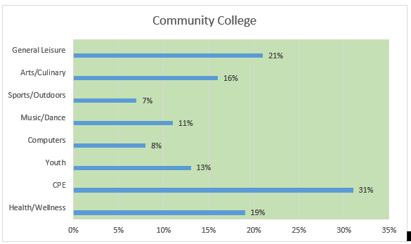
Community Colleges
Some totals may not equal 100% because courses may be included in more than one category

Slide 31
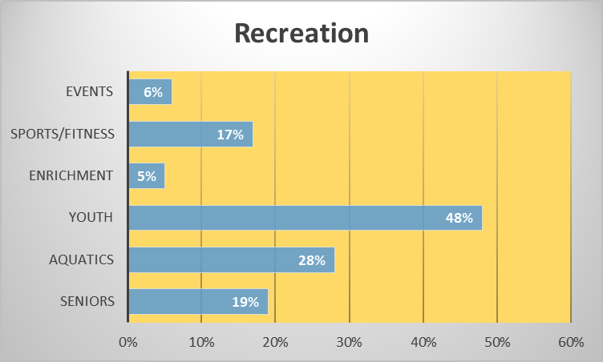
Recreation

Slide 32
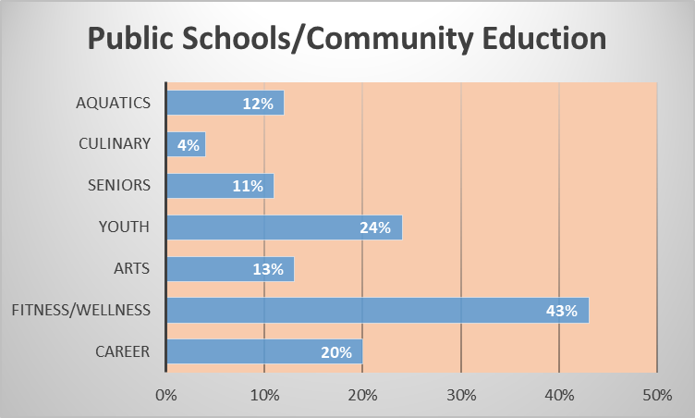
Public Schools

Slide 33
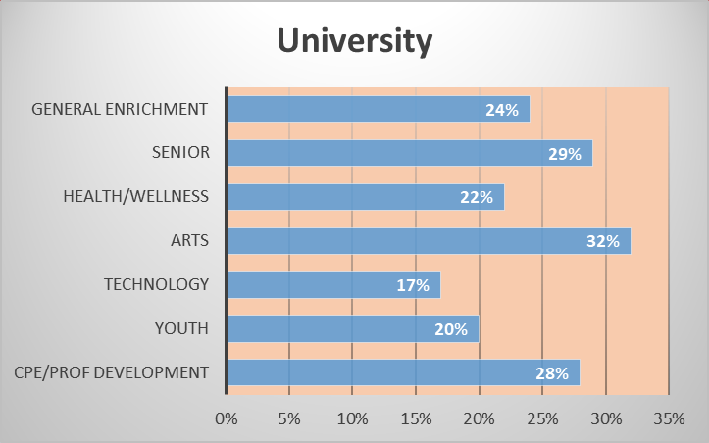
University

Slide 34
Dashboard
See how your program compares to other similar programs around North America
The data is generated by surveying all LERN members about how their organization has performed over a set period of time.
You will be asked to answer basic demographic questions that will be used to allow members to drill down further into the data and create the most relevant analysis for their programs (for example, technical schools in Kansas that have between 5,001 and 10,000 yearly registrations and a budget of $250,001 and $500,000).
You will also be asked if you offer Open Enrollment and/or Contract Training. Then you will be asked specific questions about the performance of your Open Enrollment and/or Contract Training programs.
These questions allow for meaningful data that can be custom tailored to create a realistic comparison between members’ programs. This tool will be available to you and other members through the LERN Club, allowing you to do your own analysis on your time!

Slide 35
Lean on LERN!
Request a FREE segmentation analysis.
Make an appointment for a FREE consulting call with a LERN consultant.
Attend the LERN Annual conference (and earn one graduate credit or CEUs)
Sign up for the New Course Development Institute offered online, beginning September 12 (https://lern.org/events-education/online-institutes/new-course-development-institute/)
Invite a LERN consultant to your staff meetings to answer questions about your program development.
Contact Tammy Peterson at info@lern.org for more information about how LERN experts can help you become more successful!
www.lern.org
800-678-5376

