Slide 1
Marketing Benchmarks
Learning Resources Network
Suzanne Kart, M.A., CeP
Associate Vice President of Marketing

Slide 2
Agenda
Integrated Marketing Concept
Print Marketing Strategies and Benchmarks
Digital Marketing and Benchmarks
Websites
eMail
2

Slide 3
Introductions

Slide 4
People are stressing out over marketing
Traditional marketing
Inbound marketing
Viral marketing
Video marketing
Mobile marketing
Social Media
Facebook
LinkedIn
Twitter
Now we have to figure out Pinterest
Gen X, Gen Y, Boomers, Seniors, and then there’s the kids, too
The Internet keeps changing on us
How can we possibly keep up?

Slide 5
Just breathe

Slide 6
What to do when you start to panic
Remind yourself marketing is still marketing
Who are you trying to reach?
What do you want them to do?
What’s the best way to find them?
Go back to the center

Slide 7
Know your benchmarks and track your data
If you don’t measure, you don’t know what’s working and what’s not.

Slide 8
Changing the way we do things in marketing

Slide 9
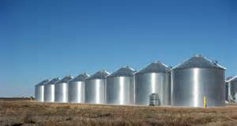
Integrated marketing
Marketing is no longer in silos.
eMarketing, mobile marketing, print marketing, inbound marketing and all other “forms” of marketing are now just marketing

Slide 10
Your brochure is the cornerstone of your marketing effort
Start with the brochure and build up from there.

Slide 11
State of print marketing
Your catalog is still the most important weapon in your arsenal.
75% of registrations still originate with the print catalog.

Slide 12
In our field…
A recent study of LERN members found that less than 1% of members do not mail a catalog.

Slide 13
It’s not just our field…
A recent USPS study looked at the shopping habits of nearly 5,000 visitors after they left 135 retail Web sites, including traditional retailers and manufacturers.
What they found was:
57% of online shoppers said that even though they buy online, they still like to have a catalog on hand
61% of online retail shoppers reported that when they have a catalog while shopping online, they may see additional items they would like to buy
84% of catalog recipients feel it’s easier to shop online with a catalog in hand.
https://www.usps.com/business/pdf/comScore_Retail_WP.pdf

Slide 14
How do we create the best catalogs?

Slide 15
Don’t redesign just to add your stamp
By keeping what’s good and what’s working (and there ALWAYS is something), you create consistency while striving for continuous improvement.

Slide 16
The evolution of your catalog
2005 Institutes
2010 Institutes
Both have good photos that match the tagline.
Both have good taglines.
Both say about the same thing.
Why is 2010 better?

Slide 17
The evolution of your catalog
2005 Institutes
2010 uses a much bigger photo (and it’s full bleed)
2010 pulls color from the photo into the text
2010 Uses san-serif font, because the cover text is made of mostly headlines
2010 Keeps what’s good about 2005, but takes it up a step
2010 Institutes

Slide 18
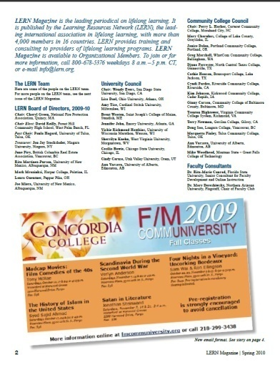
Another example
2002
2010
Both prominently say LERN Magazine
Both are 4-color
Both Tease the stories inside
Why is 2010 better?

Slide 19
Another example
2002
2010
2010 replaces a best practices example with a photo illustration – it’s now about the reader
2010 uses contemporary color and a full bleed photo
2002 follows more of a newsletter style, 2010 uses magazine design

Slide 20
Where do we start?

Slide 21
Target your marketing!
Images
Text & Language
Graphic Elements
Color Choices

Slide 22
You really need to figure out
Who are your customers?
What can you do for them?
What will appeal to them?
What information do they want from you?
What’s the best way to reach them?
Why should you they choose you?

Slide 23
Who Are Your Customers Really?

Slide 24
Best Customers
Other Customers
Non-Customers

Slide 25
80% of your business comes from 20% of your customers!

Slide 26
Segment the Market
You want to segment the market because you serve some, but not all, demographic groups.
There is no average participant.

Slide 27
Market Segmentation
A process by which you distinguish or differentiate your various audiences, build a separate demographic profile for each group and then deliver different products and even different promotions aimed at your best market segments.
80/20 Principle

Slide 28
Why Segment the Market?
You serve some, but not all, demographic groups.
Roughly 20-25% of your customers give you 80% of your business.
You need to know who the 20-25% are.
To focus resources on that 20-25% — programs, staff, marketing.
To make sure you serve your best customers very well.

Slide 29
Problems Caused by NOT Identifying Primary Market Segments
Ineffective program selection
Wasted promotion dollars
Decrease in repeat rate
Reduced operating margin
Wasted staff time

Slide 30
Using Customer Recency & Monetary Value
Recency = a customer attended in the recent past.
The Key: Defining what is recent. Here are the benchmarks:
Community Programs = 1 year
CPE = 1-3 years
Conferences = 1-2 years
Credit Programs = 1-2 years
Monetary Value = Higher than average dollars spent during defined period.
“Monetary Value” could be “Activity Level”

Slide 31
Chart 1: Organization Participants

Slide 32
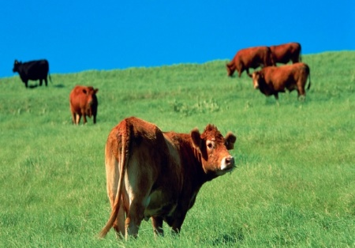
Your Customers
More recent Less recent
High dollar
Low dollar

Slide 33
Chart 2: Revenue/Operating Margin

Slide 34
Chart 3: Organization Resources

Slide 35
Chart 4: Efficiency Strategy
More money
Less money
More time Less time

Slide 36
Who lets the dogs out?
You do!

Slide 37
Your Seven Primary Market Segments
You have seven primary market segments.
Each segment is defined by common demographics.
Your seven segments make up your best customers – they are your most recent customers and those who spend the most money with you.

Slide 38
How do I find out my seven segments?

Slide 39
Mailing to your seven segments
Brochure:Participant Ratio should be 50:1 or better

Slide 40
Next, create a powerful web site
You want something that’s
Intuitive and easy to navigate
Looks good
Search engine optimized
Mobile optimized (Right now only 50% of LERN members have a mobile optimized site – and this year the number of people who access the Internet from a mobile device will outnumber the people accessing the Internet from a laptop.)
Last spring, Google adjusted it’s search indicators to give preference to mobile optimized web sites.
Easy to update – and updated often.

Slide 41
Google search: “Employee training Iowa”

Slide 42
This ranked first in organic search

Slide 43
“Events” means this page is updated often Social media icons (when you scroll down) mean they have a presence there “News” means they have inbound links from independent sites They use the words “employee,” “training,” and “Iowa” often

Slide 44
You also want to monitor your Google Analytics

Slide 45
Unique Visitors
The total number of individual visitors to your site during a specific time period – not counting repeat visits by the same person.
Look for an upward trend over a period of time.
If the number of unique visitors is not rising, you need to look at what marketing efforts you are using to push people to your site.

Slide 46
New visitors versus repeat visitors
This is a comparison of those who have come to your site only once and those who have come more often.
A good repeat rate is 15%.
If your repeat visitor rate is higher than 30 percent, you are not generating enough new visitors to grow.

Slide 47
Traffic Sources
How your visitors are finding you (including organic traffic, referral traffic, and direct traffic).
Direct traffic comes from someone who types in your URL.
Organic traffic comes when someone finds you through a search engine such as Google.
Referral traffic comes from a link on another website.
The goal is to have 40-50% of your traffic come from organic search and 20-30% come from referrals.

Slide 48
Bounce Rate
The number of new visitors who leave your site almost immediately after arrive with no other interactions.
A high bounce rate can indicate problems with your website, such as you’re not providing the information people are looking for – or they can’t find it.
This is also something that you should monitor over time – and take action if your bounce rate is not going down.

Slide 49
Length of page view
This is pretty straight forward, it’s how long the average person stays on a given web page.
This number varies based on the size of your site.
It’s best to compare this number against other similar size sites using the Google analytics tool.

Slide 50
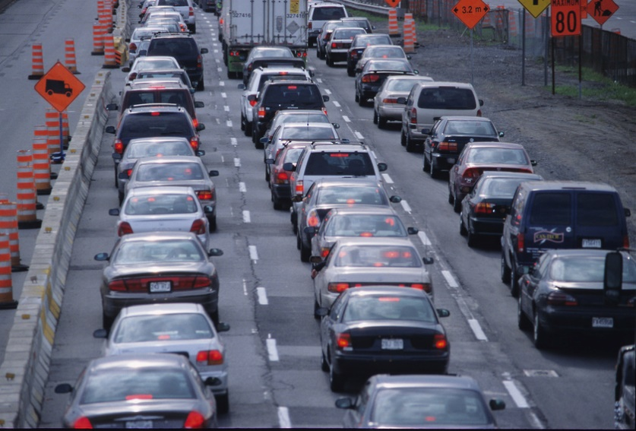
Now, it’s time to generate traffic!

Slide 51
Send Email
Have your promotional emails come from a person – not just organization.
Always link back to your web site.
If your open rate stays at 20% and your opt out and bounce rates are both <1%, it’s working.

Slide 52
LERN members and email
The majority of LERN members (54%) send 2-6 emails a month.
However, 9.5% still aren’t sending email promotions to their customers.

Slide 53
LERN members and email data
40% of LERN members who do email marketing don’t track – or don’t know how to track – click-through rates.

Slide 54
Create a blog
Organizations with blogs get 55% more traffic.
Blog pages are 400% more indexed
We know that nearly 90% of American consumers search the Internet before making a purchase. If 90% of your potential customers are searching, don’t you want to make sure your web site is at the top of the list?

Slide 56
eMarketing for lifelong learning – we rank #1 on Google

Slide 57
Another great blog

Slide 58
Blogging Benchmarks
3-5% of visitors to your blog should become leads.
That means the respond to a call-to-action and give you their contact information.

Slide 59
Next, get active on social media
Search engines use social media indicators such as how often your linked to and how often your content is shared to determine search engine ranking.
Eight percent of LERN members are STILL not using social media to market their programs.

Slide 60
Summary
Know your seven market segments
20% of your business comes from 80% of your customers
Your brochure:participant ratio should be 50:1 or better.
Print is still responsible for 75% of your registrations.
Your email open rate should be 20% or better with around 15% of those people clicking.
Know your Google analytics data.

Slide 61
Thank you!
Suzanne Kart
kart@lern.org

