Slide 1
Marketing on a shoestring budget
Suzanne Kart, M.A., CeP
Associate Vice President for Marketing

Slide 2
No matter what your budget, you need to start with a plan
If you don’t know where you’re going, any road will get you there

Slide 3
You need to decide
Who you are trying to reach
What you want to tell them
What you want them to do
Where can you find them
How will you know if you succeeded?

Slide 4
Your most expensive, and most effective weapon in your marketing arsenal
Some 70% of your registrations originate with your print brochure

Slide 5
Ways to reduce brochure reduction costs
Print less pages – but don’t eliminate course descriptions.

Slide 6
Focus in your best customers
MAILING RESPONSE RATE AMOUNT
6,000 past participants 6.00% 360
30,000 new participants 1.00% 300
36,000 total 1.83% 660
Assuming the cost of each promotion is $.25, the following is the cost to get a new customer versus retaining a past participant:
$.25 X 6,000 = $1,500/360 = $4.17
$.25 X 30,000 = $7,500/300 = $25

Slide 7
LERN members – take advantage of our free market segmentation analysis
Email info@lern.org for details

Slide 8
Select Winning Carrier Routes
Do not mass mail to ZIP Codes!
Mail to past participants multiple times!
Target best carrier routes!

Slide 9
What is a Carrier Route?
A postal carrier route is the group of addresses to which the USPS assigns the same code to aid in mail delivery.
These codes are 9 digits. 5 numbers for the ZIP Code, one letter for the carrier route type, and 3 numbers for the carrier route number.
05055 R003
12508 C007
Typically, each carrier route is related to where a particular mail carrier delivers.
NOTE: C=City (by foot), R=Rural (by auto), B=PO Box, H=Highway Contract Route & G=General Delivery Route

Slide 10
LERN Members – take advantage of our free carrier route analysis
Email info@lern.org for details

Slide 11
Focus in on digital marketing

Slide 12
But make sure it integrates with your traditional methods
Create a plan
Create a powerful website
Drive people to your website
Create a catalog
Email
Blogging
Social media
Search engine optimization
Search engine optimized
Mobile optimize
Easy to navigate
Success!

Slide 13
A Powerful website
Search engine optimized – nearly 90% of American consumers search the web before making a purchase (Hubspot)
Mobile optimized - according to analysts at Morgan Stanley, mobile usage will surpass desktop usage in 2015.
Easy to navigate

Slide 14
What does a non-mobile optimized site look like on your mobile device?

Slide 15
Penn State

Slide 16
SEO Google search: “Employee training Iowa”

Slide 17
This ranked first in organic search

Slide 18
“Events” means this page is updated often Social media icons (when you scroll down) mean they have a presence there “News” means they have inbound links from independent sites They use the words “employee,” “training,” and “Iowa” often

Slide 19
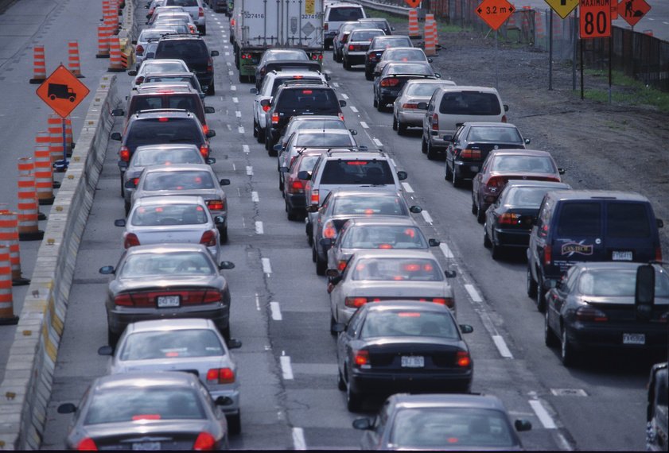
Now, it’s time to generate traffic!

Slide 20
Send More Email
Have your promotional emails come from a person – not just organization. For instance, you probably received emails from both William Draves and Suzanne Kart about this conference – rather than just “LERN.” Emails that come from a person are more likely to get opened.
Always link back to your web site.
Send more emails to less people. You’ll get more business. If your open rate stays at 10-20% and your opt out and bounce rates are both <1%, it’s working.

Slide 21
LERN members and email
The majority of LERN members (54%) send 2-6 emails a month.
However, 9.5% still aren’t sending email promotions to their customers.

Slide 22
Create a blog
Organizations with blogs get 55% more traffic (Hubspot)
Blog pages are 400% more indexed
We know that nearly 90% of American consumers search the Internet before making a purchase. If 90% of your potential customers are searching, don’t you want to make sure your web site is at the top of the list?

Slide 23
Some facts*
Nearly 40% of US companies use blogs for marketing purposes
Organizations that blog have 55% more website visitors
B2C companies that blog get 88% more leads/month than those who don’t (think open enrollment)
B2B companies that blog get 67% more leads/month than those who don’t (think contract training)
*Source: An Introduction to Business Blogging , a publication by Hubspot

Slide 24
great blog

Slide 25
Next, get active on social media
Search engines use social media indicators such as how often your linked to and how often your content is shared to determine search engine ranking.
Eight percent of LERN members are STILL not using social media to market their programs.

Slide 26
More great ideas

Slide 27
Create presentations
Slideshare is among the 150 most popular websites in the world (Forbes)
It allows users to upload shareable presentations. It’s a bit like YouTube, you find a presentation you like and then you share it.

Slide 28
You can use YouTube to do the same thing
Record your presentation in Powerpoint, save as a WMV, upload to YouTube, share on your website, via social media, and email

Slide 29
Or you can take the show on the road
Once you have a great topic to speak about, you can make the presentation to local organizations
Chamber of Commerce
Clubs like Lions and Rotary
Do you have a local PBS affiliate or NPR station?
Viral marketing is not just an online thing – and it’s especially important for attracting Gen Y (Langara)

Slide 30
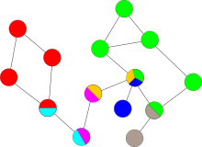
Do a free seminar (or webinar)
Engaging your key constituents makes them feel connected to your program and want to come back.
GoToWebinar and WebEx both have free trials to test a webinar.
Anymeeting is a free service that can accommodate up to 200 attendees.

Slide 31
FREE????
We can’t give away anything for free – then people won’t buy what we’re selling, right?
They’ll just take the free stuff and run, right?

Slide 32
Wrong

Slide 33
A marketing lesson from the Grateful Dead

Slide 34
The Grateful Dead
Original inbound marketers
Most successful touring band in history with $1 billion in revenue from concert tickets.
They let people record their concerts (free content) and share with anyone.
This did NOT stop people from paying to see them live – it made MORE people want to see them live.

Slide 35
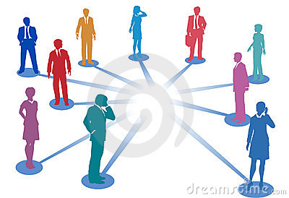
Leverage your community
Networking works

Slide 36
Make friends with a journalist
Think beyond just newspaper reporters
TV
Online/bloggers
Magazines
Radio

Slide 37
Do Not be afraid to ask for referrals
And give incentives for people to recommend you such as discounts or coupons

Slide 38
Thank you!
Suzanne Kart
kart@lern.org

