Slide 1

LERN Program Review
Position Your Program for Success

Slide 2
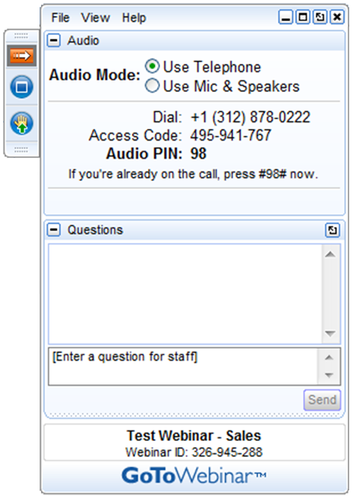
GoToWebinar
Today’s webinar will be recorded. A link to the webinar will be sent to participants within the next 24 hours.
Please do not place the webinar call on hold. If you need to take another call, please leave the call and rejoin later.
Please use the Questions function in your GTW menu to ask questions. Questions are answered at the conclusion of the presentation.

Slide 3
Learning Resources Network
The leading association in continuing education and lifelong learning
Founded in 1974 as a nonprofit
“Information That Works!”

Slide 4
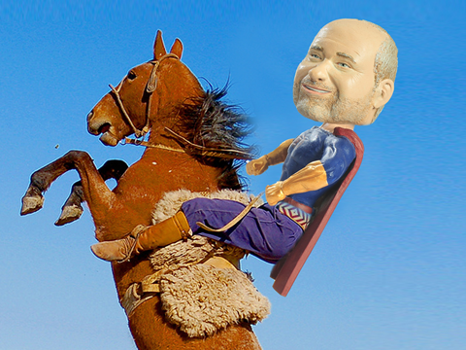
Greg Marsello
Co-Founder of LERN
Road Warrior
Data Analysis & Technical Support
Program Reviews – 200+

Slide 5

Agenda
Explain LERN’s Program Review
Outline the benefits of the Program Review
Describe how the Program Review works, including process, what you need to do and price
Examples
Answer your questions

Slide 6

LERN’s Program Review
LERN’s Program Review is an informal assessment, not an audit, of your program to provide specific how-to recommendations to improve your programming, marketing, sales and operations efforts

Slide 7


Slide 8
Program Review Benefits
Compare your program to similar programs
Match your program to industry standards
Understand best practices you should implement
Learn how to access your program’s performance going forward
Have a report you can forward/share with central administration

Slide 9
Program Review Process
You are assigned a LERN consultant
LERN consultant provides you a list of data, information and materials to prepare and forward
LERN consultant analyzes data, information and materials
LERN consultant visits for 2 days. Day 1 is to review data, information and materials and to gather more information. Day 2 LERN consultant reviews preliminary recommendations.
Within a month, LERN consultant forwards a LERN Program Review Report with recommendations
LERN consultant is available by telephone to review
LERN consultant is available as long as needed to provide email and telephone support

Slide 10

What You Need To Do
Provide
Registration and/or purchasing data
Promotion materials and website address
Financial information
Benchmark numbers
Organizational chart
Pricing examples
Marketing, business and/or strategic plans
Program review expectations

Slide 11

Price
The price for the Program Review is $9,000 including expenses
Implementation of just some of our recommendations will generate at least 10:1 ROI in cost savings and increased revenue

Slide 12






Examples

Slide 13
“LERN’s thorough Program Review converted 40 years of industry expertise into solutions customized for RPCA. Greg Marsello took the time to meet with staff to fully understand our operation, then provided a detailed menu of recommendations. More than an operational change, this shift in mindset has doubled participation and cost recovery. With LERN’s tools and best practices, we continue to aim even higher.”
Kelly Gilfillen, Marketing Manager, City of Alexandria Department of Recreation, Parks and Cultural Activities (RPCA)

Slide 14
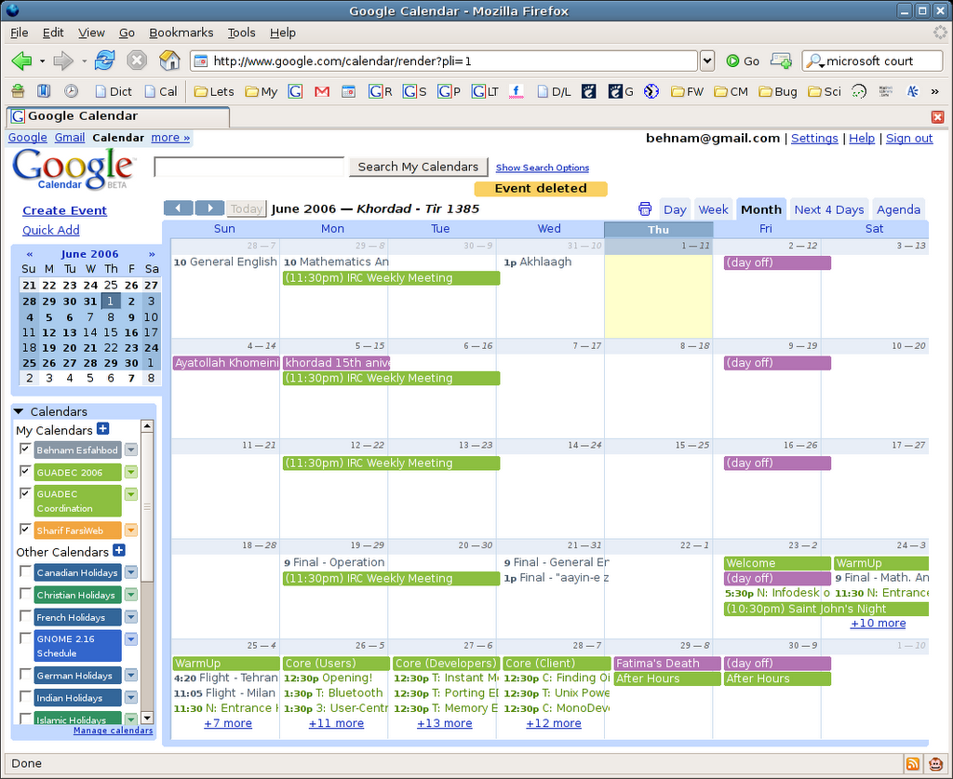
Schedule An Appointment
December 7 – 15
30 minutes
https://app.hubspot.com/meetings/marsello
Email to follow

Slide 15

THANKS!
ANY QUESTIONS?
You can find me at:
marsello@lern.org

