Slide 1
Focus on: Special Event Toolkit for Success
LERN Webinar
2016
Lecturer: Laura Wetherald, CPRP

Slide 2
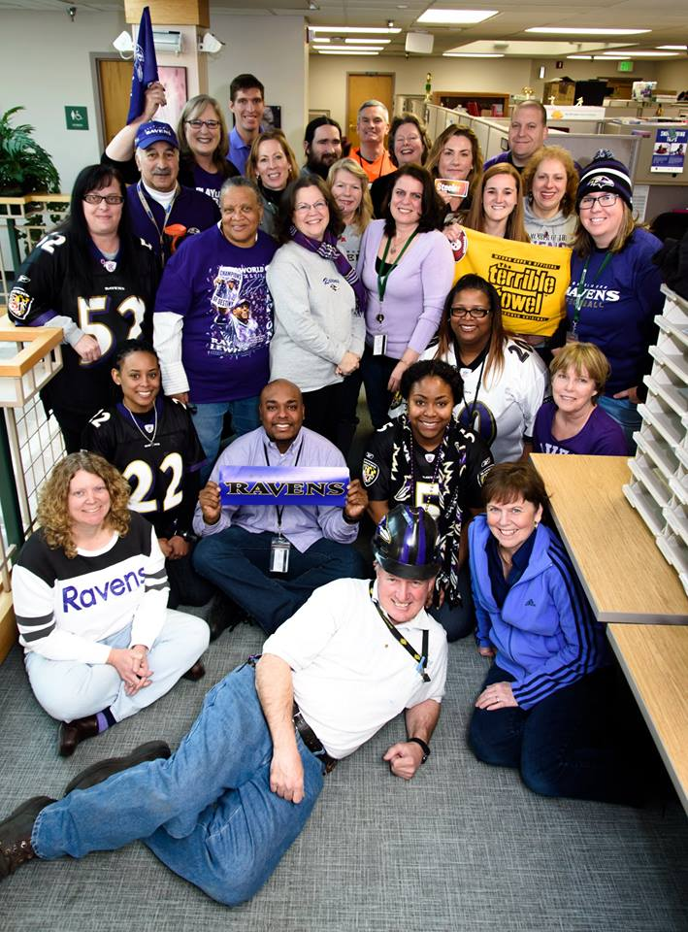
Overview of the Session
Introduction
Overview of the Session
Handout of Special Event Plan
Handling Questions and Webinar Process

Slide 3
Why do a Special Event?
You can take a smaller proven event and make it bigger with more games, vendors, experiences, just more of a good thing
You can have a greater visibility for your efforts
You might make the evening news!
Establish or re-confirm a sense of community
Chance to celebrate a theme/time of year
Have a chance to celebrate and value differences
Events offer choices…choices offer freedom… freedom offers likelihood of play and exploring

Slide 4
Why are we having the event? Community Involvement and Your role
Needs Assessments
  There is no one audience
  No longer can we offer a program and assume people will come
  Brainstorming
  Research
  What do you want to find out about event details? Best time, location, good parking, inclusive environment?

Slide 5
Why Do Programs Need to be Special anyway?
What is an example of a bad title?
Special Event Theme Ideas
Ideas, where do they come from?...
Taking the theme to being off the charts to create a wonderful memory for all attendees.
What is one that worked for you?

Slide 6
Adding Special Flare to An Event Location
Your Signature…What is yours?
Our agency’s is exceptional customer service…
Who has a signature that you would recognize?
What is a signature that you would use for a theme of New Orleans? July 4th?

Slide 7
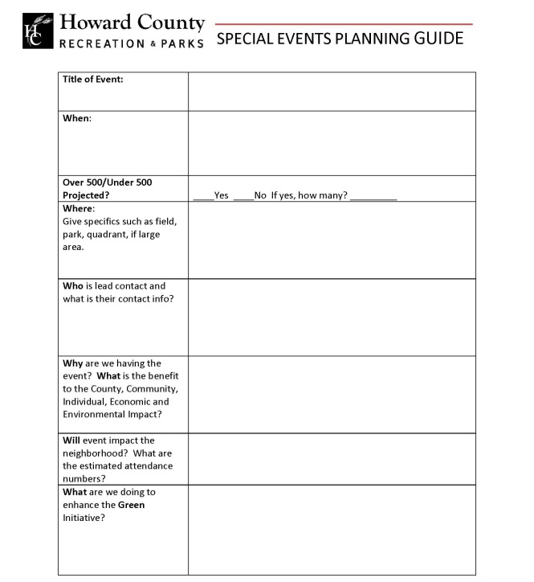
Special Event Planning Tool

Slide 8
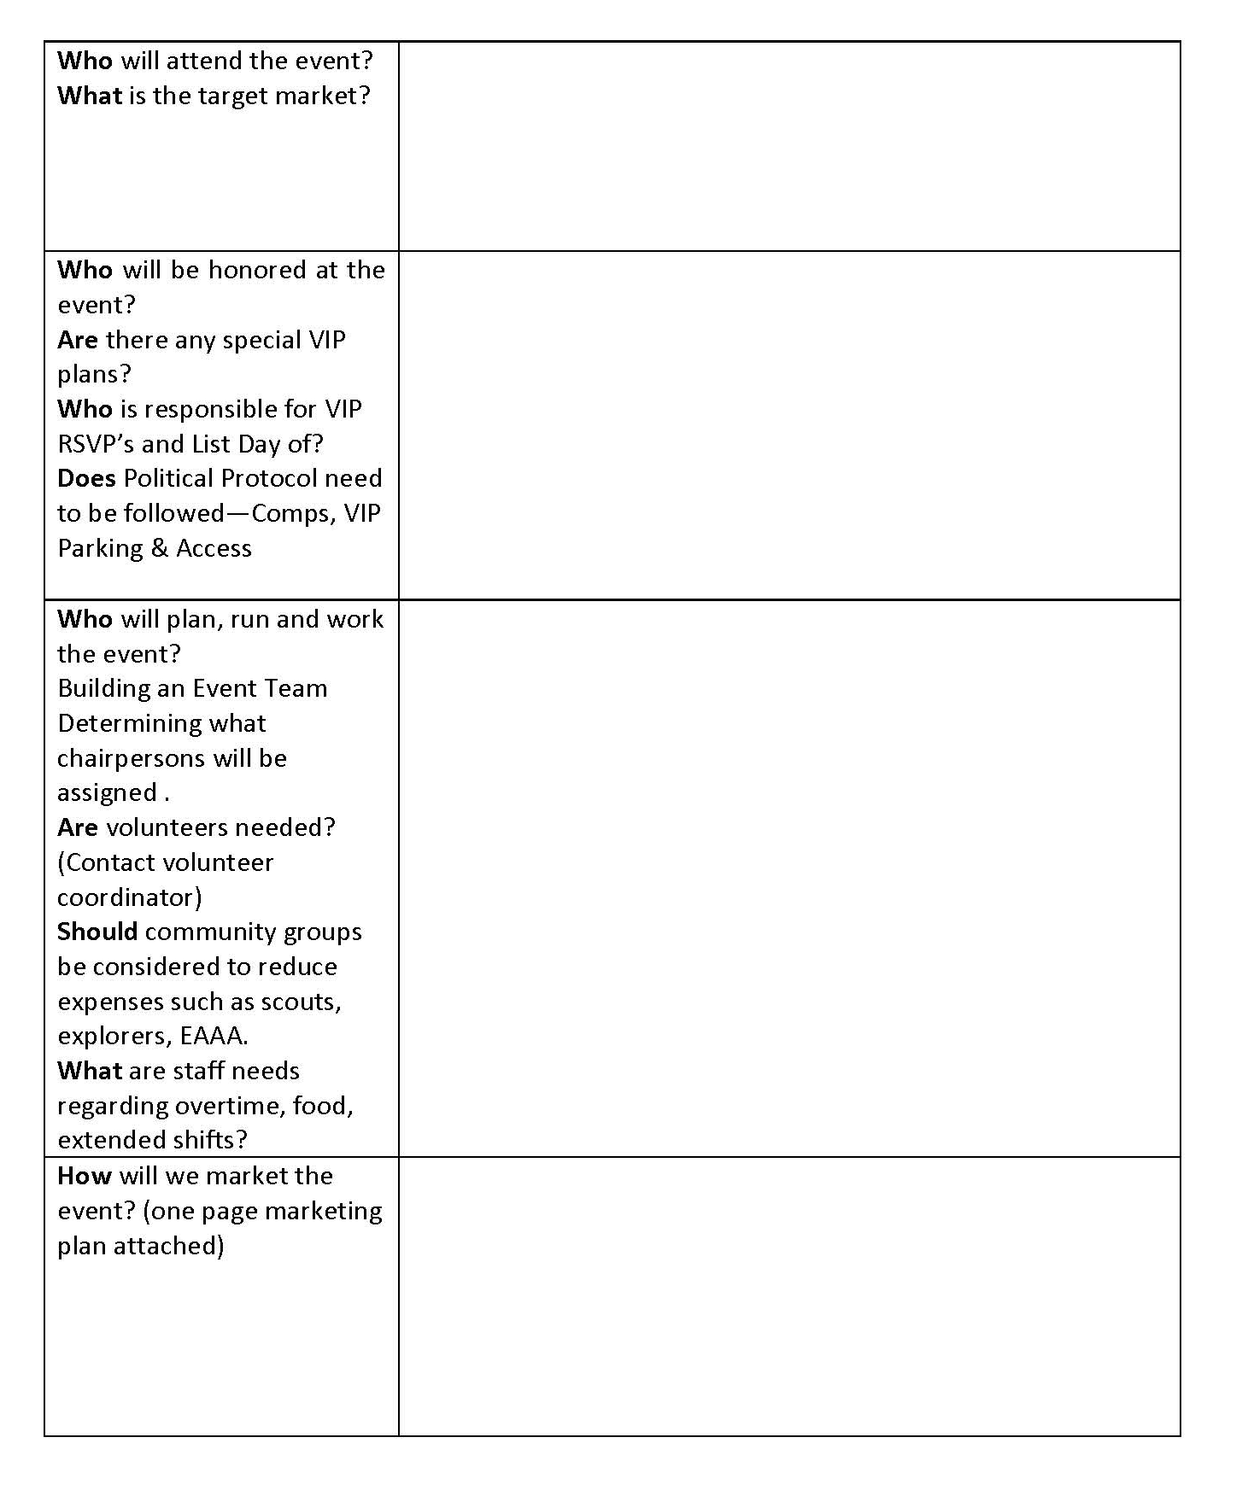
Special Event Planning Tool – cont’d

Slide 9
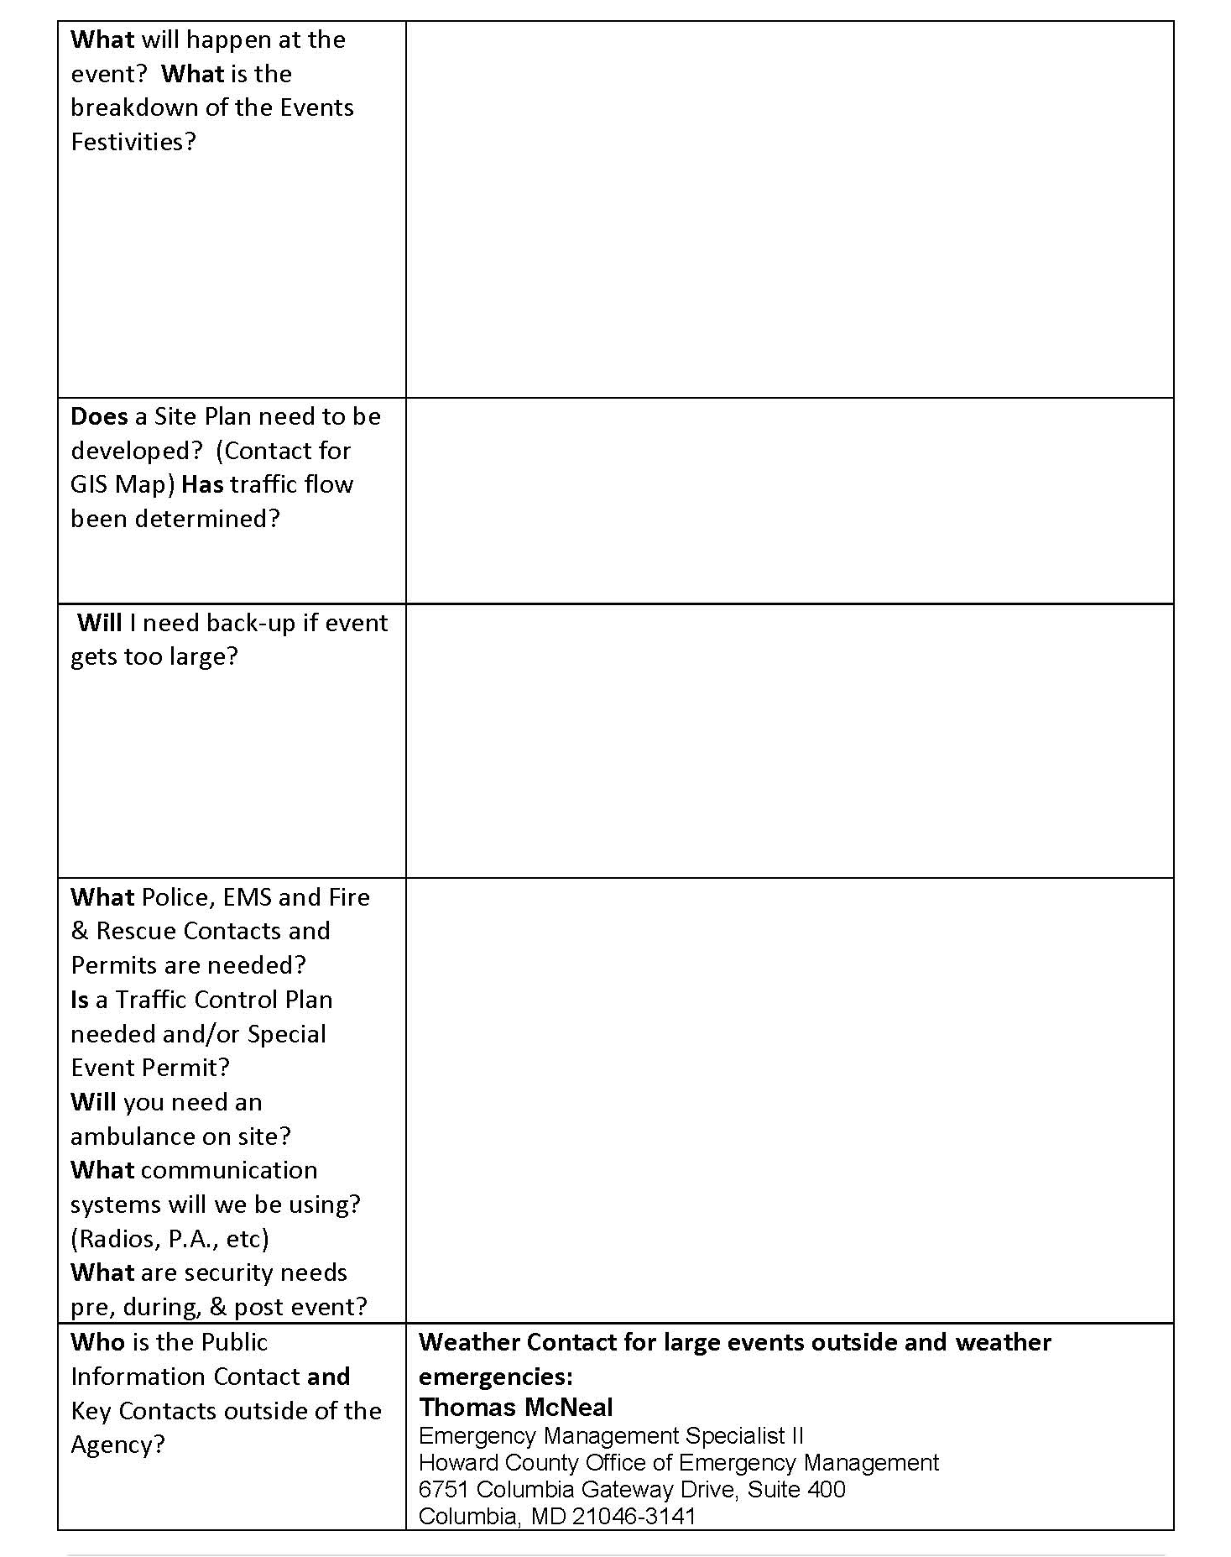
Special Event Planning Tool – cont’d

Slide 10
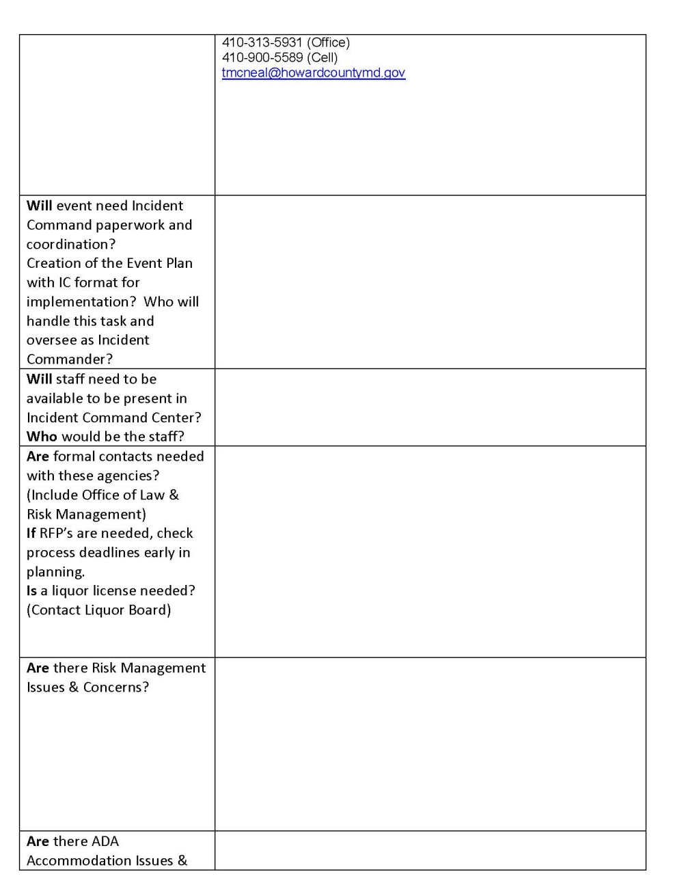
Special Event Planning Tool – cont’d

Slide 11
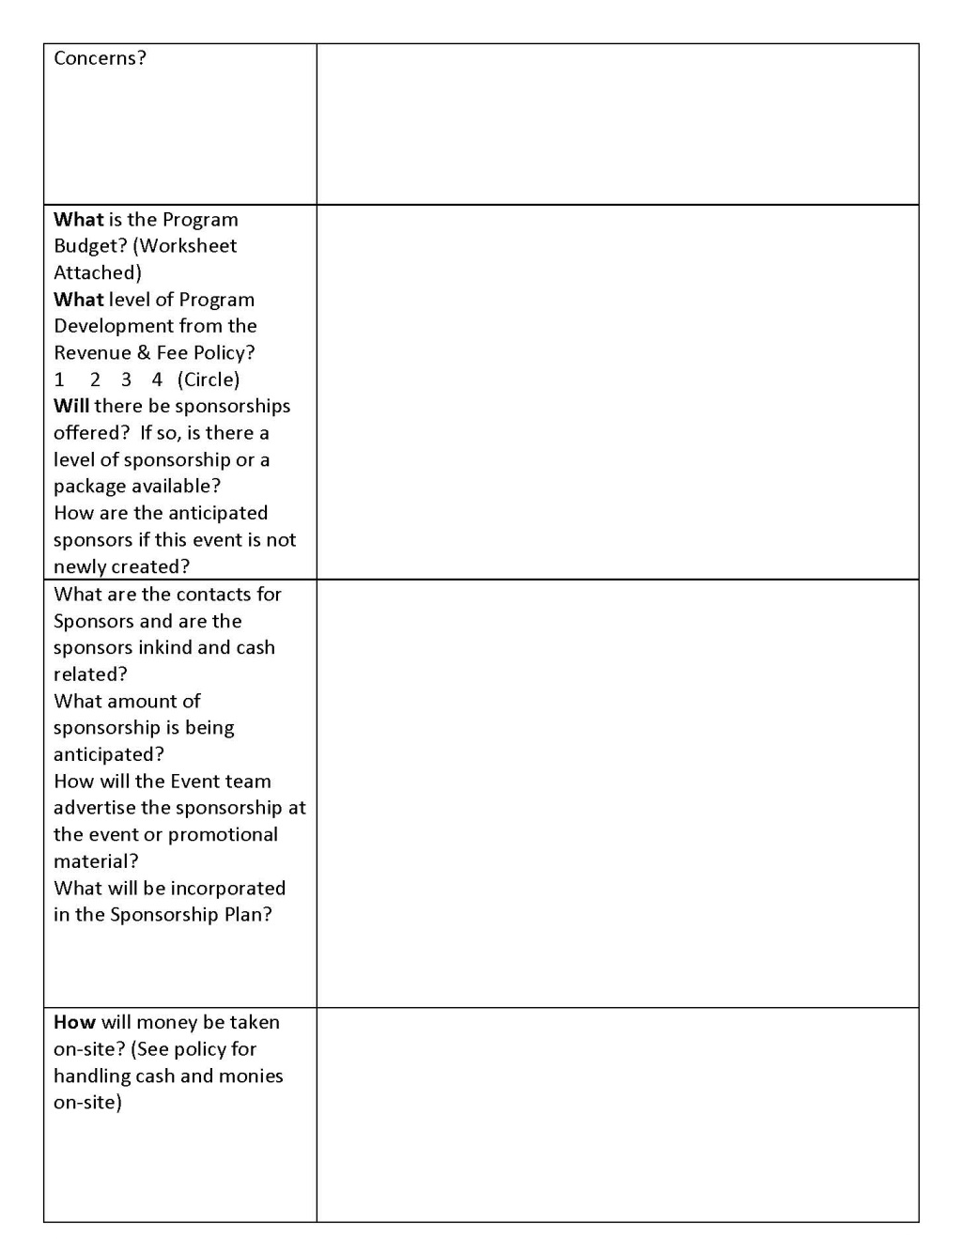
Special Event Planning Tool – cont’d

Slide 12
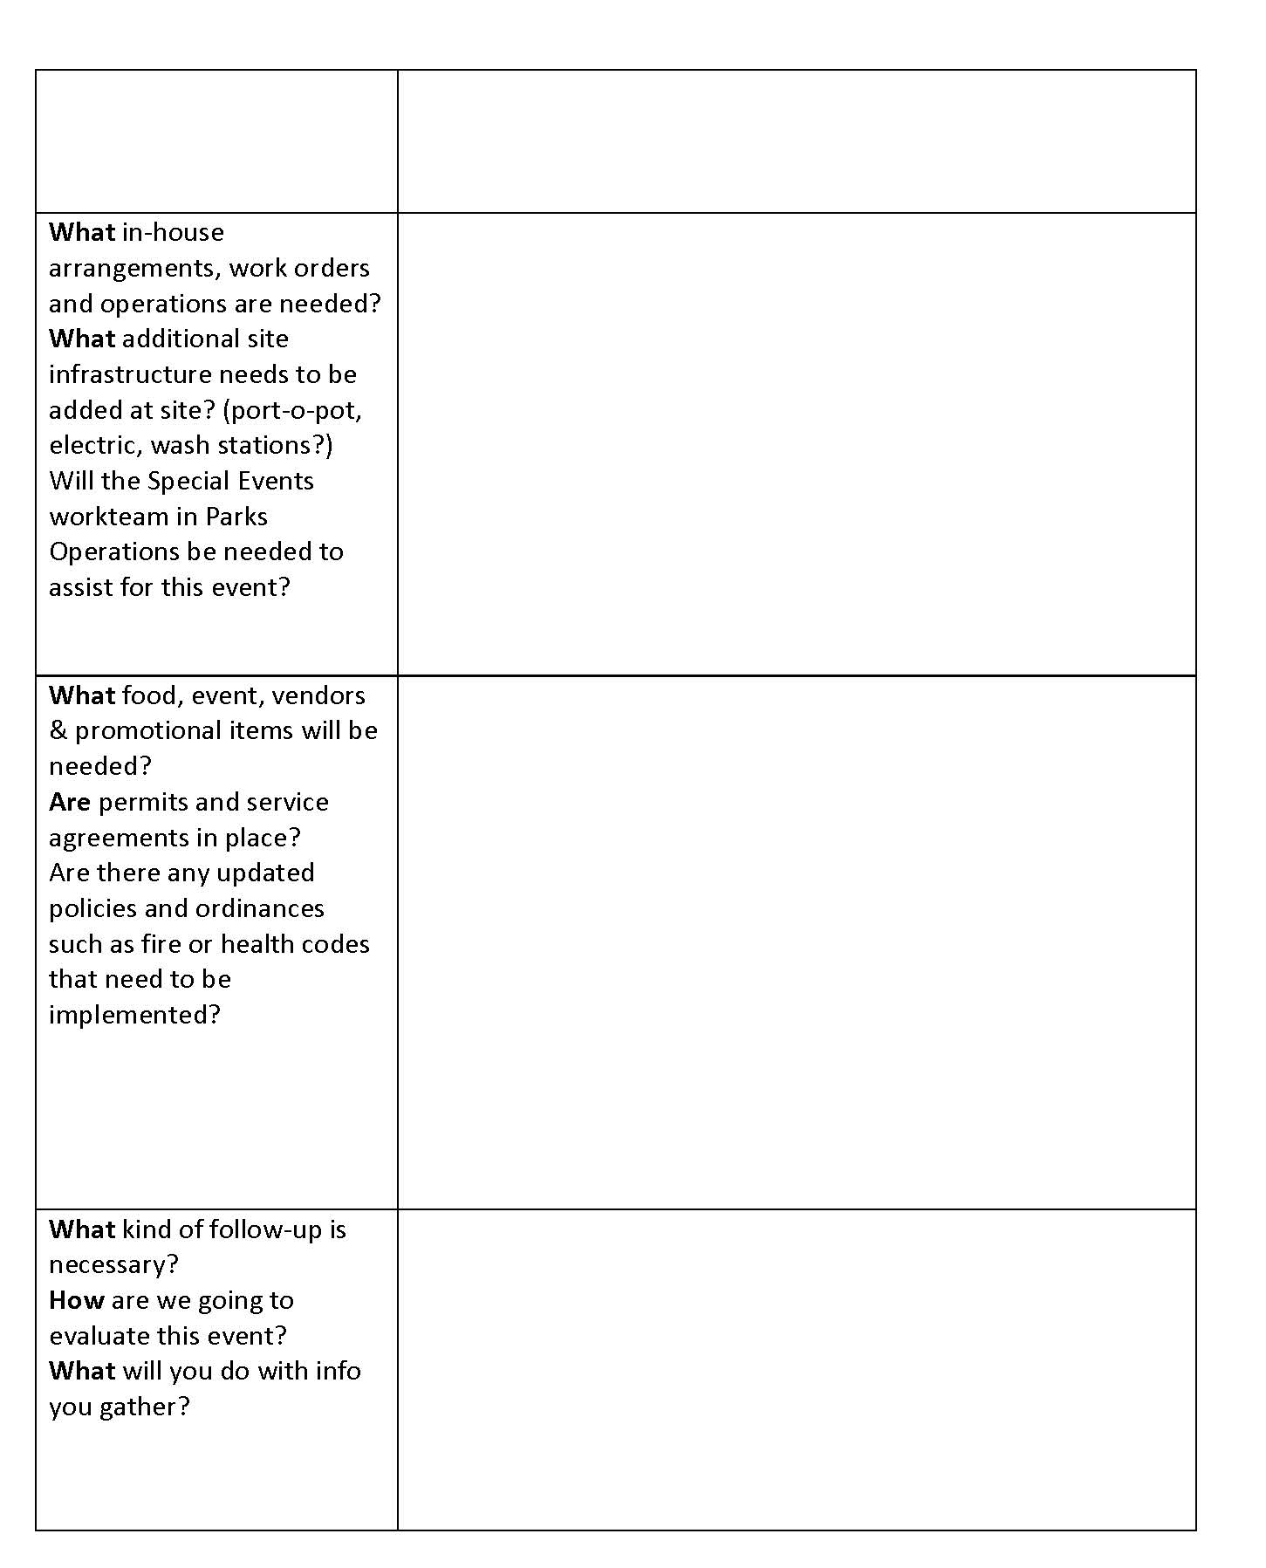
Special Event Planning Tool – cont’d

Slide 13

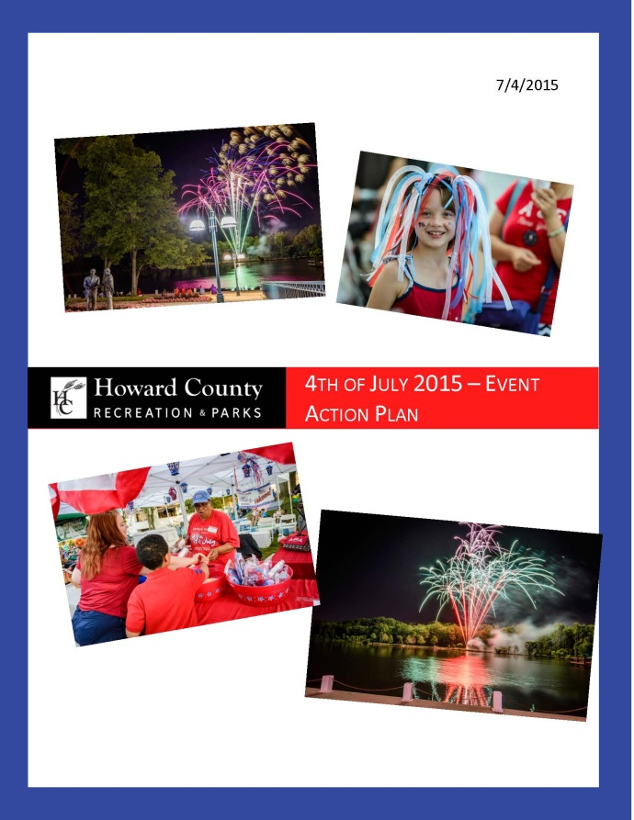
Incident/Event Action Plan

Slide 14
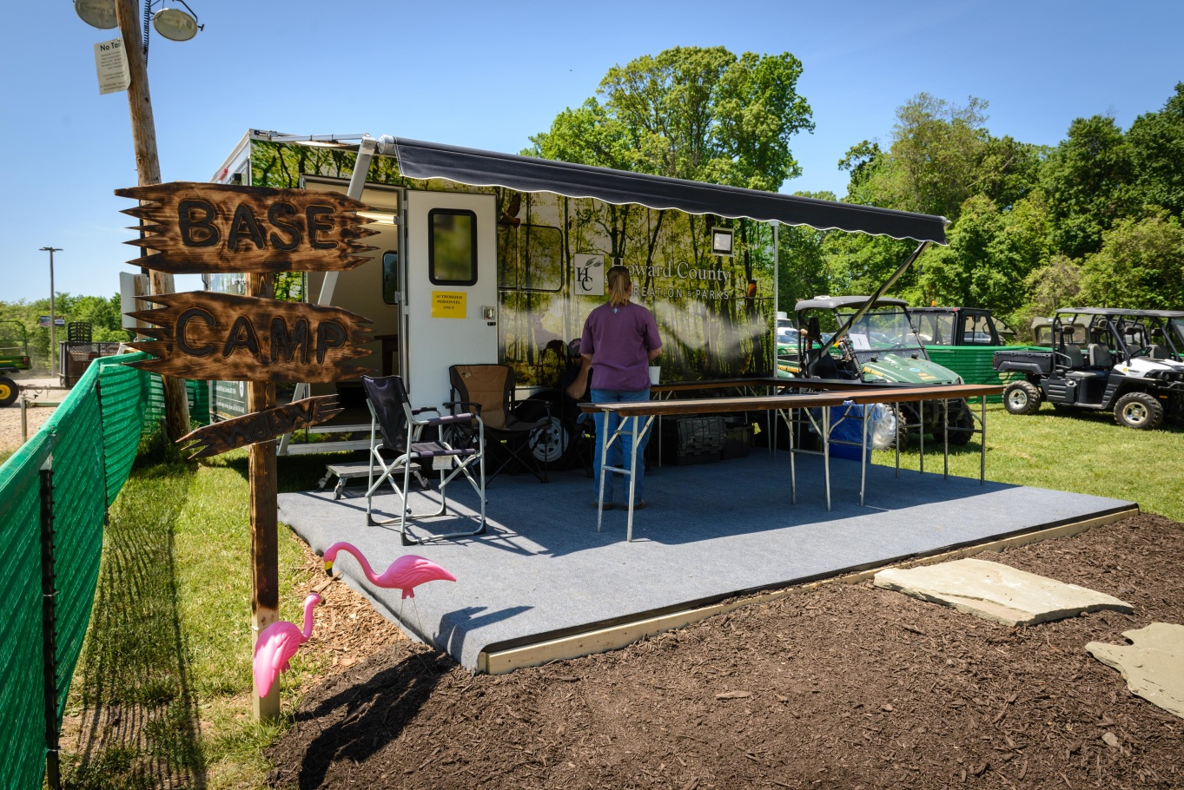
Command Tent or Base Camp

Slide 15
Little Things to Remember
Don’t forget the little things
That may be what people remember the most!
Every Events needs an official opening, closing and thank you
Housekeeping items, Have a script
Decoration should be able to be recycled
Refreshments-simple if you can but appropriate
Space- too big or too little?
Use your time well, sometime you need to move an event along or an act or performance
Include staff, key customers to make it more memorable
Signage-don’t go cheap and don’t do hand written and Mack Shore you Spell Everything Rite
Save Parking Spots for VIP’s and chairs as well. Not everyone can stand
Think about ADA, and how someone with a disability could enjoy the activity as well

Slide 16
Sample Marketing Plan Prototype: (Name of Event)
Background
  Insert a paragraph telling what the event is, what it’s all about, when it’s scheduled and any other information that might be useful to familiarize the reader with the program
Objectives
  Using bullet points, describe your critical goals.
  To the extent possible, Objectives should be quantifiable (e.g. number of attendees, tickets sold, revenues collected, etc.
  Ideally, objectives are a stretch, but ultimately achievable with good planning and attention to detail. The extent to which you meet your Objectives determines the success of your event

Slide 17
Risk Management
Risk
Management
16 Steps to Managing Risk……
Policies
Needs Assessment
Goals and Objectives
Program Development
Supervision
Rules, Regs
SOP’s
Safety Inspections
Accident Reporting
Emergency Procedures
Releases and Waivers
Insuring Against Risk
In-service Training
Public Relations
Legal/Insurance and
Periodic Review

Slide 18

Layout and Traffic Flow
What does the site look like on paper
What about vehicles on the site?
What about Police Traffic Permits
What about putting that sign across the road?
Safety first
Coming and Going
Bathrooms, I gotta go!
Moving them out in an orderly fashion
I want to be first in line! Orderly caucus

Slide 19
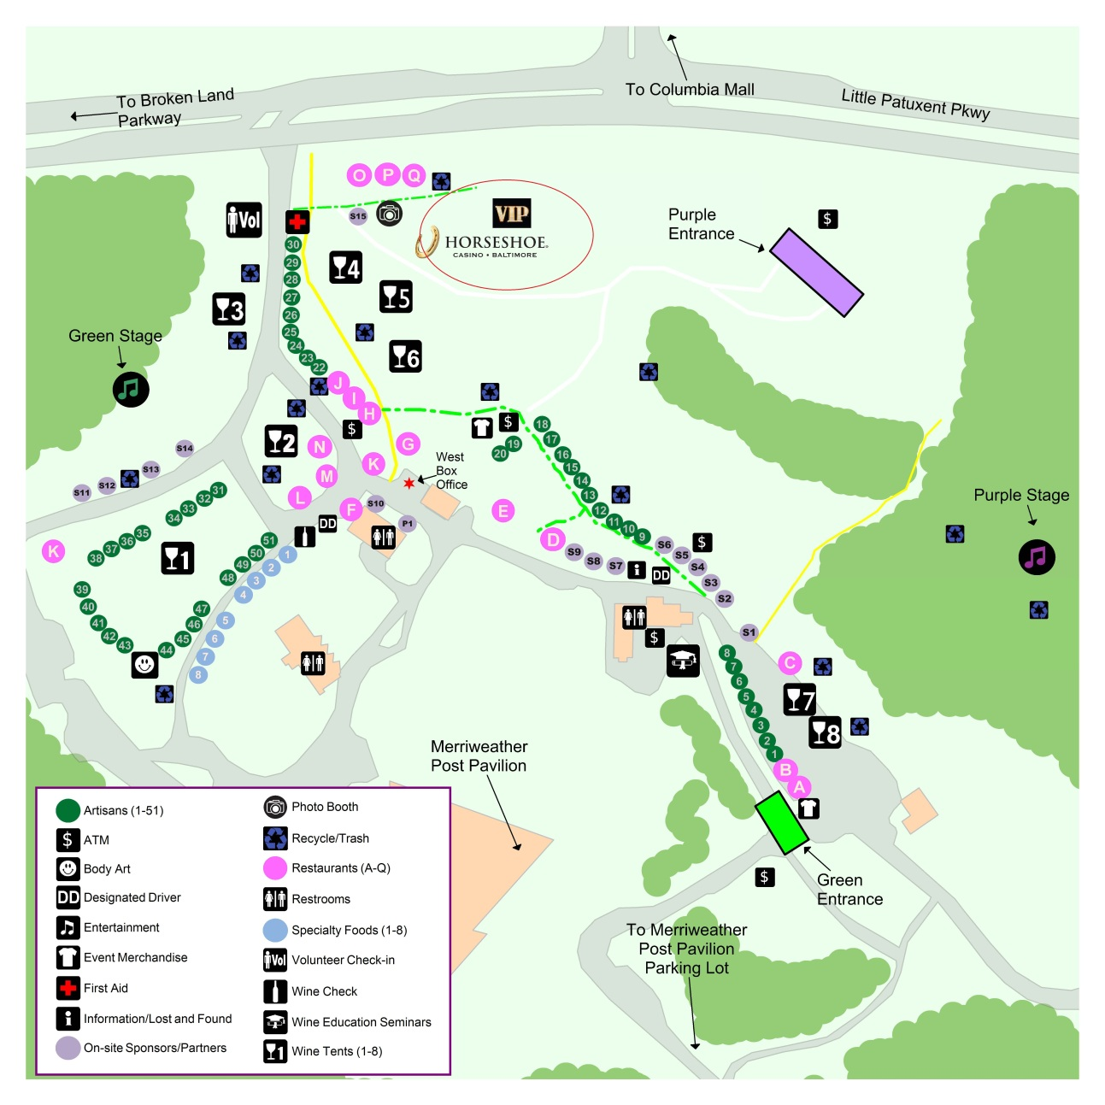
Maps and Site Entry and Exit

Slide 20
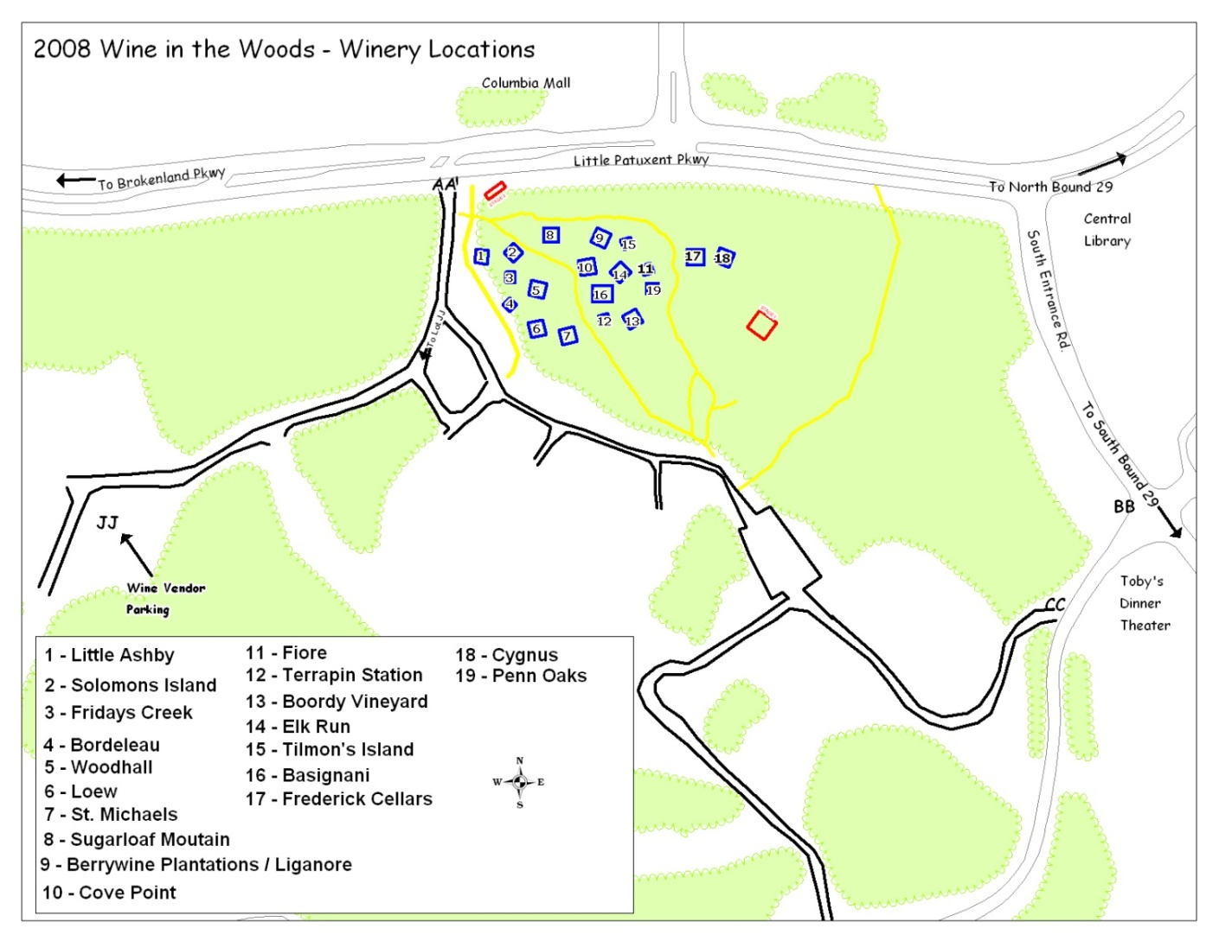
Site Plans for Event- Where do I go?.....

Slide 21
Before the Participants Arrive
Safety is paramount, Safety Checks
Centralized Equipment Depot for pick up and drop of supplies
Leaders and Supervisors should have checklist of events and festivities
Staff can have fun as well….sell the event during the event !
Open the Doors and get out of the way!
When you walk in, participants should be able to feel a whow factor

Slide 22
Adding Flare to a Table or Area that is crying for a Great Theme
What can you do to provide attractive center pieces on a shoe string?
How you set the table? Colors drapes can go a long way
Fresh greens can add a nice touch!
Recycle decoration
Simple, yet elegant
Sponsors and giveaways
Borrow from Senior Centers or other facilities
When you walk in, you should think, that is a beautiful table!

Slide 23

Making your Budget Work Large or Small
Stretching your Dollars
Trade or Barter
Sponsorship
Free Publicity
Partner with Advertisers
Raising Money from Exhibitions, Shows, Events
Birthday Parties or Parties within an Event
Concessions
Price the event right from the start- free is not always good!

Slide 24
Evaluation-Measuring Program Effectiveness in an Alternative Manner
Numbers Served
Publicity
Entrance to other Services
Jobs Created
Business Served
Program Prototypes were created
Outcome based questions?
Forms that Yield Results
  Make size or form length short
  Ask the right questions not ones you will not be using
  Attendees complete form on site and get something for it
  The results are compiled and shared in a PSA or on website perhaps with picture testimonials or video.
  Quick follow-up with survey monkey if you have emails

Slide 25

When you goof….
Goofs will happen
Goof Repair Kit
  Speed
  Phone not letter
  Apologize
  Listen
  Reasons but no Excuses
  Apologize again
  Offer Options
  Nothing Phony
  Focus on Solutions quickly instead of pointing blame

Slide 26
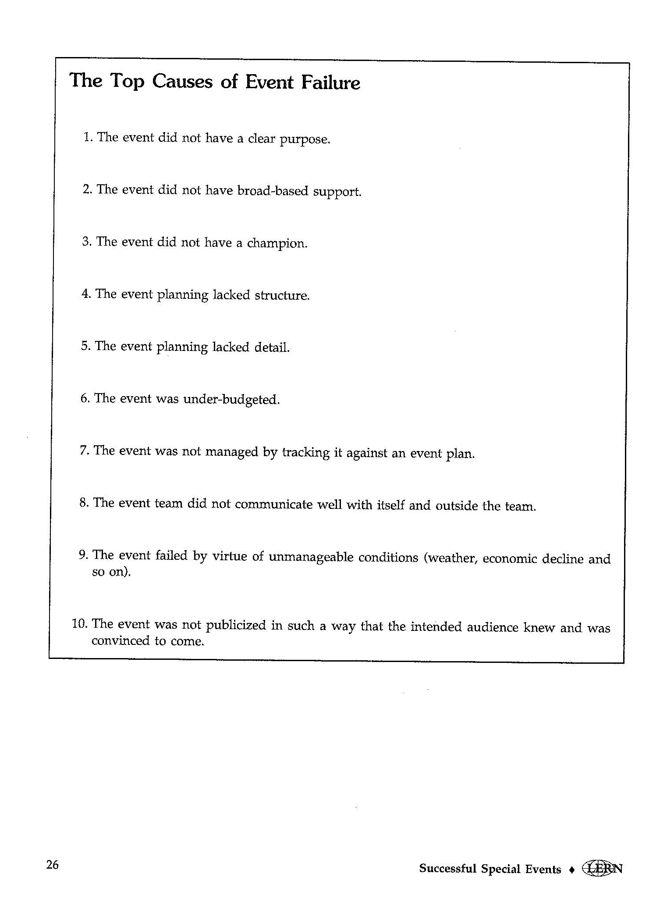
The Top Causes of Event Failure

Slide 27
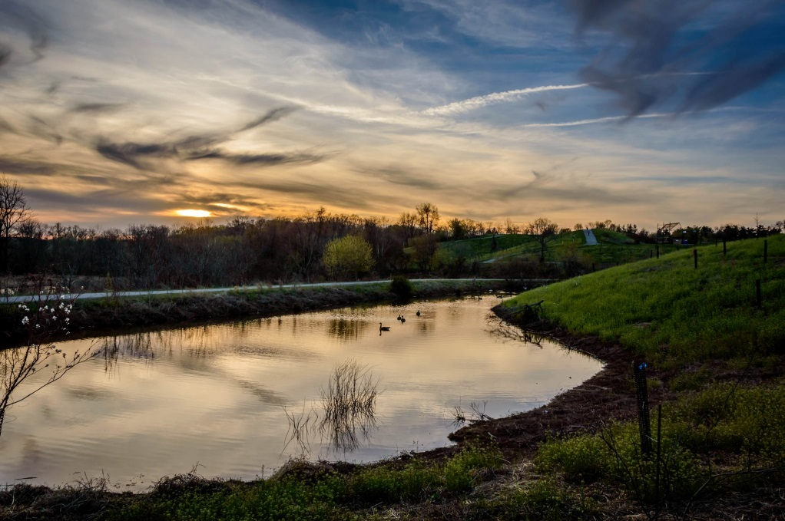
Summary/Wrap Up
Questions and Answers
Thank you
Email:
lwetherald@howardcountymd.gov

