Slide 1
Strategies for Success with a Small Contract Training Unit
LERN Best Practice Webinar
February 7, 2019

Slide 2
Using GoToWebinar
Today’s webinar will be recorded. Within the next 24 hours an email with a link to the recorded presentation and handouts will be sent out.
Please do not place the GTW conference call on hold. If you need to take another call, please leave the GTW call and rejoin later.
Please use the Questions function in your GTW menu to ask any questions.

Slide 3
Learning Resources Network
The leading association in continuing education supporting course programming and contract training
Founded in 1974 as a nonprofit
“Information That Works!”®

Slide 4
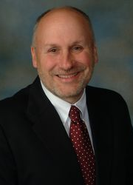
Presenters
Greg Marsello, LERN Co-Founder, Senior Vice President & Contract Training Subject Matter Expert
Eric Johnson, Associate Vice President of Center for Enterprise, Northeast CC, Nebraska & LERN CT Council Chair

Slide 5
Agenda
Contract Training
Contract Training Knowledge Competencies
Strategies for Success with a Small Contract Training Unit
Contract Training Conference
LERN Contract Training Services
Questions & Answers

Slide 6
Contract Training

Slide 7
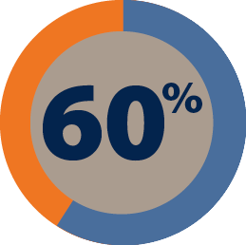
Ideally just focus just on contract training

Slide 8
What Is Contract Training
Not individual, but business, government agency or organization
Independent from open enrollment course programming
Not recruitment, but selling
Relationship building
Not just training…shifting from information to solutions
50%+ operating margin…profitable

Slide 9
LERN Contract Training Update

Slide 10
Contract Training Knowledge Competencies
Understanding Contract Training
The Finances of Contract Training
Real World & Team Selling
Marketing, Lead Generation & Client Analysis
Needs Assessment
Pricing Contract Training
Teaming with the Right Instructors
Documents & Templates
Quality Assurance & ROI

Slide 11
Strategies for Success with a Small Contract Training Unit

Slide 12
#1. Someone Has to Sell
Competition has grown and phones not ringing like before
Selling is relationship building and takes time
Try to centralize non-selling tasks with other staff
At the least dedicate X hours a week to selling

Slide 13
Lead Generation Best Practices
Referrals
Analyze Present Clients & Students
Events: Speaking, Webinars, Breakfasts
Networking
Sharing Knowledge
Consortiums
Inside Salesperson

Slide 14
Conducting a QA Meeting
Ask for a 10-15 minute meeting
Do it yourself
Send a thank you note

Slide 15
#2. Data to Collect, Report to Run
Quarterly Analysis | 1st Quarter | 2nd Quarter | 3rd Quarter | 4th Quarter
Income
Operating Margin (Income – Direct Costs)
Number of Contracts
Average Income per Contract (Total Income / Total Contracts)
Prospects
Leads
Leads:Contract Ratio (Total Leads / Total Contracts)

Slide 16
#3. Perform Needs Assessment
Gather Preliminary Data
Plan
Perform Analysis
Analyze the Data
Prepare Your Report

Slide 18
#4. Know How to Price
Formula pricing does not work
Market pricing does work
The cost of producing the contract
What competitors are charging
What clients are willing to pay
Pricing Example
Production Cost: $4,000
Production as a % of Income: 40%
Projected Income: $10,000
What is competition charging?
What have clients paid in the past?
Review price breaks
Final Price: $9,500 or $12,500

Slide 19
Price Breaks Are Psychological
The point at which a significant number of potential clients will think price for this contract is too high
$250 | $2,500 | $15,000
$500 | $3,000 | $20,000
$750 | $5,000 | $25,000
$1,000 | $7,500 | $30,000
$1,500 | $10,000 | $40,000
$2,000 | $12,500 | $50,000

Slide 20
Pricing Best Practices
Use market pricing
Income should be at least two times your production costs
Add value by increasing benefits
Test prices
Think in terms of price breaks
Diversify prices in a product area to give choice. It allows you to appeal to audiences who want contracts at different levels of prices.
Give options

Slide 21
#5. Be an Expert & Curriculum Development
You cannot be everything to everybody
What are your top 3-7 areas of expertise
Competition: Stomp, Walk-Away, Gap
Current content

Slide 22
#6. Know Your USP & Have a Sales Kit and Webpage
Unique Selling Proposition
Your defining characteristic. What your best clients value most about you.

Slide 23
#7. Use a Simple Sales Contract

Slide 24
Contract Structure
Preamble, Recital, Words of Agreement
Definition
Action Section
Reps & Warranties
Covenants & Rights
Conditions to Obligation
Endgame Provisions & Remedies
General Provisions
Signatures
Action Section
An exchange of promises
Value of services

Slide 25
#8. Have an Instructor Agreement & Handbook

Slide 26
Client Contract Checklist
Specify dates, course title, times and locations
Describe role of support staff, if any
Specify the outcomes expected
Define terms of ownership
Define instructor responsibilities in detail.
Define project contingencies if success depends upon them
State conditions for changing the scope of the work
State the terms for cancellation or termination
State the terms of your guarantee
Articulate the payment schedule
Give a brief policy about follow-on work

Slide 27
#9. Lean on LERN

Slide 28
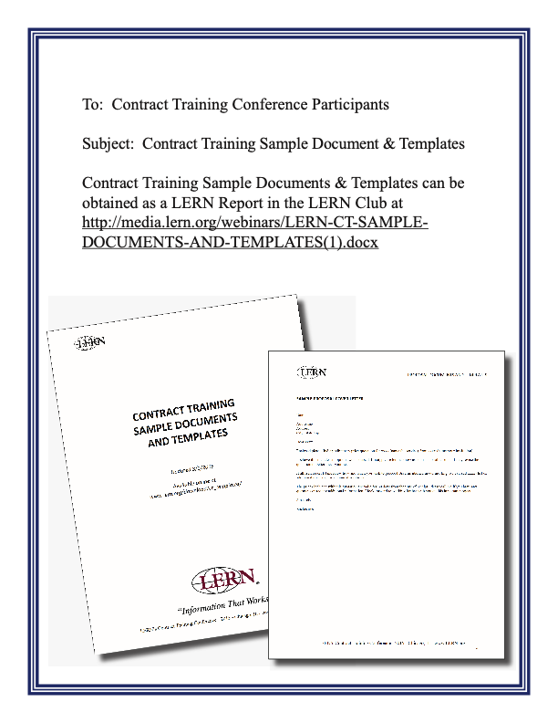

Slide 29
Contract Training Conference

Slide 30
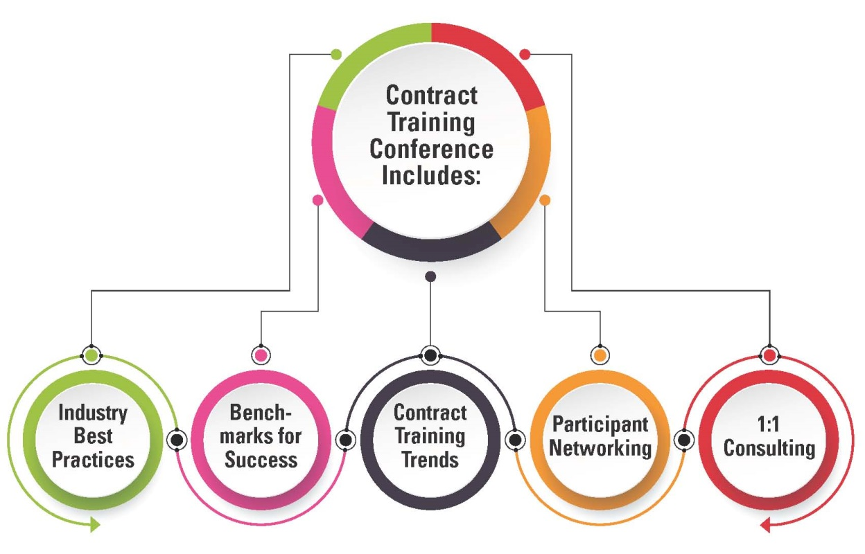

Slide 32
LERN Services
Annual Contract Training Conference
Contract Training Institute & Certified Contract Trainer (CCT) Designation
Contract Training Webinars & LERN Club Articles
Publications: Needs Assessment and Market Plan Tool Kits
Technical Assistance: Email, Calls & Presentations
Program Review

Slide 34
Thank You!
www.lern.org
info@lern.org
eric@northeast.edu
marsello@lern.org

