Slide 1
Streamlining Brochure Production
Brendan Marsello
2013 LERN Annual Conference
November 22nd, 2013

Slide 2
Today’s Presenter
Brendan Marsello
Learning Connection/George Washington University
Works primarily on programing, catalog production and the website

Slide 3
Learning Connection
In business in the Rhode Island area for 32 years
Learning Connection has produced over 190 catalogs
Though distribution and volume have changed, our catalog is still our most important marking tool

Slide 4
Two Important Facts
Print promotion is still important, 75% of our sales come from the catalog
The catalog and website must work together
Design (look, categories)
Branding
Digital Catalog (.pdf, Digital Brochure)

Slide 5
Catalog Building Challenges: Definition
Catalog = Brochure, Schedule, Program Guide and so on

Slide 6
Catalog Challenges: Who Needs a Catalog?
Individual
Mass
Paid
Direct Mail 75%
Advertising 5%-10%
Unpaid
Customer Service 5%
eMarketing & Publicity 10%-15%

Slide 7
Catalog Challenges: Costs
Printing Costs…size, pages, amount
Mailing Costs…mass versus targeted
Postage Costs…mass versus targeted
Production Costs
- Timeline - Coordination
- Software - Catalog/Web/Reg

Slide 8
Catalog Challenges: Reduced Revenue
Less programming time
Poor customer service
Less terms/sessions
Difficult online registration
Frustrated staff

Slide 9
Program Plan
Establish a timeline
Determine best preforming classes (overall and seasonally) for best repeat times
Cut/rest underperforming classes
Use Program Plan as a guide for contacting instructors and ask them for several dates
Give yourself plenty of time!

Slide 10
Program Plan
Try to have 20% new classes (80/20 Principle)
Find topics your students want!

Slide 11
Program Plan

Slide 12
Timeline (time to print date)
Program plan (5-6 weeks)
New instructor interviews (5-6 weeks)
Emails to instructors for dates (5-6 weeks)
Build classes on website (4 weeks)
Send confirmations to instructors (3 weeks)
Extract class info and send to graphic designer (3 weeks)
Proof extract in template (2.5 weeks)

Slide 13
Timeline
Update and return to graphic designer (2weeks)
Provide ideas for covers and features (2 weeks)
Proof final draft (1.5 weeks)
Extract mailing list and send to printer (1 week)
Graphic designer delivers .pdf to printer (1 week)
Printer delivers catalogs to post office and distributor

Slide 14
Catalog/Website Integration
You only have to enter class information once and it integrates with the catalog, website and online registration
Less time and fewer human errors
Formatting looks uniform to the student

Slide 15
Use an Extract Template
Template allows you to pull a uniform extract every time
Helps you streamline the process of getting the catalog to the graphic designer
Saves you the time of putting it together by hand
Once dialed in, this process becomes very easy and fast

Slide 16
Extract Template

Slide 17
Instructor Confirmation
Send an email (automated or by hand) to all instructors for them to proof/confirm their class
Give them a deadline
Present them with all the class info in the email
Let them know that if you don’t hear back, we assume its alright!

Slide 18
Instructor Confirmation

Slide 19
Catalog Production
Streamline your relationship with your graphic designer
Designer should use a template for consistency and ease
Proof the catalog in the template
Provide the designer with ideas for covers, features and pictures
We use Mary Lynch (DatatoDesign)

Slide 20
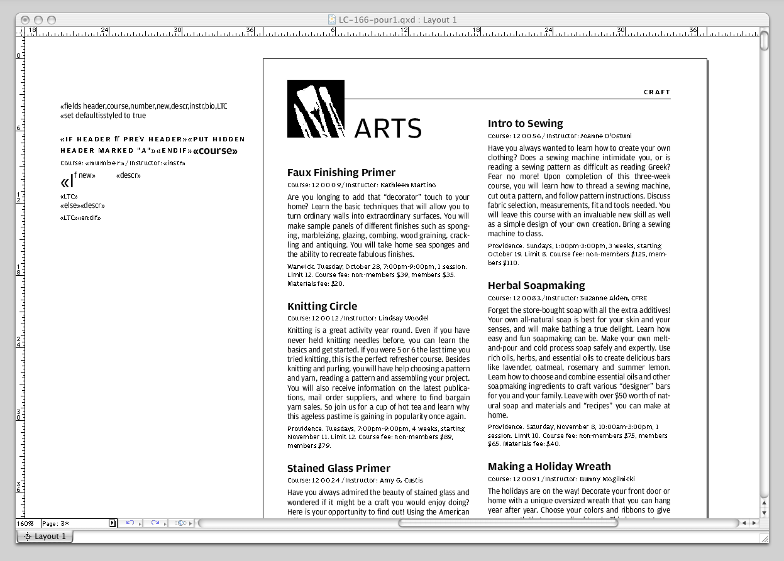

Slide 21
Proofing
Proof rough draft in the 1st pour
Allows you to see what students will see
Double check dates, times, number of sessions and prices.
Read descriptions from the view point of a student
The final proof should be for visuals and layout, not for content

Slide 22
2 Covers

Slide 23
Mailing List
Target your best students (those that have bought something!)
Also target recent activity (catalog request, created profile)
The more postage goes up, the more important each individual catalog gets
Two mailing for each catalog (use two covers)

Slide 24
Distribution
Use someone that knows the area
Track where catalogs are picked up the fastest
Make them visible – this is also a marketing opportunity
Be consistent with your best locations, some people always return to one spot
Distribute twice per catalog (preferably with different covers)

Slide 25
Website Integration
Allow for catalog request, make it easy
Display the current catalog cover
Link to a .pdf catalog or a Digital Brochure
Integrate the Digital Brochure and link classes to registration
Use a Google calendar to allow students to visualize the class schedule

Slide 26
Digital Brochure

Slide 27
Google Calendar

Slide 28
Thank You!
Please ask any questions
brendan@learnconnect.com

