Slide 1
Thriving the Next 5 Years – LERN’s Success Factors
August 23, 2016

Slide 2
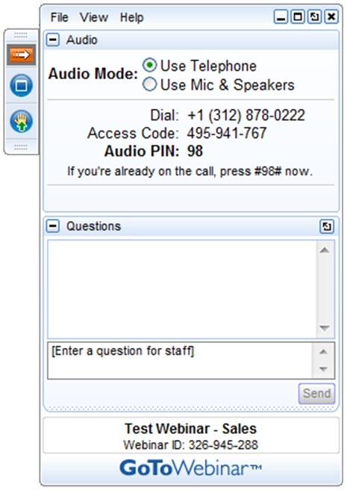
GoToWebinar
Today’s webinar will be recorded. A link to the webinar will be sent to participants within the next 24 hours.
Please do not place the webinar call on hold. If you need to take another call, please leave the conference call and rejoin later.
Please use the Questions function in your GTW menu to ask any questions. Questions are answered at the conclusion of the presentation.

Slide 3
Presenter
Greg Marsello
LERN Co-Founder
Road warrior
Program Reviews

Slide 4
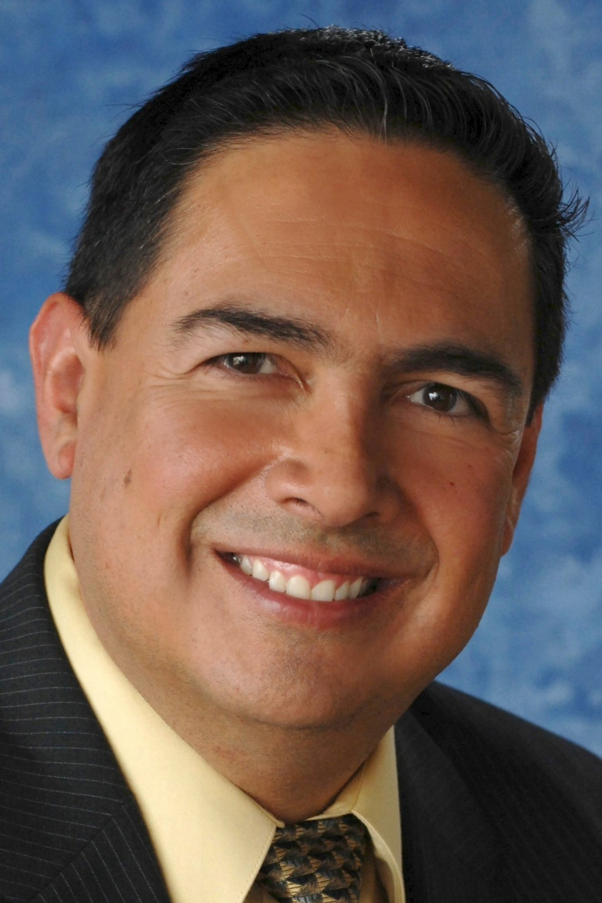
University of New Mexico Continuing Education Guests
Joe Meira, Executive Director Operations & Extended Learning Contracts
James Fowlkes, Executive Project Director, Curriculum Strategies

Slide 5
LERN Member Services Team
New Website and LERN Club
New Digital Library
New Lifelong Learning Assessment Tool
Popular Data Analysis
Classic Brochure and Website Critiques
Free Technical Assistance
Julie Coates - Senior VP for LERN Information Services
Katie Lynch-Morin - Director of Communications
Brendan Marsello - Director of Member Support Services
Tammy Peterson - Director of Customer Service

Slide 6
Agenda
LERN’s Success Factors
Program Review
University of New Mexico Continuing Education
Questions & Answers

Slide 7
The Next 5 Years
Increased accountability
Increased competition
Increased expectations
Increased roadblocks
Increased staff turnover

Slide 8
Do It Right!
Open enrollment course programming, marketing, operations & contract training
Benchmarks
Best practices
80/20 Principle
Right not perfect

Slide 9
LERN’s 15 Success Factors

Slide 10
#1. Centralize Operations
Increase staff productivity
Let revenue generators generate revenue
Increase internal and external customer satisfaction
Streamline processes
Pull, don’t push

Slide 11
#2. Become or Remain Financially Self-Sufficient
Numbers are critical
You are not a cash cow…net at 0-5%
Operating margin, operating margin, operating margin
Realistic growth
Net to be allocated to future growth

Slide 12
#3. Move from Direct Mail Marketing to Integrated Marketing
You can’t be everything to everybody
Targeting critical
Print remains important
Content marketing the glue
Focus on retention
Think campaigns with at least 3 portals

Slide 13
#4. Introduce One New Initiative a Year
New program area, market segment or delivery method…revenue stream
3 years, 5-10% of income, 40%+ operating margin and “show me the names”
One new initiative every $2,000,000

Slide 14
FY18
FY15
I
IV
1. Brainstorm
8. Evaluate
2. Research
7. Decide
6. Try It
3. Options
4. Model
5. Development
II
FY17
FY16
III

Slide 15
#5. Shift from Information to Solutions
Increase customer value, not just customers
Be the answer…even if you are not the answer
Consulting, mentoring, research...
Advising, job placement
Listen and fix

Slide 16
#6. Have a One-Year Business Plan and Strategic Plan
One-Year Business Plan
Unit Goals
Unit Budget & Benchmarks
Division Goals
Operating Margin Budget
Benchmarks
Course/Contract Goals
Market Segments
Strategies
Term/Quarter
Promotion Strategies: Type/Distribution/Retention
Promotion Timeline
Staff Responsibilities
Strategic Plan
Foundation: Who, Mission, Values Statements, USP, Environmental Scanning, SWOT, Key Data, Market Segments, and Competition
Major Initiatives
Strategic Improvements
Areas to Address
Strategic Plan Actions
Strategic Plan Timeline

Slide 17
#7. Operate Like a Business

Slide 18
#8. Follow the 30% Rule
Different from 20-30 percent new
Program area, market segment, delivery method
No more than 30 percent of registrations and/or revenue
Don’t cut back, but grow others

Slide 19
#9. Be Data-Driven and Use LERN Benchmarks
Student registration data
Course/class data
Promotion data
Contract sales data
Staff productivity
Operating margin
Cancellation rate
Quality and service scores
New
Repeat Rate
Lead:Contract Ratio

Slide 20
#10. Your Leader Must Shift from Being a Manager to a Visionary
50 percent out of the office
Management or leadership team
Staff training
Understand operations
Customer and client advocate
Roadblocks

Slide 21
#11. Be Essential
Speak the right language
Toot your horn
Build internal and external alliances
Let others tell your story
Understand content marketing

Slide 22
#12. Know and Grow Your Primary Market Segments
You cannot be everything to everybody
80/20 Principle
Purchasing history and demographics
7 primary market segments
Market potential and market share

Slide 23
#13. Live Your USP
What makes you unique, different
The benefits you provide others do not
Be zealous
Remind repeat customers, as well as announcing to potential customers

Slide 24
#14. Understand New Learning Trends
Learning requirements are changing
Latest eTools
Learning styles
Online education increasing, but hybrid the best
Teachers becoming facilitators

Slide 25
#15. Lean on LERN

Slide 26
LERN’s Program Review
LERN’s Program Review is an assessment of your community education, continuing education and/or contract training unit to provide specific how-to recommendations to significantly improve your programming, marketing, sales, and operations efforts.
LERN’s Program Review is different from LERN’s Program Review and Certification

Slide 27
Program Review Benefits
Compare your unit to similar units
Match your unit to industry benchmarks
Understand best practices you should implement
Learn how to assess your unit’s performance going forward
Have a report you can forward to central administration

Slide 28
Program Review Process
You are assigned a LERN consultant.
LERN consultant provides you a list of data, information, and materials to prepare and forward.
LERN consultant analyzes data, information, and materials.
LERN consultant visits for 2 days. Day 1 is to review data, information, and materials and to gather more information. Day 2 LERN consultant reviews preliminary recommendations.
Within a month, LERN consultant forwards a LERN Program Review Report with recommendations.
LERN consultant is available by telephone to review.
LERN consultant is available as long as needed to provide email and telephone support.

Slide 29
What You Need To Do
Provide…
Registration and/or purchasing data
Promotion materials & web site address
Financial information
Benchmark numbers
Organizational chart
Pricing examples
Marketing, business, and/or strategic plans
Program Review expectations

Slide 30
Price
The price for the LERN Program Review is $9,000 including expenses.
Implementation of just some of our recommendations will generate at least a 10:1 ROI.
Questions going forward will be answered.

Slide 31
Joe & James

Slide 32
Questions & Answers

Slide 33
Thank You!
For more information and support
www.lern.org
info@lern.org
Julie Coates - Senior VP for LERN Information Services
Katie Lynch-Morin - Director of Communications
Brendan Marsello - Director of Member Support Services
Tammy Peterson - Director of Customer Service

