Slide 1


Surveys That Work

Slide 2

Surveys Work

Slide 3

What you are doing wrong
#1 You are surveying the wrong people
#2 You don’t know what you want to know
#3 You are not spending enough time figuring out the right question to ask
#4 You are not using an Advisory Group
#5 For big questions, you are not using the 8 Stage Needs Assessment Model
#6 You are asking too many questions
#7 You are not giving them closed ended choices
#8 You are not making it easy to return

Slide 4

Who to Survey

Slide 5
Only Survey Your Best Customers

Slide 6
Chart 1: Finding Your Best Customers

Slide 7
Chart 2: Net Income
Why You Should Survey Only Your Best Customers

Slide 8
Finding Your Best Customers
Your Best Customers are those who participate most Recently and most high Dollar.
Run out a list in your computer of those who participated most recently and spent more than average.

Slide 9
Best Customers in 7 Segments
Your best customers are in 7 or so different demographic segments.
Figure out what demographic characteristic is most important in your organization.
A few:
-Birth Year
-Where they live
-Job Title
-Education, etc.
Survey your customers and ask one question.

Slide 10
Consider 7 Surveys
When you have identified your Best Customers by Market Segmentation, then you can design different surveys for each market segment.
This is really powerful !
IDEAL: one survey a month- -
to one (or more) of your 7 segments.

Slide 11

Constructing a Successful Survey

Slide 12
Surveys
General Data Collection
Evaluation Surveys
Promotion Tracking
Single Issue Surveys
What we Think.
What we Do.

Slide 13
Survey Success Chart
This chart illustrates how getting answers to one or two of the Ten “Right” Questions can dramatically increase the success rate for your organization. At the left, without knowing much about what your audience wants, your chances for success with “trial and error” are very low. At the right, after you ask your audience one to two of the Ten “Right” Questions, your chances of success go up substantially.

Slide 14
The Ten Right Questions To Ask
1.Subject
2.Topic
3.Title
4.Place
5.Time
6.Right instructor
7.Right format
8.Right promotion (ask, then test)
9.Price (survey for what they pay elsewhere)
10.Right Audience (you decide)

Slide 15
Figure out what you want to know
“What will get you to come to our program?” is not the right question
Time and money are not the right answers
Look at your data. Determine your top problem, top leading hypothesis that will make the most difference, and then find the answer with a survey

Slide 16

Ask as few questions as possible
Half the task of getting answers is in knowing what questions to ask.
What NOT to ask:
-Anything for which you already have the data
-Anything in which their actions or behavior is known.
Anything open ended.
Not more than one ‘answer’ at a time.
Research, exploration, ideas.
WHAT TO ASK
Quantifiable data (place, time, day of week, etc.)
Answers. Have a hypothesis. Choose:
Best Survey:
One Question !

Slide 17
Give them choices
Narrow down the responses using your Advisory Group
Start with 10 or more ideas
Narrow down to 5-10
Survey lists the 5-10 choices

Slide 18
Sample question.
Every word counts.
IF you were to attend a seminar from our continuing education program, which 3 (1, 2) of the following would you be MOST interested in:
Art
Science
Math
Social studies
History

Slide 19
Sample question.
Every word counts.
IF you were to attend a seminar from our continuing education program, which 3 (1, 2) of the following would you be MOST interested in:
Art
Science
Math
Social studies
History

Slide 20
Best Response Formats
IF you were to attend our program, what are the THREE (3) topics of Most interest to you:
Name your first choice:
Check as many as you like:
Your comments:

Slide 21
Biggest No- No’s
Please rank.
Too many survey questions
Fishing expedition: questions all over the place, person doesn’t know what you’re asking or looking for
You ask the person to THINK

Slide 22
How many responses do you need?
SURVEYS RESPONSE ERROR POSSIBLE
RETURNED RATIO RANGE RESPONSE
400 Any 5%
200 80 - 20 6% 74 - 26
75 - 25 6% 69 - 31
70 - 30 6.4% 63 - 37
65 - 35 6.8% 58 - 42
60 - 40 7% 53 - 47
100 75 - 25 8.6% 66 - 34
70 - 30 9% 61 - 39
65 - 35 9.5% 55 - 45
60 - 40 10% 50 - 50
50 75 - 25 12% 63 - 37
70 - 30 13% 57 - 43
65 - 35 13.5% 51 - 49
60 - 40 14% 46 - 54
25 80 - 20 16% 64 - 36
75 - 25 17% 58 - 42
70 - 30 18% 50 - 50

Slide 23

Distributing Surveys
Increasing Response

Slide 24
Three types of email surveys
Make it easy to reply
1. Email (not HTML) from your computer, with Reply, type answer, hit send.
2. Email, HTML, complete and send
3. Survey Monkey (or a similar program)

Slide 25
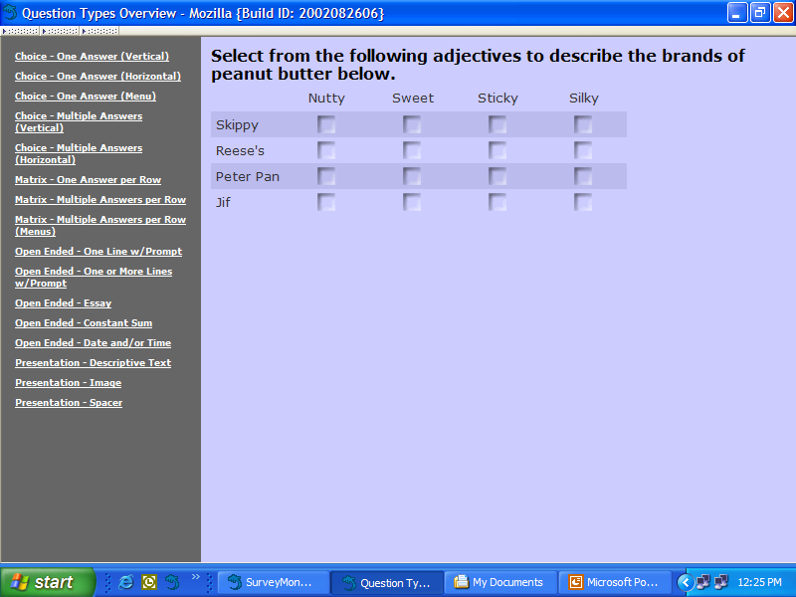

Slide 26
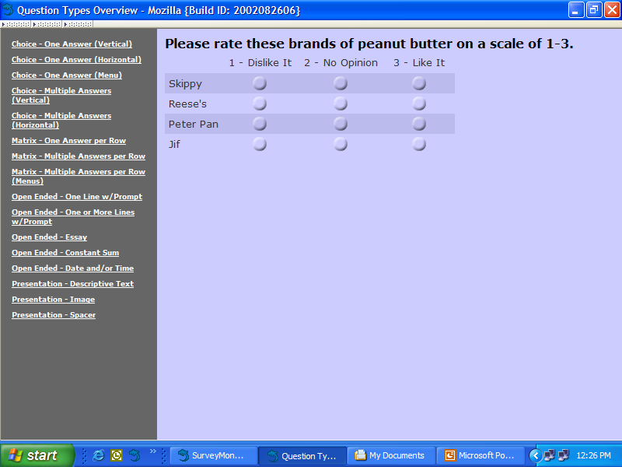

Slide 27
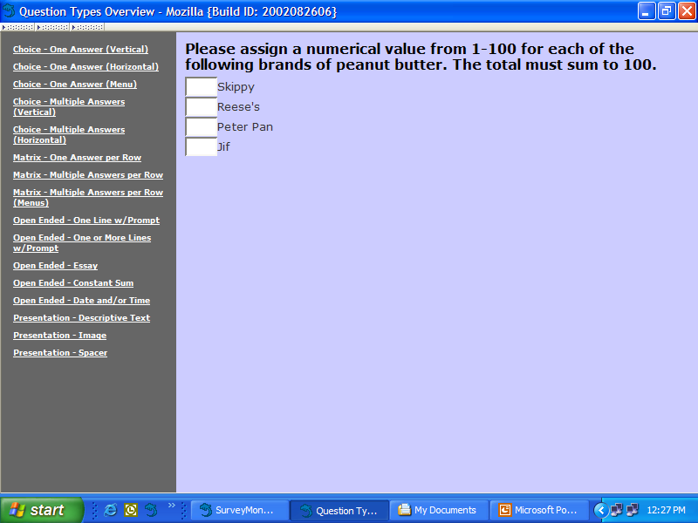

Slide 28
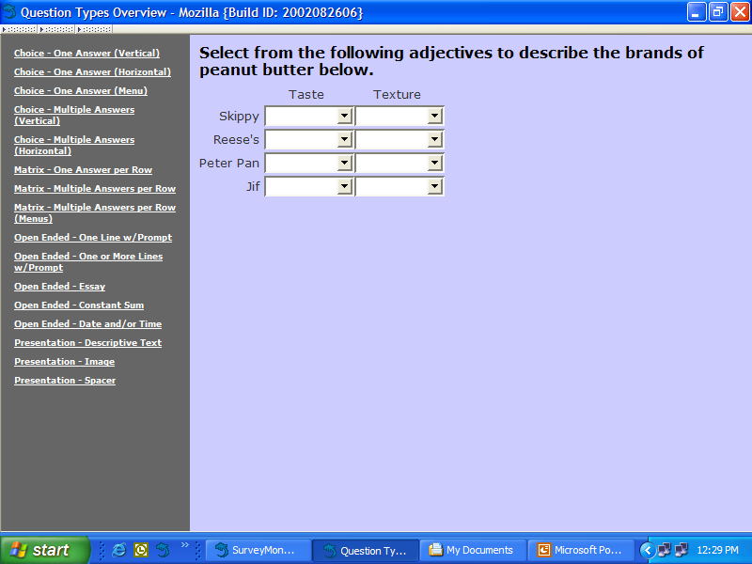

Slide 29
Create an Advisory Group

Slide 30
8-Step Needs Assessment Model

Slide 31
Biggest Email Mistake
Putting the addresses in either the
“To” line
“CC” line.
Never do this.
Always put the addresses in the
“Bcc” line

Slide 32
Top Email Subject Lines
Need your opinion
Please vote
Take our poll
2 second survey
If you have a regular email newsletter, just use the normal Subject line for the email newsletter.

Slide 33
Email Survey Response Line
To respond to the survey, just hit Return, type (yes/no; 1/2/3/ etc.; a.b.c. etc), and hit Send.
Put To respond sentence in second line, and repeat at the end of the email.

Slide 34
Email survey tips
1. State the survey question in the first line of the email.
2. Do the “To respond” line.
3. Then explain the survey in 2-3 sentences.
4. Give the survey response options.
5. Repeat “To respond line.”
6. Thank them.
7. Provide details if need be last.

Slide 35
Editing your survey question
Are there other possible responses?
Is each answer category clear?
Can any response be misinterpreted or interpreted in more than one way?
What will the results be?
Ask Advisory Board to review the question.

Slide 36
Surveys Work
Thanks for being a LERN Member!

