Slide 1
Why Winners Win
Greg Marsello
June 19, 2018

Slide 2
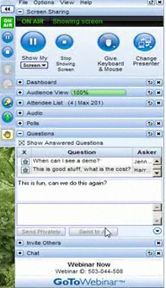
Using GoToWebinar
Today’s webinar will be recorded. Within the next 24 hours an email with a link to the recorded presentation and handouts will be sent out.
Please do not place the GTW conference call on hold. If you need to take another call, please leave the GTW call and rejoin later.
Please use the Questions function in your GTW menu to ask any questions.

Slide 3

Learning Resources Network
Founded in 1974
“Information That Works!”®
Best practices, benchmarks and trends
Membership association
Critiques, data analysis, technical assistance, certifications and more!

Slide 4
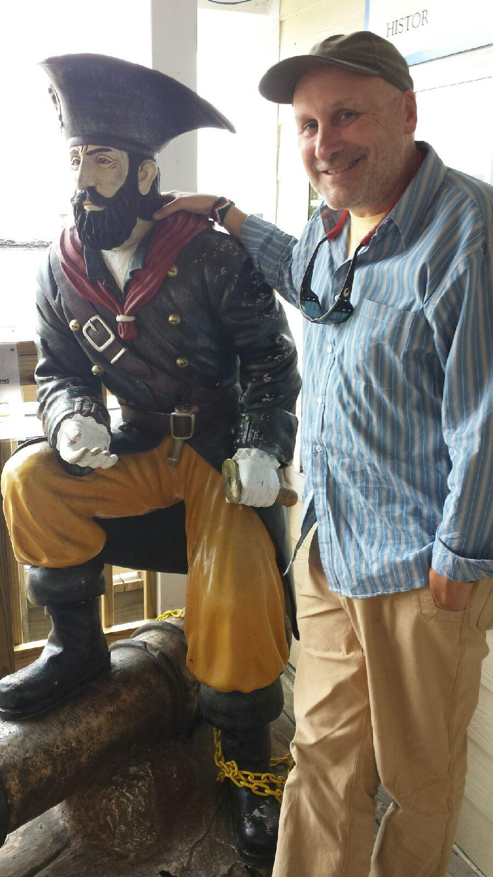
Presenter – Greg Marsello
LERN co-founder and Senior Vice President
Road warrior
LERN Program Reviews
Course/event programming, marketing, contract training and operations

Slide 5

Agenda
LERN Constituencies
State of Lifelong Learning
Why Winners Win
6 Key Benchmarks
What Winners Are Doing
Lifelong Learning Assessment Tool
Questions & Answers

Slide 6
LERN Constituencies
Higher Education
Recreation Departments
Public Schools
Associations
Other

Slide 7

Unique BUT 80/20

Slide 8
State of Lifelong Learning
30% up, 40% flat, 30% down…shifting up/investment
Eliminate, decentralize, or merge
Pressure for increased net without much investment, thus the need for improved productivity and efficiency
Generation Y is the future – products, marketing, customer service, and delivery – thus Generation Y staff critical
Software, structure, and business operating system a must to survive
USP – Community!!!

Slide 9

Challenges
Economy
Central administration
Staff skills & productivity
Initiatives
Competition
Knowledge
Vision

Slide 10
Rating
Win/Risk
25%
At Risk
50%
Winners
25%

Slide 11

Why Winners Win

Slide 12
#1. Financially Self-Sufficient
Income | $ |  | 100%
Promotion | $ |  | 10-15%
Production | $ |  | 45-50%
Direct Costs | $ |  | 60%
Operating Margin | $ |  | 40%
Administration | $ |  | 35%
Net | $ |  | 5%

Slide 13
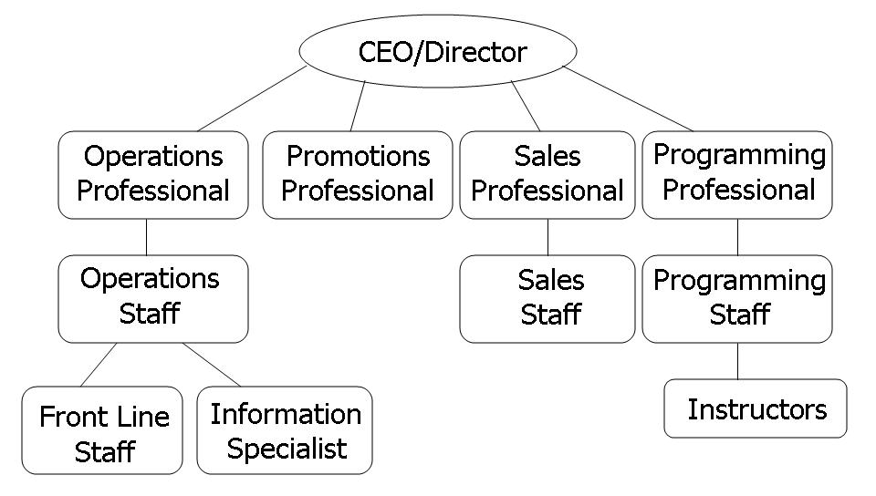
#2. Right Structure & Operating
System

Slide 14
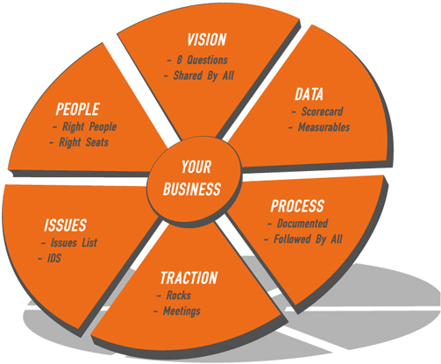

Leadership Team & Business Operating System Critical

Slide 15
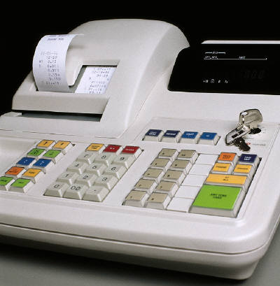
#3. Data-Driven Decisions
Participant/Student Registration Data: Primary Market Segments, Carrier Routes/Postal Codes, Repeat Rate/LTV, Best Customers & Next Course
Course/Class/Activity Data: LERN Key Formulas, Operating Margin, Repeat Course/Class & Planning
Promotion Method Data: On-Time & Promotion Method ROI
Contract Sales Data: LERN Key Formulas, Operating Margin, Client and Contract Star/Dog & Planning

Slide 16

#4. Best Practices

Slide 17

#5. One-Year & Strategic Planning
One-Year Business Plan
Strategic Plan

Slide 18
The Plans
#1. Vision
#2. Strategic Plan
#3. One-Year Business Plan
#4. Market Plan
#5. Quarterly Update
#6. Improvement Plan

Slide 19
LERN One-Year
Business Plan Model
Annual
Annual Goals
3-7
Quarter
Quarterly Goals
Weekly
To Dos generated at Meetings
As Assigned
1. Annual Goals
2. Annual Budget
3. Program/Service Areas
  a. OM Budget
  b. Benchmarks
  c. Course/Contract Goals
  d. Market Segments
  e. Strategies
4. Term/Quarter
5. Promotion Strategies: Type/Distribution/Retention
6. Promotion Timeline
7. Staff Responsibilities

Slide 20

#6. Right Software

Slide 21

#7. Visionary & Connected Leadership: 50%, 25%, 25%

Slide 22
6 Key Benchmarks
Staff Productivity (Revenue/FTE Staff): $125,000 (winners at $150,000-$250,000
Operating Margin (Revenue – Direct Costs): 40% (winners striving for 50%)
Net (Operating Margin – Administration Costs): 5% (winners striving for 5-10%)
Repeat Rate (People/Clients repeating from Year 1 to Year 2/People/Clients from Year 1): CP 30-50% and CT 50
New (New Offerings/Total Offerings): CP and CT 20-30
Cancellation Rate (Cancelled Offerings or Contracts/Total Offerings or Contracts): CP 15% and CT 0-5%

Slide 23

Score Your Program…0/.5/1
Financially self-sufficient
Right structure and operating system
Data-driven decisions
Best practices
One-year and strategic plans
Right software
Visionary and connected leader
6 to 7 a Winner
3 to 5 a Work in Progress
0 to 2 at Risk

Slide 24

What Winners Are Doing

Slide 25

Continuing to Centralize Functional Tasks Under Operations
Registration, confirmations, go/no-go decisions and participant and teacher communication, and other requirements
Customer service, including advising and other participant support…information specialist
Software management
Logistics coordination, including room scheduling, materials ordering, room preparation, instructor packets, evaluation tabulation, and payroll processing
Data collection, analysis, and reporting
Tracking and reporting on promotion methods
Online learning management with third party vendors
Finances
Relationship with Business Office and Human Resources
Facility management
Purchasing
Data loading and sometimes repeat course management
Policy, process, and procedure documentation and management
Document and template storage

Slide 26
Moving to a 50% Operating Margin and Increased Net
Income | $ |  | 100%
Promotion | $ |  | 10%
Production | $ |  | 40%
Direct Costs | $ |  | 50%
Operating Margin | $ |  | 50%
Administration | $ |  | 35%
Net | $ |  | 15%

Slide 27
Shifting to Integrated Marketing Campaigns Focused on Targeting and Retention
Social Media
Other
Direct Mail
Website
eMarketing

Slide 28

Introducing New Revenue Streams
1. New program/service area, market segment, or delivery method
2. 3-years+ life span
3. 5-10% revenue by year 3
4. 40%+ operating margin by year 3
5. Show me the names
6. 1 new initiative a year

Slide 29




FY20
FY17
I
IV
1. Brainstorm
8. Evaluate
2. Research
7. Decide
6. Try It
3. Options
4. Model
5. Development
II
FY19
FY18
III

Slide 30
Shifting from Information to Solutions
Information
- Teaching
-Training
Solutions
- Advising/Jobs
- Consulting

Slide 31
Following the 30% Rule
Market
Segment
Delivery
Method
Program
Area

Slide 32
Giving Everyone a Number
Cancellation Rate
Customer Service & Quality
Leads : Contract Ratio
Promotion : Registration Ratio
New
Repeat Rate

Slide 33

Shifting from Victim to Collaborator

Slide 34

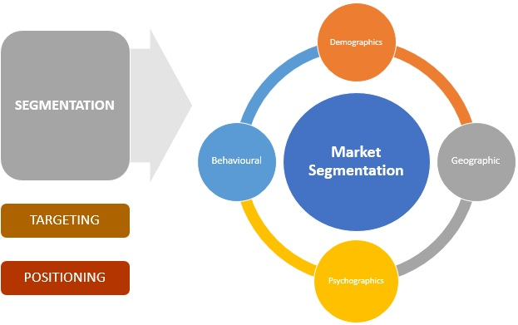

Being Experts, Not Trying to Be Everything to Everybody

Slide 35
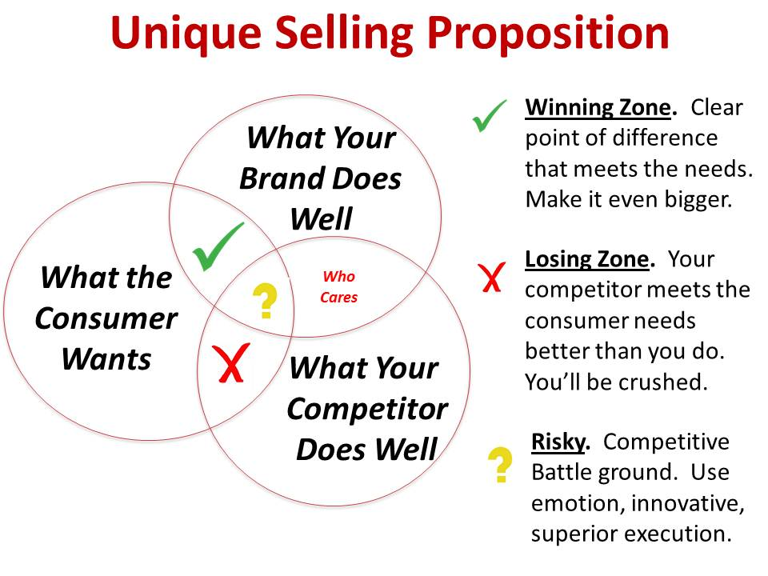
Knowing and Living Their Unique Selling Proposition

Slide 36
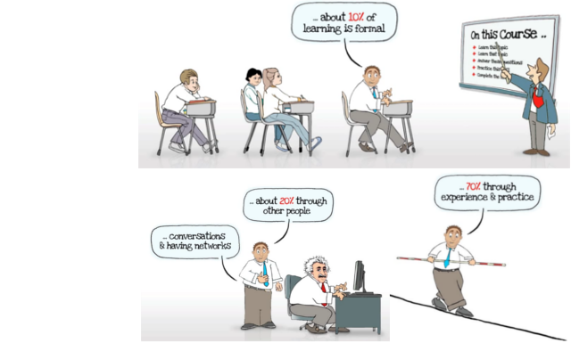
Understanding New Learning Trends & Shift Teachers to Facilitators

Slide 37
Lifelong Learning Assessment Tool
Winning lifelong learning programs evaluate their performance yearly and work on improving areas of weakness. LLAT covers key areas such as finances, marketing, course programming, operations, contract sales and much more.

Slide 38


How LERN Can Help

Slide 39


Slide 40


Thank You!
www.lern.org
info@lern.org
marsello@lern.org

