Slide 1
How to ensure quality customer service on every call!
Tammy Peterson, Learning Resources Network, Inc
Information Specialist

Slide 2
Discussion Points:
The importance of customer service
5 ways to create customer service culture
Frontline staff job description and duties
Call Greeting
Customer contact walk-through
Online customer service and tools
Other customer service software
Warp up and Resources

Slide 3
Customer service statistics
The number of mobile social network users in the US will grow from 58.5% in 2012 to 79.1% this year. US Mobile Social Networks
This year, we will see a decline in one-way participation in content to under 20%. This means the customer will gain even more control and choice over content. Google Insights Route to 2015
Customer-centric companies gained 43% in performance compared to a 33.9% decreases for companies who have neglected customer experience. Forrester’s Customer Index
Seventy-eight percent (78%) of consumers have abandoned a transaction because of poor service. American Express

Slide 4
My favorite stat
Globally in 2013, 66% of consumers switched brands or business due to poor customer service, a 4% increase on the previous year. Some 82% of those who switched said the brand could have done something to stop them. Accenture Global Consumer Pulse Survey

Slide 5
5 ways to Create a customer service culture
1. Hire for the culture. It’s an old adage that says hire for the attitude and train the skill. This is a little different. Even with the right attitude, will the new employee fit in to the culture you are trying to build or sustain? Look beyond the attitude to the personality. Make sure there is a cultural fit.
2. Train for the culture. If the employee has the right attitude and personality that meshes with your culture, get him/her up to speed and entrenched in your culture as quickly as possible. They must understand what the company stands for; its goals, mission and vision.
3. Everyone must be on the same page. I call this alignment. Understanding the company’s goals, mission and vision is one thing. Employees must be able to articulate the essence of these statements. I love the concept of the “mantra,” which is a sentence version of the goals, vision and mission that succinctly sums up what the company’s culture is about.

Slide 6
5 ways to Create a customer service culture
4. Allow people to experiment. This is another way of saying people are empowered to try and do new things and is especially true in the world of customer service. The outcome should be favorable for the customer, not hurt the company (financially, legally, etc.) and enhance the relationship with the customer.
5. Create a learning environment. If you really let people experiment, and they are truly empowered, there will be much to learn from the successes and failures of your employees. Celebrate it all. Encourage people to learn from their successes and their failures. Share these lessons with everyone.

Slide 7
Information specialist
Customer Friendly – Needs to be caring and willing to go the extra mile for the customer
Informed – has to have all of the answers
Organized – The ability to follow up quickly
Available – Give answers quickly and complete calls with long-winded customers
Information specialist is receptionist – handle the call themselves
Registration people are receptionist – answer questions and take registrations

Slide 8
INFORMATION SPECIALIST TOPICS
Course and products in brochure – What, when, who and where.
Registration process – the ability to take registrations and answer questions regarding the event/course.
Organization policies – refunds, instructor payment, deadlines, staff schedules
Teacher services – new instructor packets, scheduling meetings with program professionals

Slide 9
The phone is ringing… are you ready??
You will need paper and a writing utensil
Your customer database should be open
Have your greeting on your lips
Start Writing Now! Greeting - Step Two
Confirm the request
Provide a time frame for service
Reiterate, thank them, conclude

Slide 10
The sunset rule

Slide 11
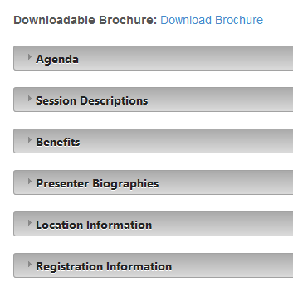
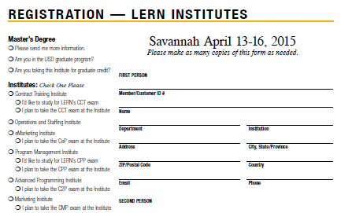
http://www.lern.org/blog/conference/institutes/

Slide 12
Collecting caller information
Are you a LERN customer?
What event are you interested in?
How would you like your name spelled on the name tag?
Is your address still 12345 LERN Way?
I have your phone number listed on the account as 123-456-7890, is that still correct?
What type of payment will you be using today?
What email address should I use to send the paid receipt?
Would you like confirmation of the registration sent to a different email address?

Slide 13
Institutes Airport Shuttle: http://www.kshuttle.com/lern-institute-april/ Open your web browser to the link provided Click on "Book Now" under “Book an airport shuttle” Select round trip or one way Under “From”, select Savannah International Airport Under “To”, select Downtown Savannah Pick up is Savannah International Airport
Under “Dropoff Location”, select Desoto Hilton
Please make one reservation per person for the individual discount
Select shuttle time that best fits your arrival and departure
Complete reservation and submit
Note: In order to receive the group discount, reservations must be made online
Best Regards,
Tammy Peterson LERN
Ph: 800-678-5376
Tammy@lern.org

Slide 14
Closing a call
Lead the conversation and information exchange
Reiterate the request and total dollar value or details of the call
Ask if you can assist them in any other way
Thank the customer for their call and for their business
Remind them they can call you for anything
Be sure to follow up with anything you promised to send or share

Slide 15
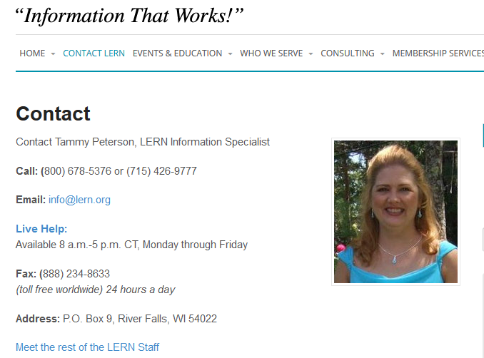

Slide 16
Reducing your customer defection rate by 5% can increase your profitability by 25 to 125%.
By 2020, customer experience will overtake price and product as the key brand differentiator.
When purchasing online, 71% of visitors expect help within five minutes.

Slide 18
Better turn around time
Tools to make you more efficient
Organization gives you the edge
Canned emails, file saving and document sharing
Cross train your frontline staff
Avoid information silos

Slide 19
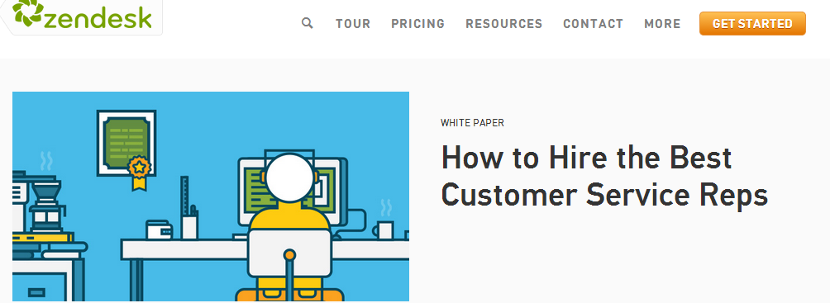
- ZenDesk - http://www.zendesk.com/
40,000 Users including include: *LERN *Vodafone *Shopify *Groupon
Allows users to track and share tickets Create a FAQ site on your public page Created follow-up tickets Track customer satisfaction and staff benchmarks

Slide 20
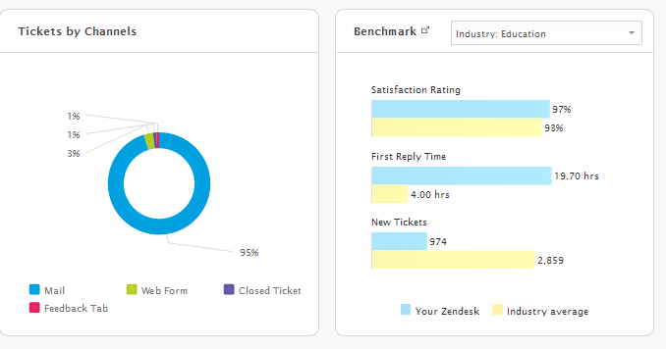

Slide 21
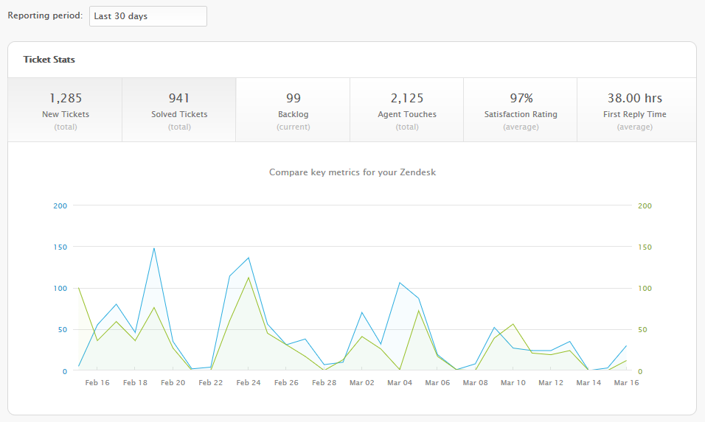

Slide 22
Hi, {{ticket.requester.first_name}}.
Thank you so much for email and interest in the LERN Certified Online Instructor program. This program is made up of three online courses and you will find the dates for all three courses for 2015 listed below. The cost of the program is $795 and this includes all books, shipping, courses, exam, etc. There are no additional costs.
Included please find the three steps to be completed in addition to the online courses to complete this program. The one-week courses require approximately 15 hours of seat time to complete. All three courses are also available for one graduate credit through University of South Dakota. LERN and USD have a joint master’s degree in Arts and Education but COI registrants can acquire graduate credit for these courses without being enrolled in the master’s program.
If you have any questions at all, please do not hesitate to email or call me and thank you so much!

Slide 23
Project Management Software Companies
DropBox – https://www.dropbox.com/business/features
Sciforma - http://www.sciforma.com/
aceProject - http://www.aceproject.com/?aw=3137284
Comindware Project - http://comindware.com/
Tenrox - http://www.tenrox.com/contact
ResourceGuru - http://resourceguruapp.com/resource-scheduling-software
Teamwork - https://www.teamwork.com/?ref=i_pmcom
Projector - http://www.projectorpsa.com/
Soho Projects - https://www.zoho.com/projects/features.html
Mavenlink - http://start.mavenlink.com/getapp-overview/?utm_source=getapp&utm_medium=getapp&utm_campaign=Visit%20Website

Slide 24
5 ways to be the best!
Always follow through:
Learn about your customers and how best to serve them:
Think of ways to “convenience” people:
Startle them:
Be more than a voice on the phone:

Slide 25
Project management software list
Customer service in Higher Ed
Blog/articles
Lead nurturing software list
Today’s PowerPoint Slides
15 steps to dealing with
customer complaints

